Slide 1
Scorecard presentation: Viet Nam

Slide 2
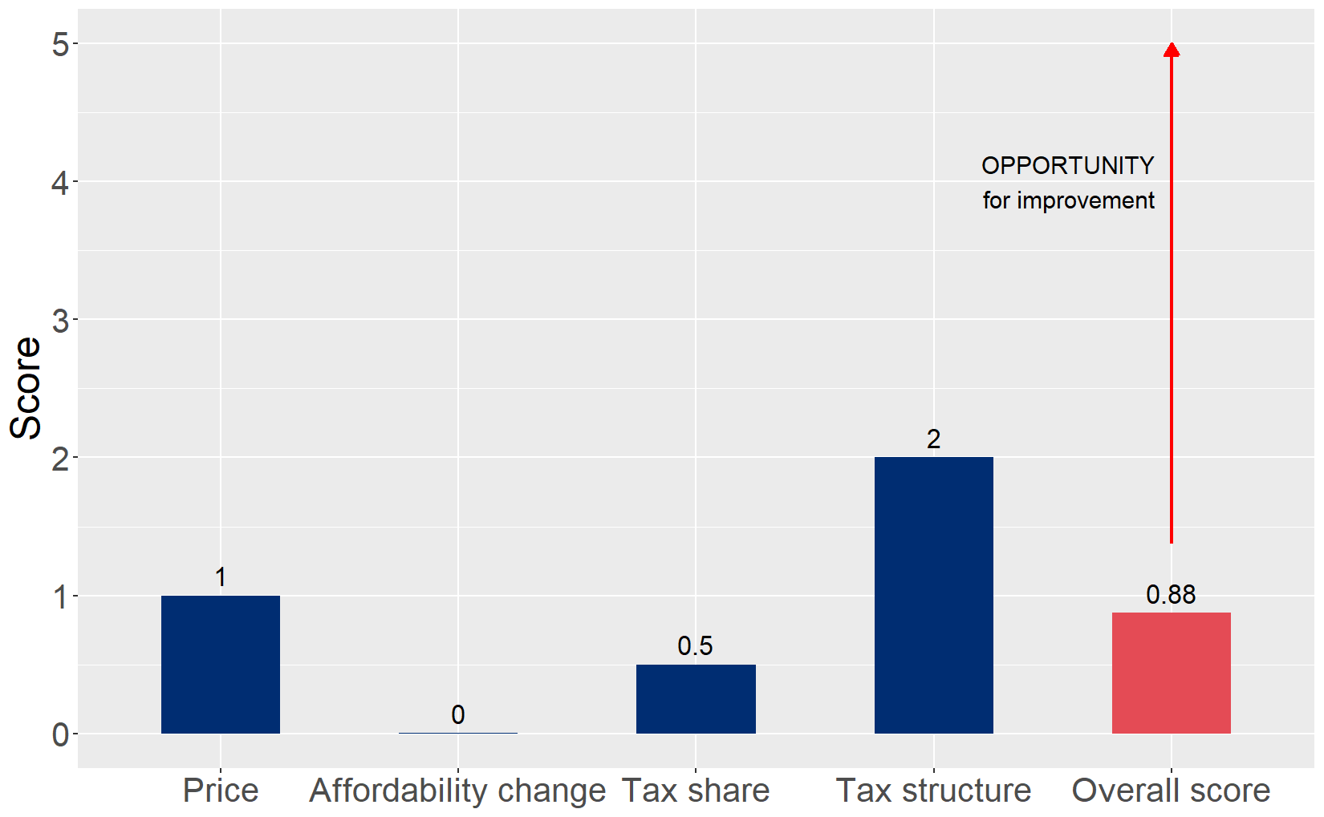
Cigarette tax policies in Viet Nam, 2024
Four key tax components were assessed using a 5-point scale, with the overall score reflecting an average of Viet Nam’s component scores. The score reflect the current strengths and opportunities in Viet Nam to further increase tax revenue and improve health.

Slide 3
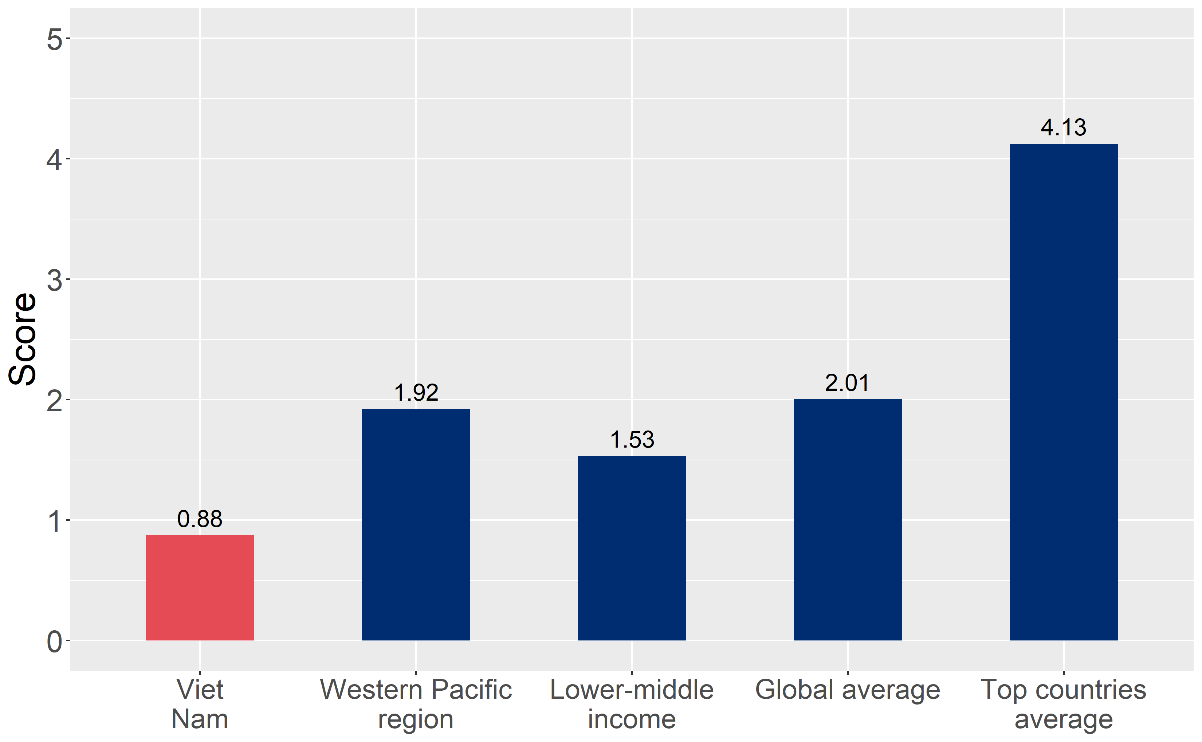
How does Viet Nam compare to other countries?
Viet Nam’s overall score in 2024 is compared to the average overall scores in its income group, region, the world, and top performers.

Slide 4
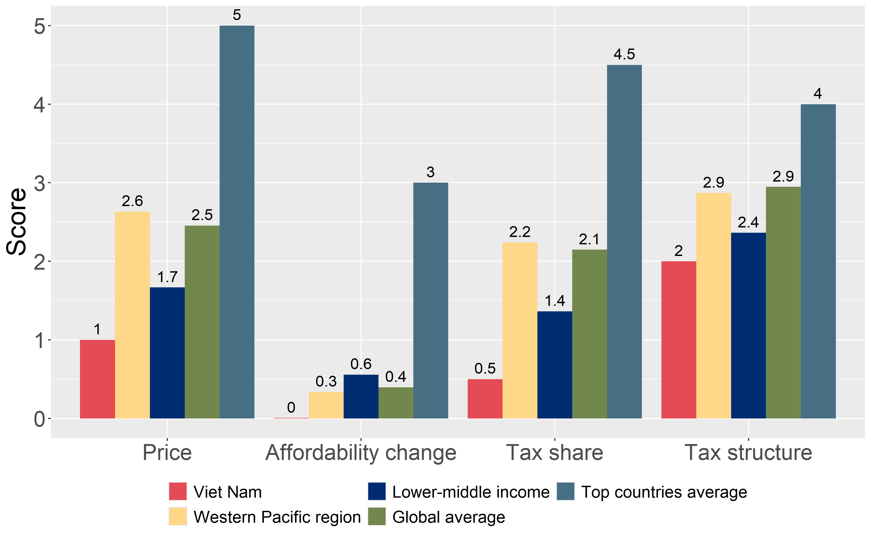
How does Viet Nam compare to other countries?
The components of Viet Nam’s score in 2024 are compared to component scores in the region, income group, world, and top performers.

Slide 5
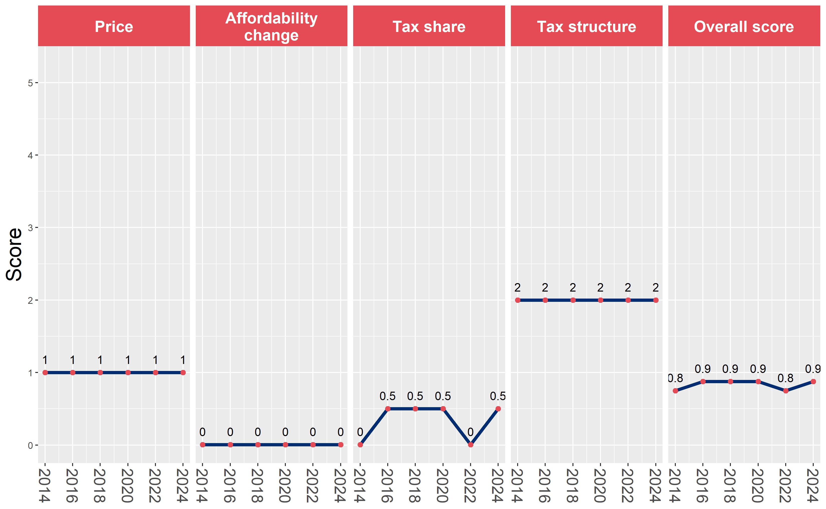
Viet Nam’s cigarette tax policies over time
Viet Nam’s overall and component scores are evaluated over a ten-year period, highlighting trends across all four Cigarette Tax Scorecard components.

