Slide 1
Scorecard presentation: United Republic of Tanzania

Slide 2
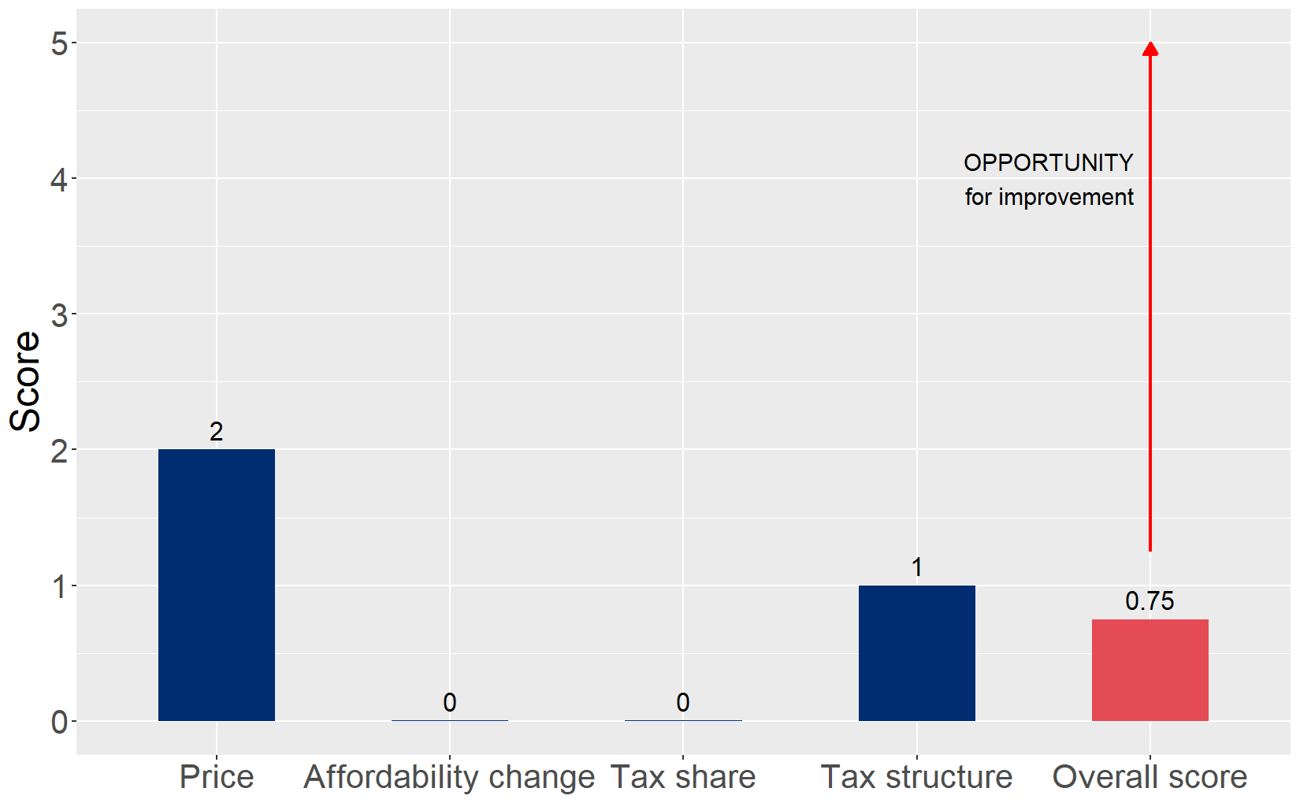
Cigarette tax policies in United Republic of Tanzania, 2024
Four key tax components were assessed using a 5-point scale, with the overall score reflecting an average of United Republic of Tanzania’s component scores. The score reflect the current strengths and opportunities in United Republic of Tanzania to further increase tax revenue and improve health.

Slide 3
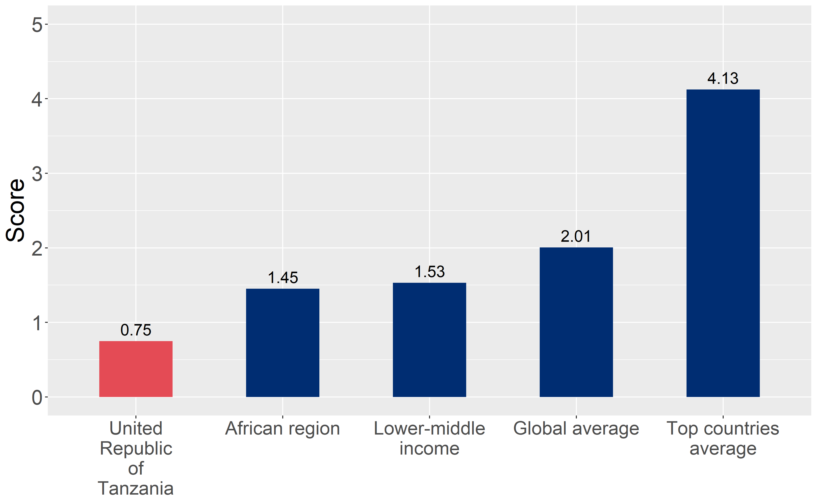
How does United Republic of Tanzania compare to other countries?
United Republic of Tanzania’s overall score in 2024 is compared to the average overall scores in its income group, region, the world, and top performers.

Slide 4
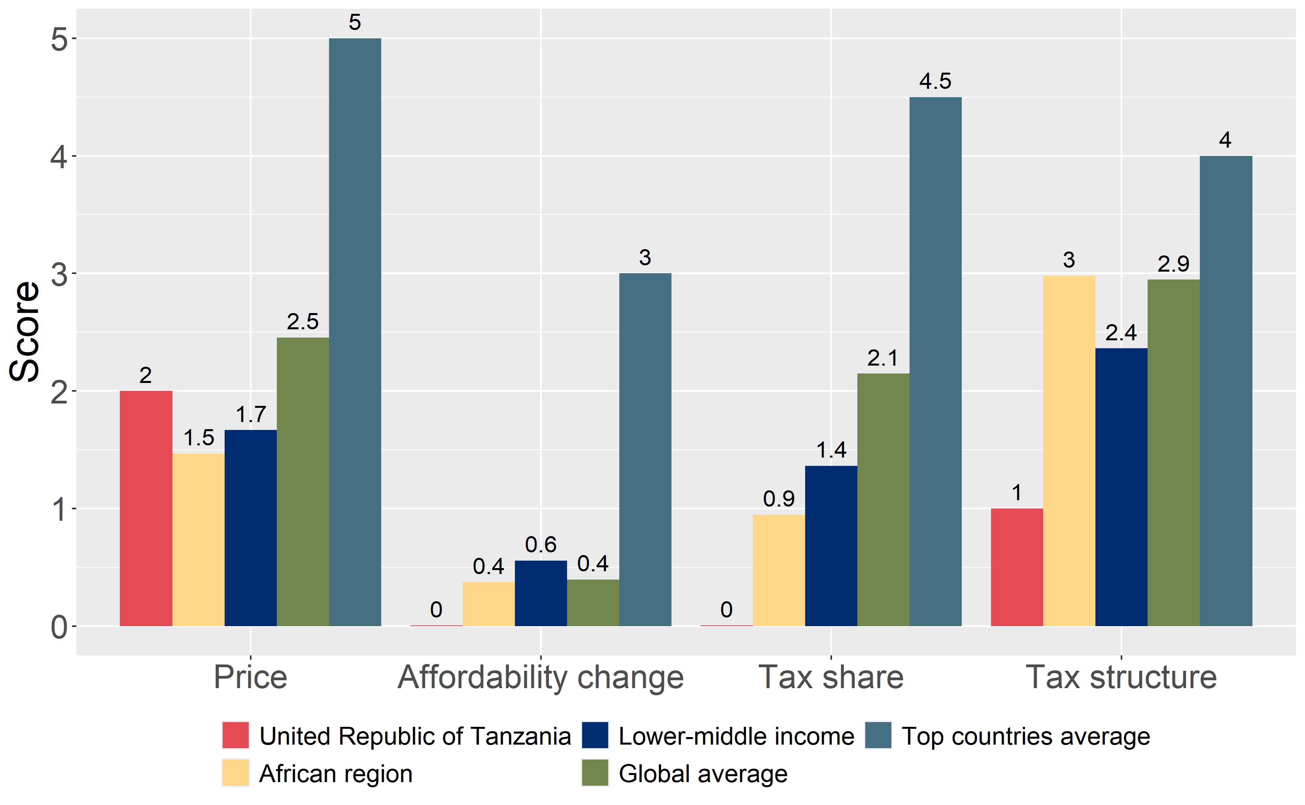
How does United Republic of Tanzania compare to other countries?
The components of United Republic of Tanzania’s score in 2024 are compared to component scores in the region, income group, world, and top performers.

Slide 5
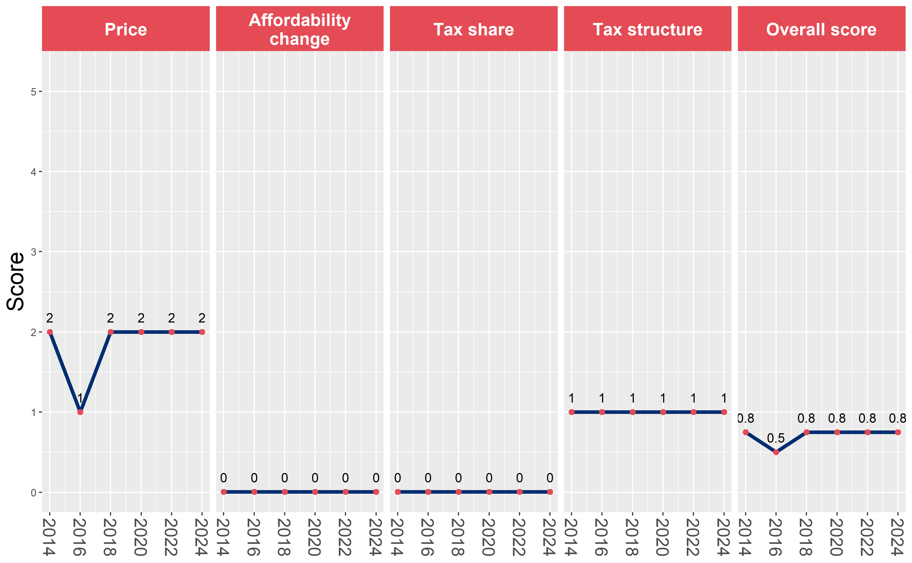
United Republic of Tanzania’s cigarette tax policies over time
United Republic of Tanzania’s overall and component scores are evaluated over a ten-year period, highlighting trends across all four Cigarette Tax Scorecard components.

