Slide 1
Scorecard presentation: Trinidad and Tobago

Slide 2
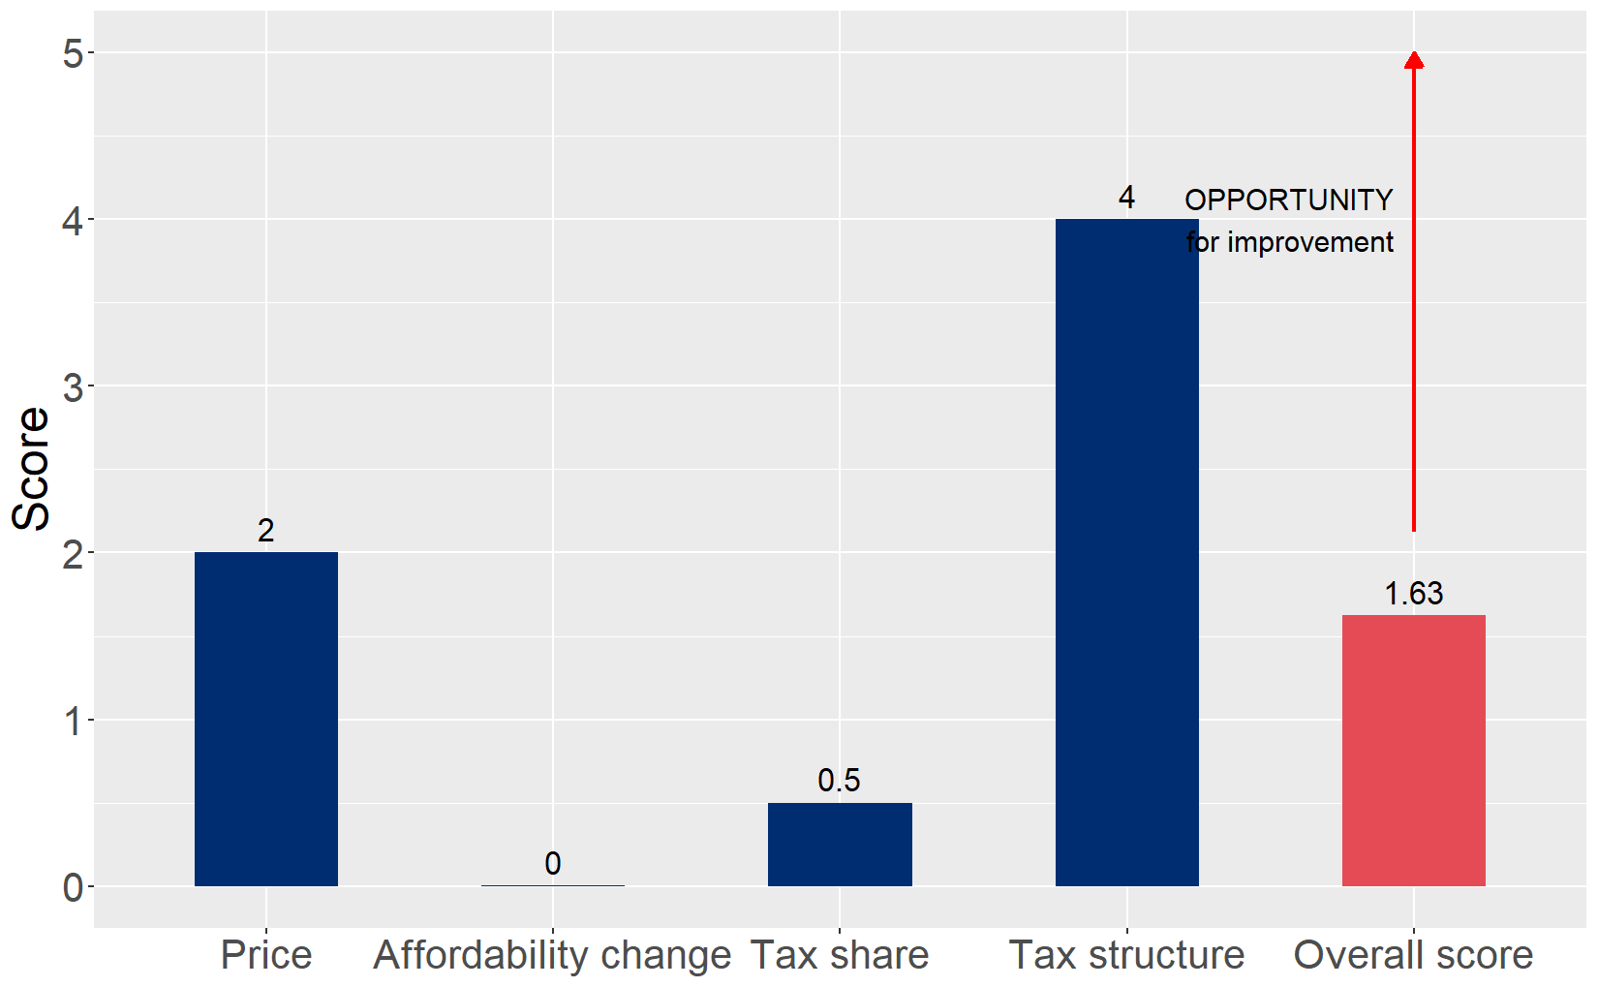
Cigarette tax policies in Trinidad and Tobago, 2024
Four key tax components were assessed using a 5-point scale, with the overall score reflecting an average of Trinidad and Tobago’s component scores. The score reflect the current strengths and opportunities in Trinidad and Tobago to further increase tax revenue and improve health.

Slide 3
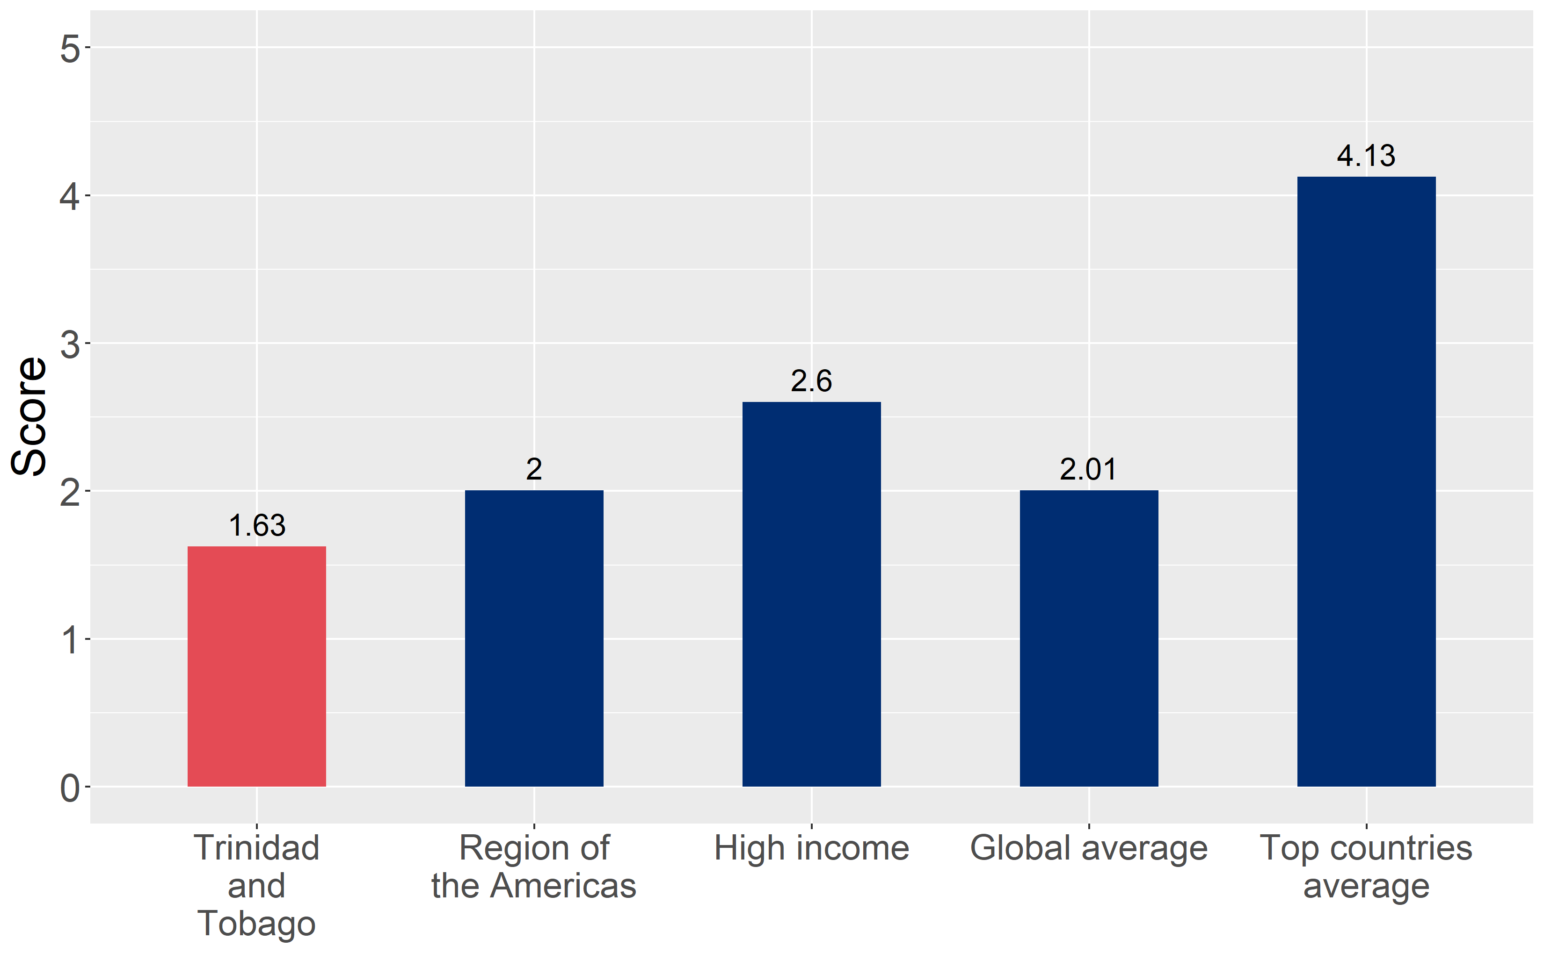
How does Trinidad and Tobago compare to other countries?
Trinidad and Tobago’s overall score in 2024 is compared to the average overall scores in its income group, region, the world, and top performers.

Slide 4
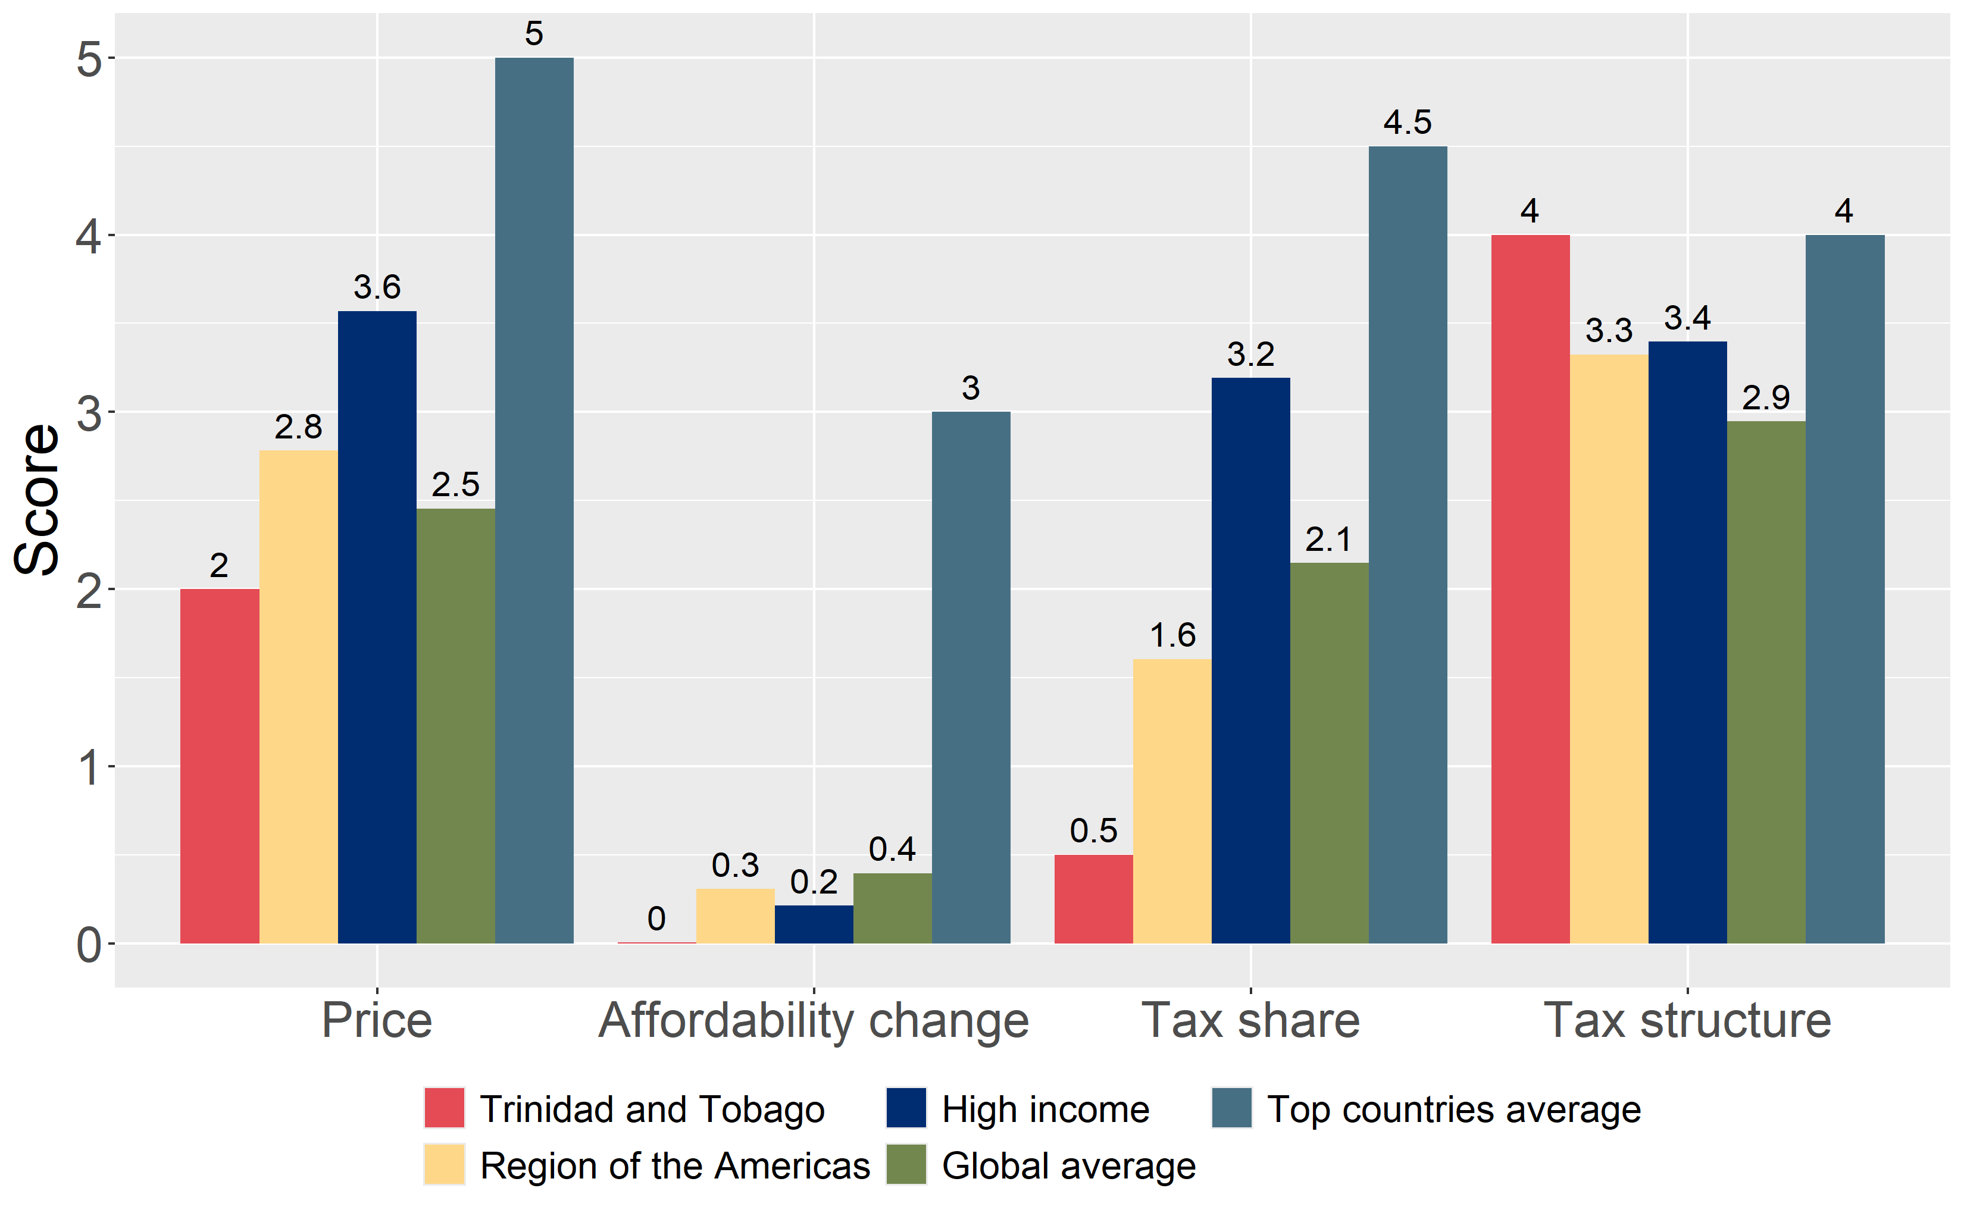
How does Trinidad and Tobago compare to other countries?
The components of Trinidad and Tobago’s score in 2024 are compared to component scores in the region, income group, world, and top performers.

Slide 5
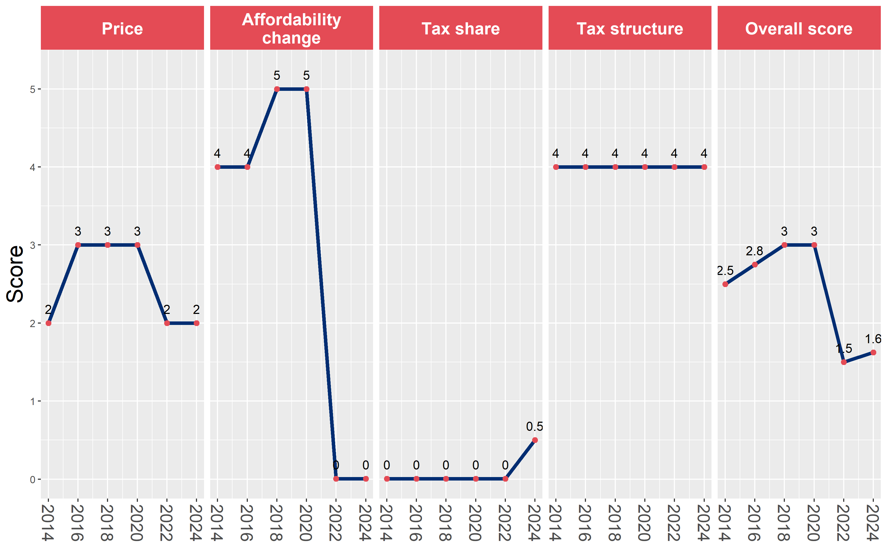
Trinidad and Tobago’s cigarette tax policies over time
Trinidad and Tobago’s overall and component scores are evaluated over a ten-year period, highlighting trends across all four Cigarette Tax Scorecard components.

