Slide 1
Scorecard presentation: Sierra Leone

Slide 2
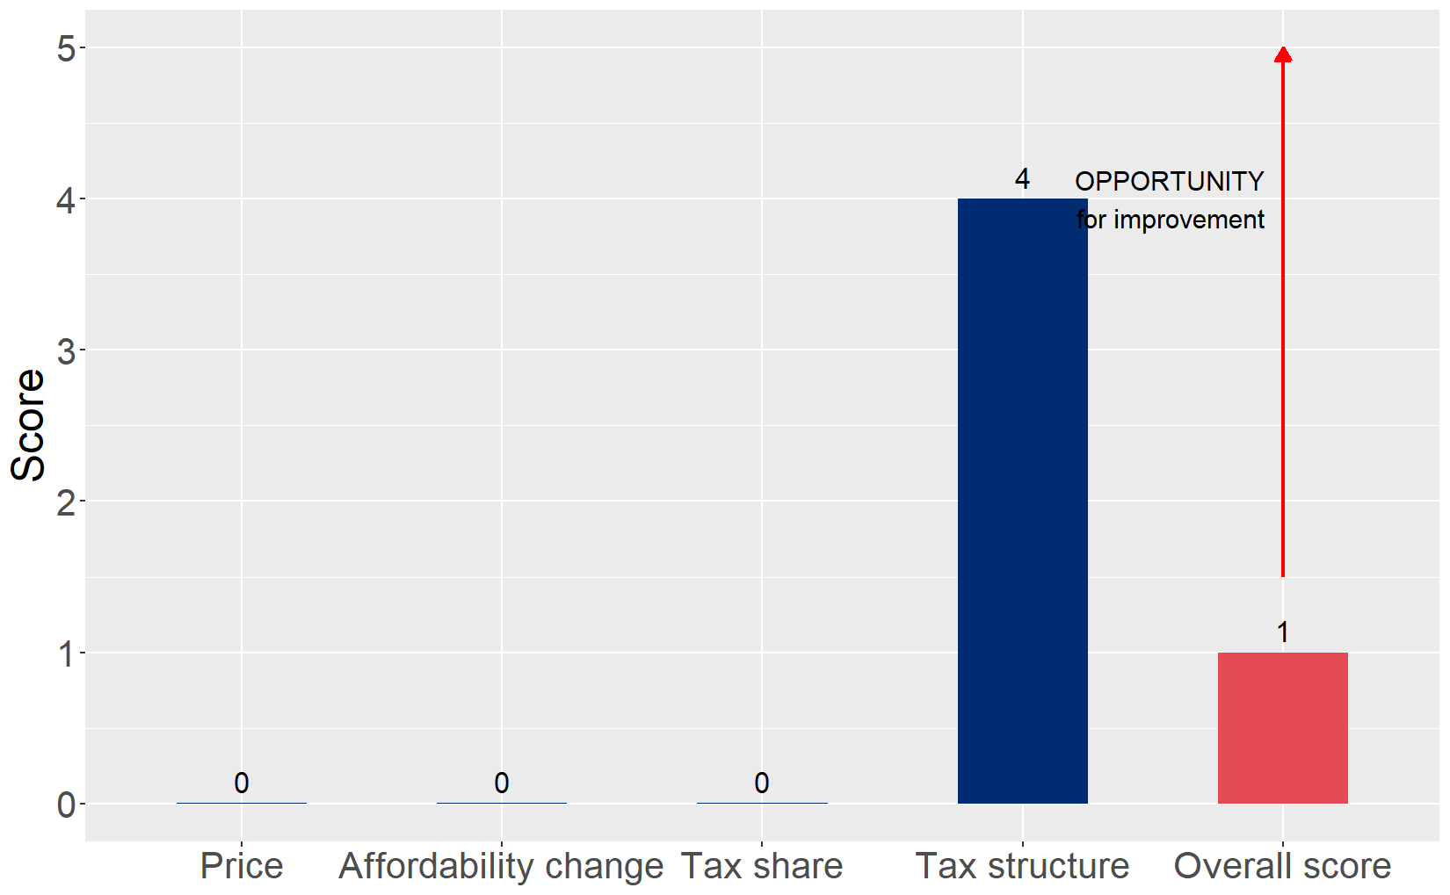
Cigarette tax policies in Sierra Leone, 2024
Four key tax components were assessed using a 5-point scale, with the overall score reflecting an average of Sierra Leone’s component scores. The score reflect the current strengths and opportunities in Sierra Leone to further increase tax revenue and improve health.

Slide 3
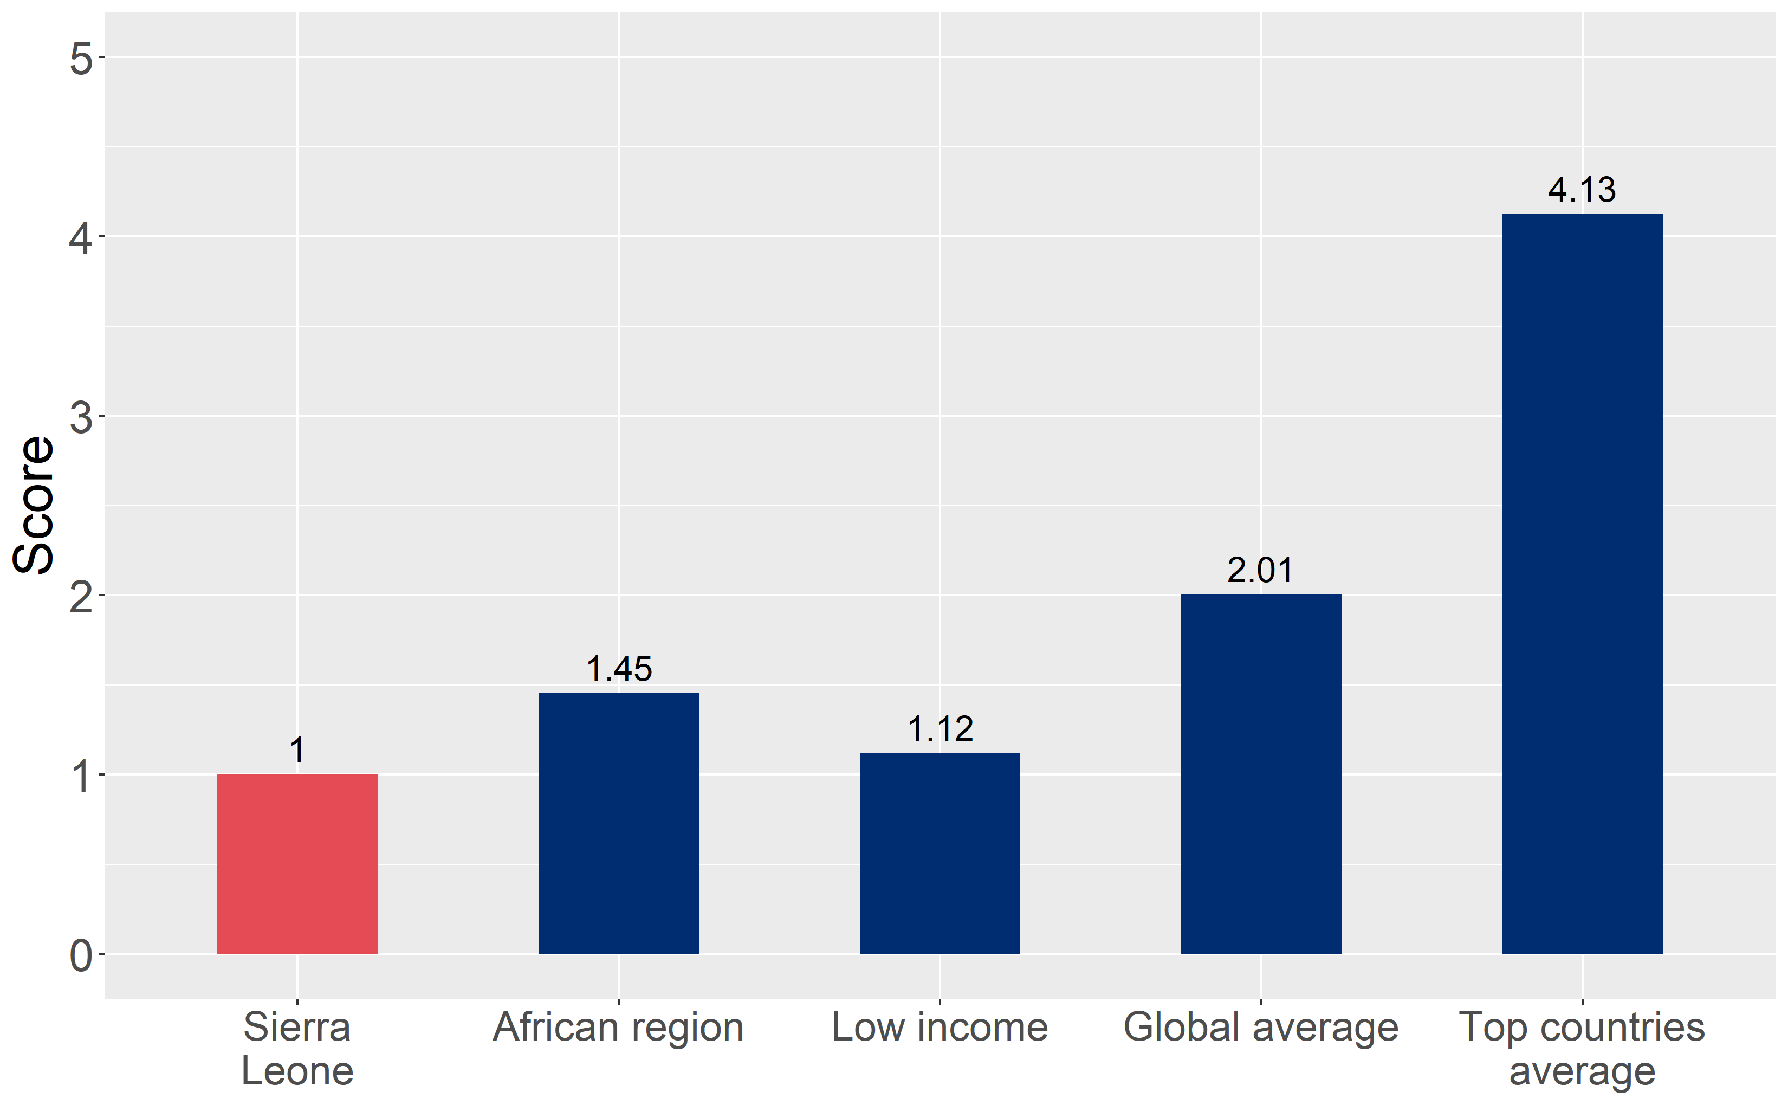
How does Sierra Leone compare to other countries?
Sierra Leone’s overall score in 2024 is compared to the average overall scores in its income group, region, the world, and top performers.

Slide 4
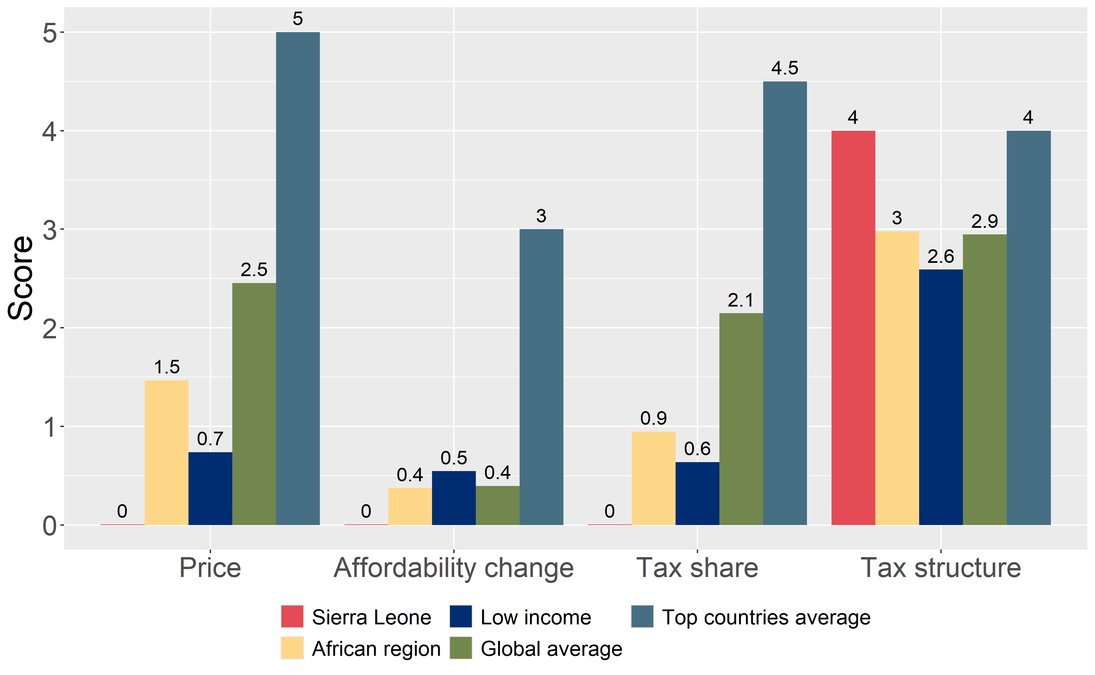
How does Sierra Leone compare to other countries?
The components of Sierra Leone’s score in 2024 are compared to component scores in the region, income group, world, and top performers.

Slide 5
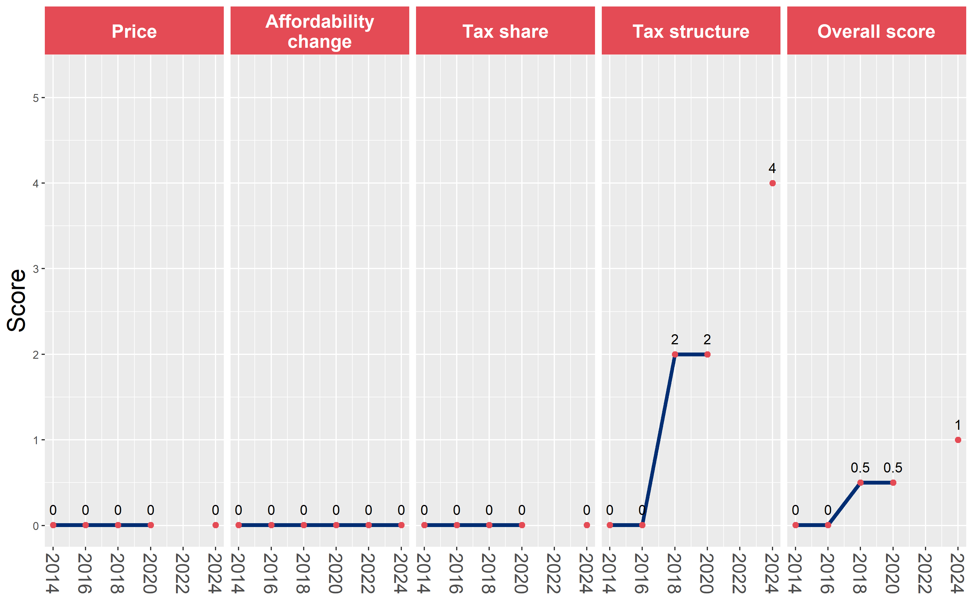
Sierra Leone’s cigarette tax policies over time
Sierra Leone’s overall and component scores are evaluated over a ten-year period, highlighting trends across all four Cigarette Tax Scorecard components.

