Slide 1
Scorecard presentation: Saudi Arabia

Slide 2
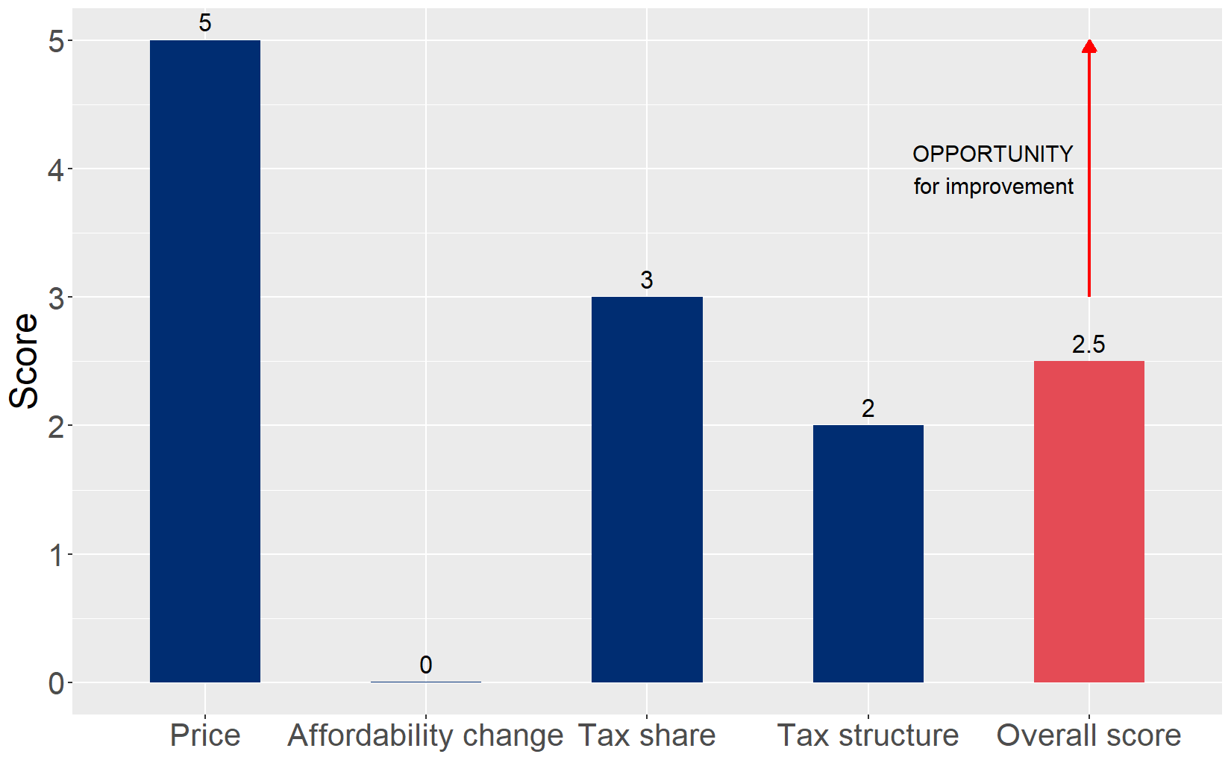
Cigarette tax policies in Saudi Arabia, 2024
Four key tax components were assessed using a 5-point scale, with the overall score reflecting an average of Saudi Arabia’s component scores. The score reflect the current strengths and opportunities in Saudi Arabia to further increase tax revenue and improve health.

Slide 3
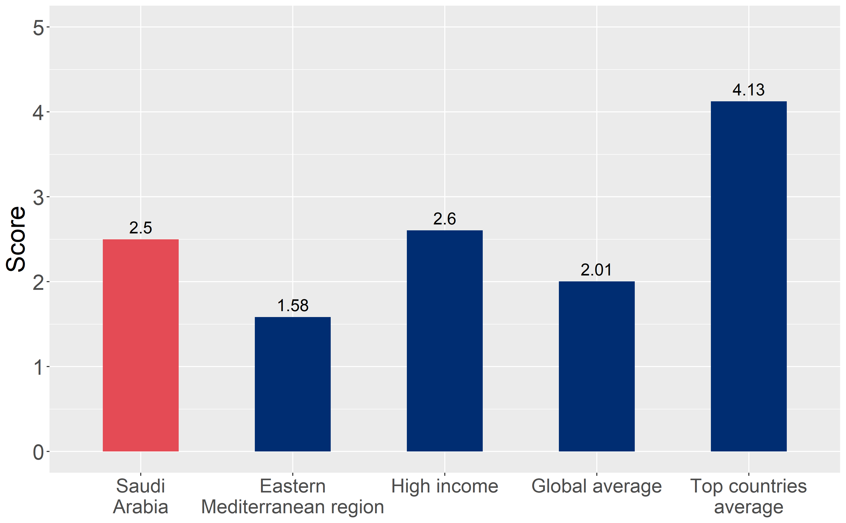
How does Saudi Arabia compare to other countries?
Saudi Arabia’s overall score in 2024 is compared to the average overall scores in its income group, region, the world, and top performers.

Slide 4
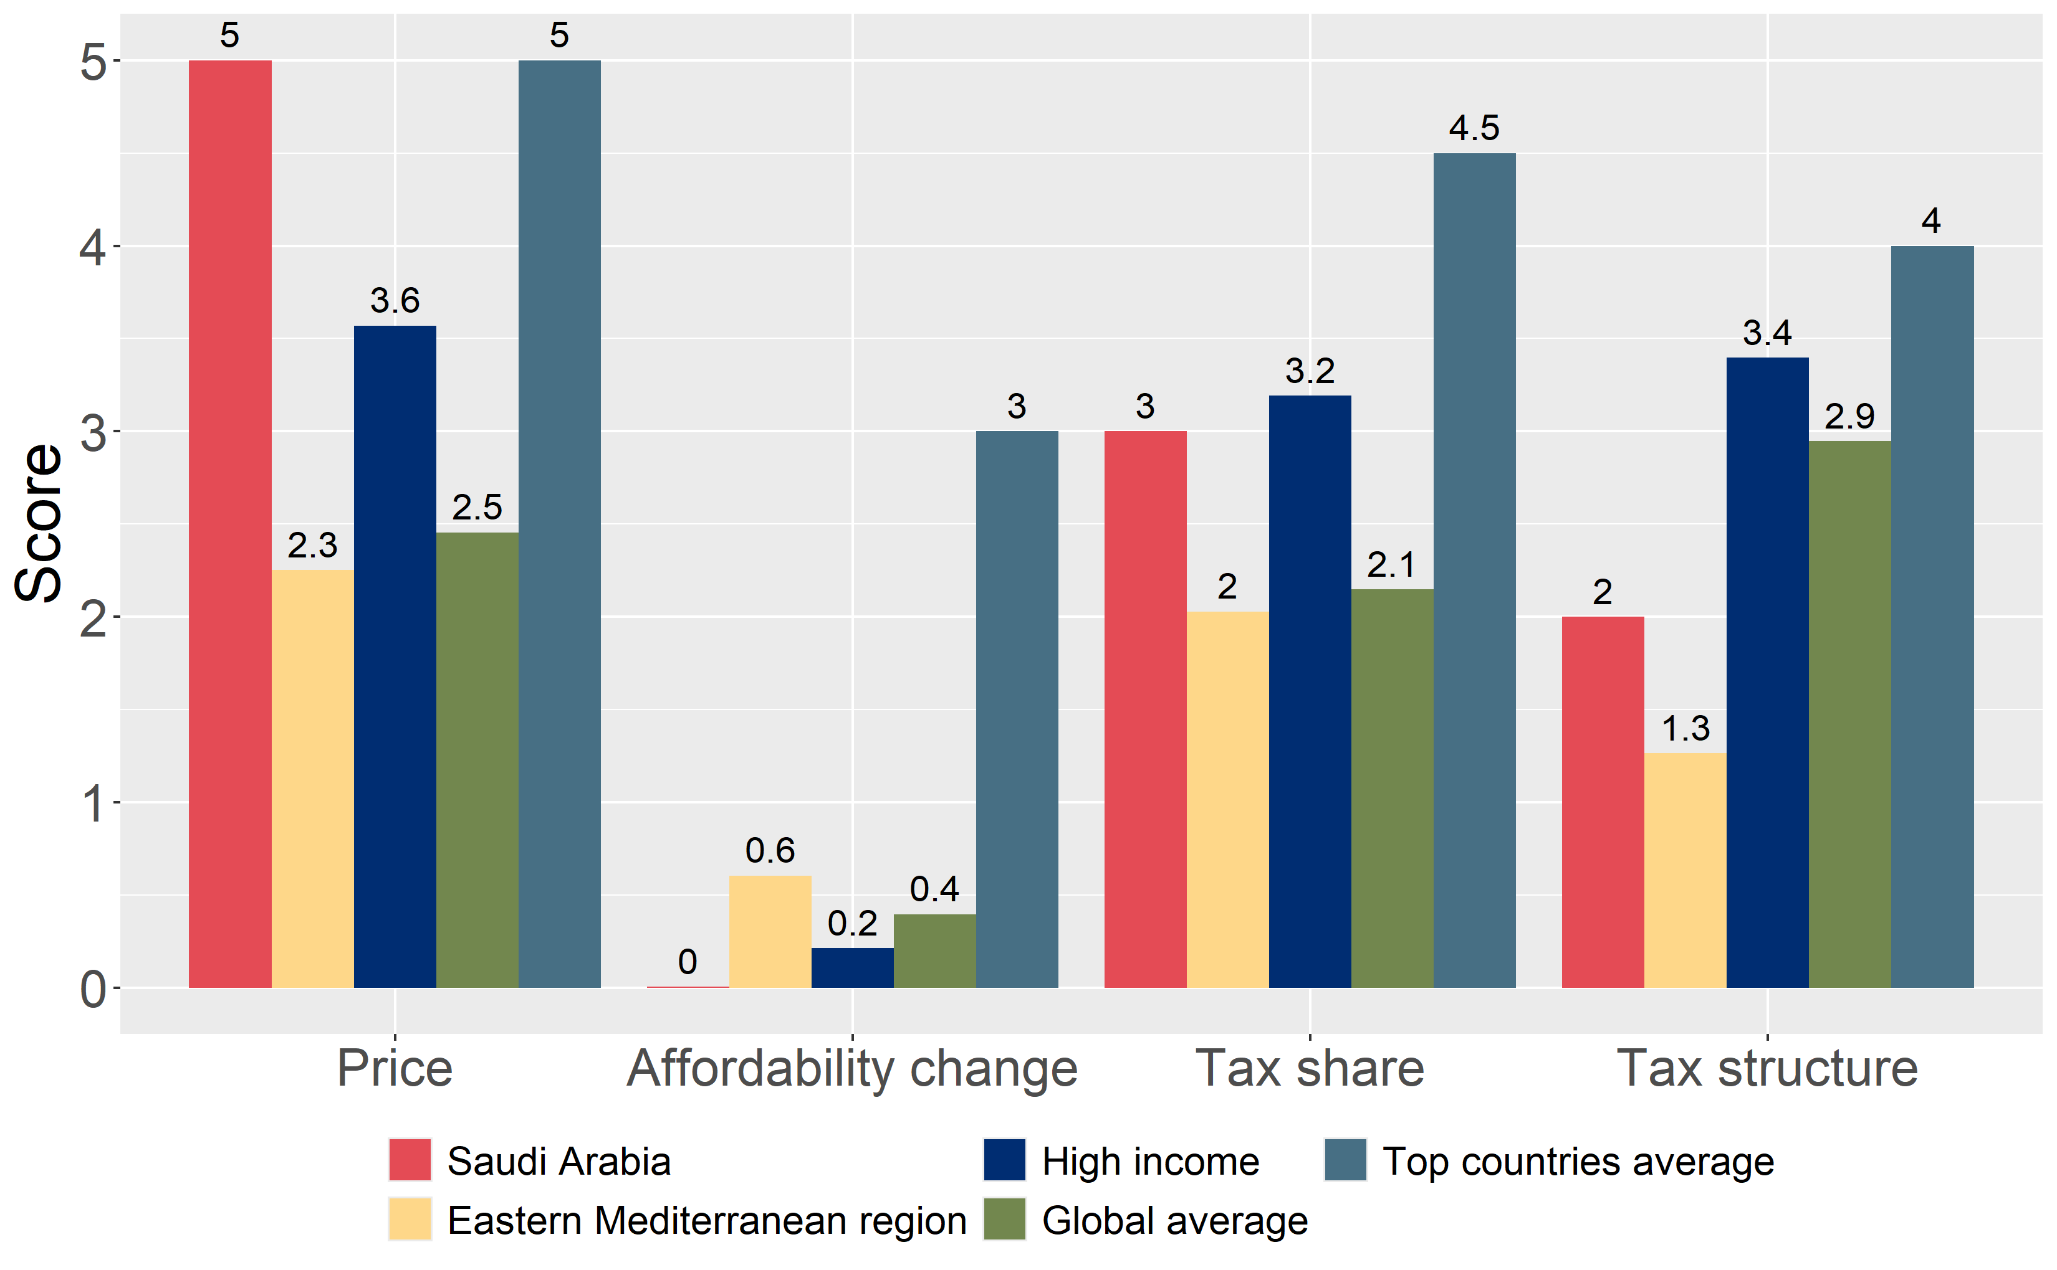
How does Saudi Arabia compare to other countries?
The components of Saudi Arabia’s score in 2024 are compared to component scores in the region, income group, world, and top performers.

Slide 5
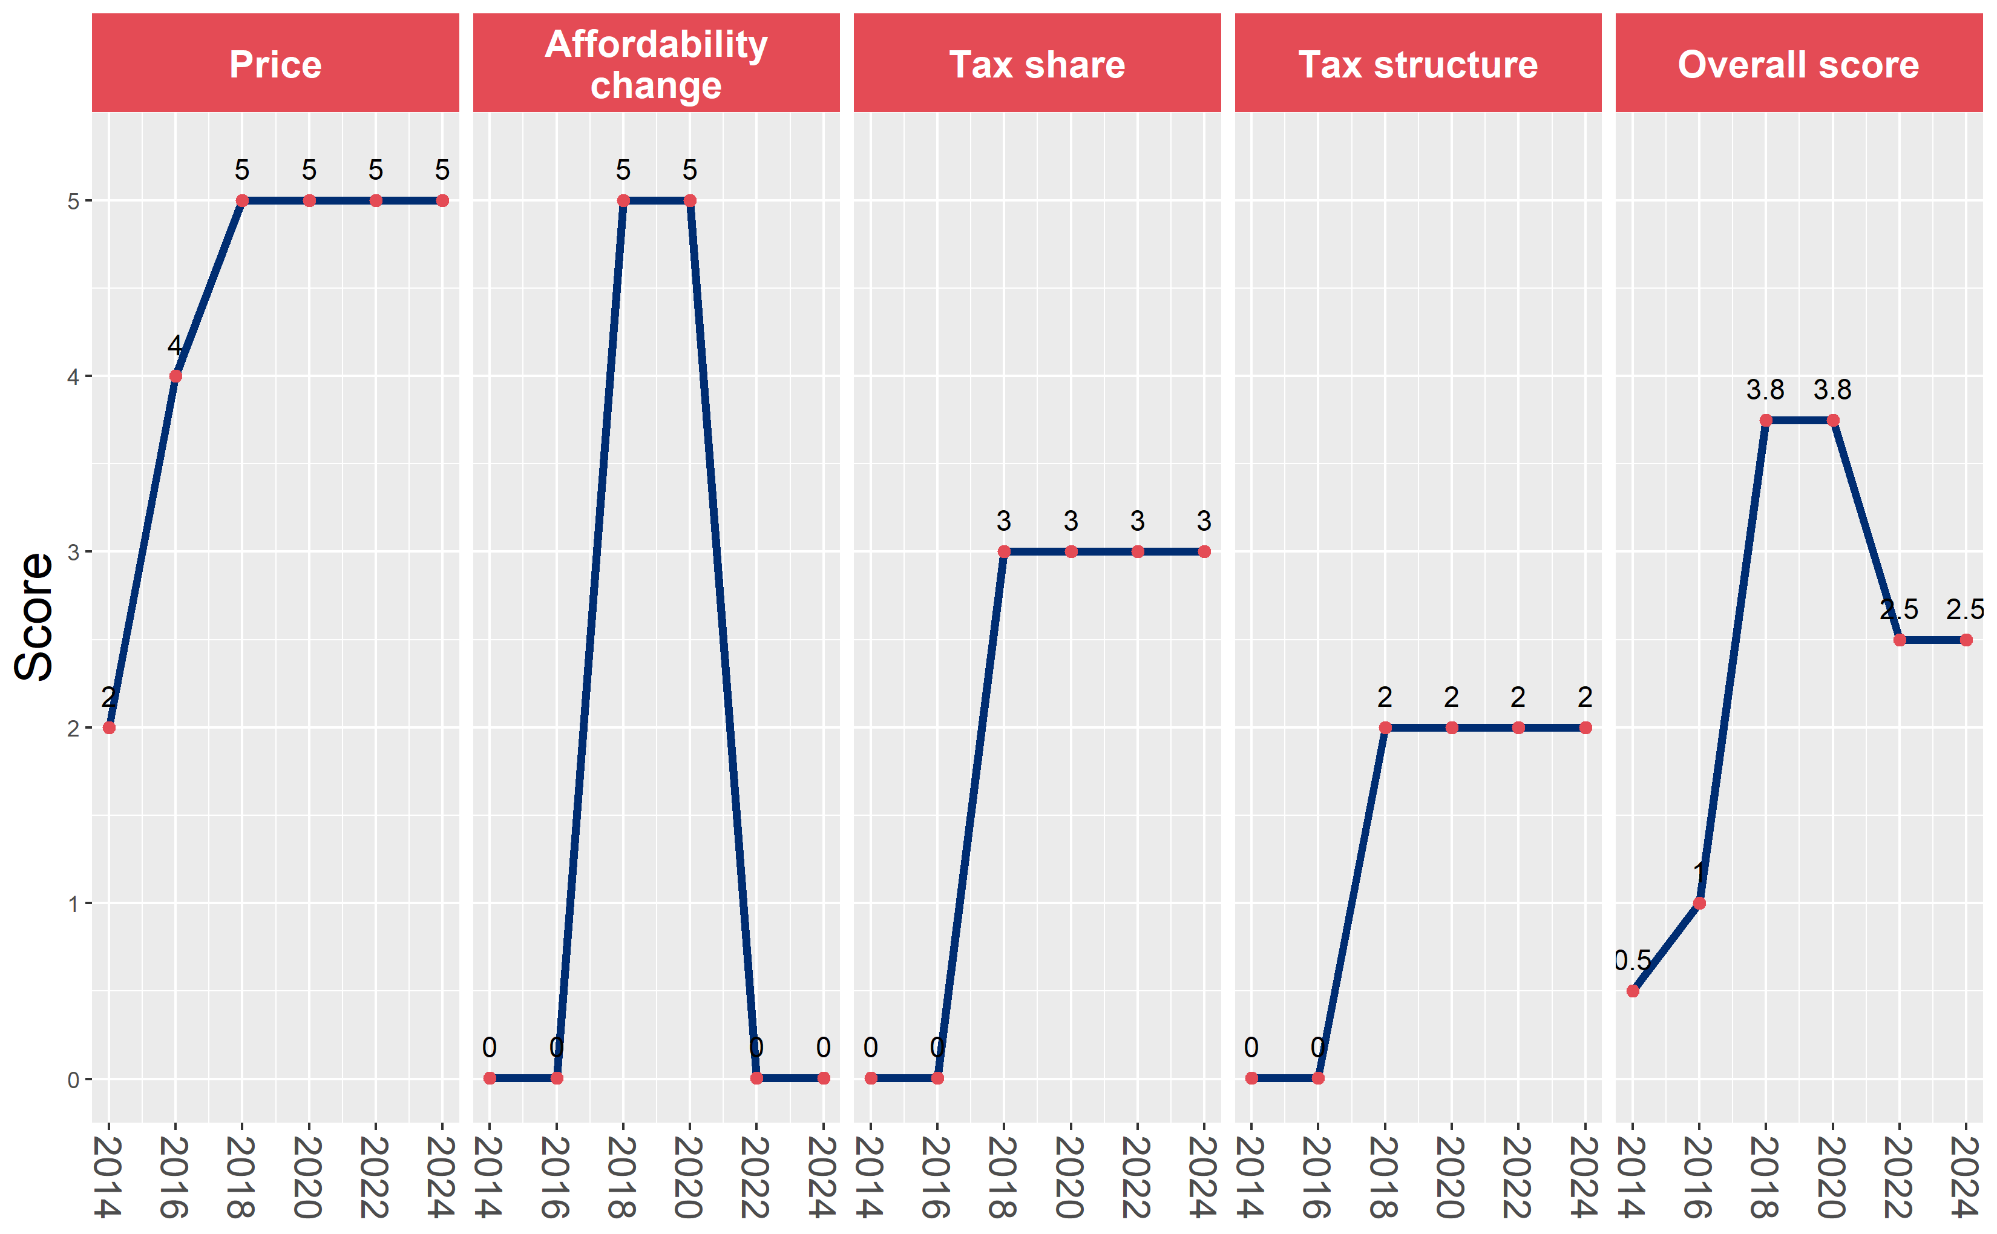
Saudi Arabia’s cigarette tax policies over time
Saudi Arabia’s overall and component scores are evaluated over a ten-year period, highlighting trends across all four Cigarette Tax Scorecard components.

