Slide 1
Scorecard presentation: Netherlands (Kingdom of the)

Slide 2
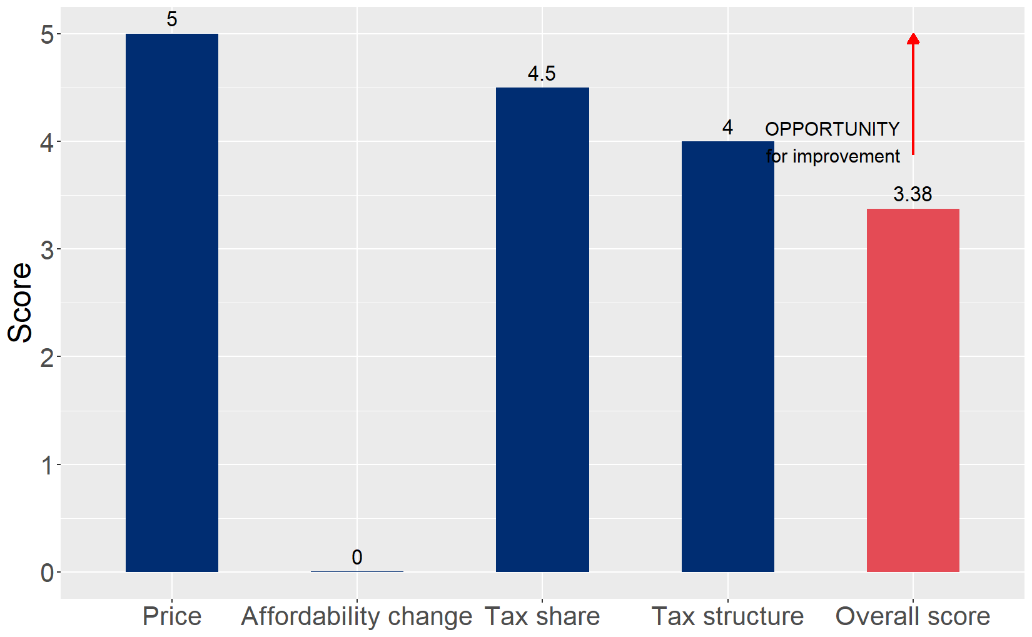
Cigarette tax policies in Netherlands (Kingdom of the), 2024
Four key tax components were assessed using a 5-point scale, with the overall score reflecting an average of Netherlands (Kingdom of the)’s component scores. The score reflect the current strengths and opportunities in Netherlands (Kingdom of the) to further increase tax revenue and improve health.

Slide 3
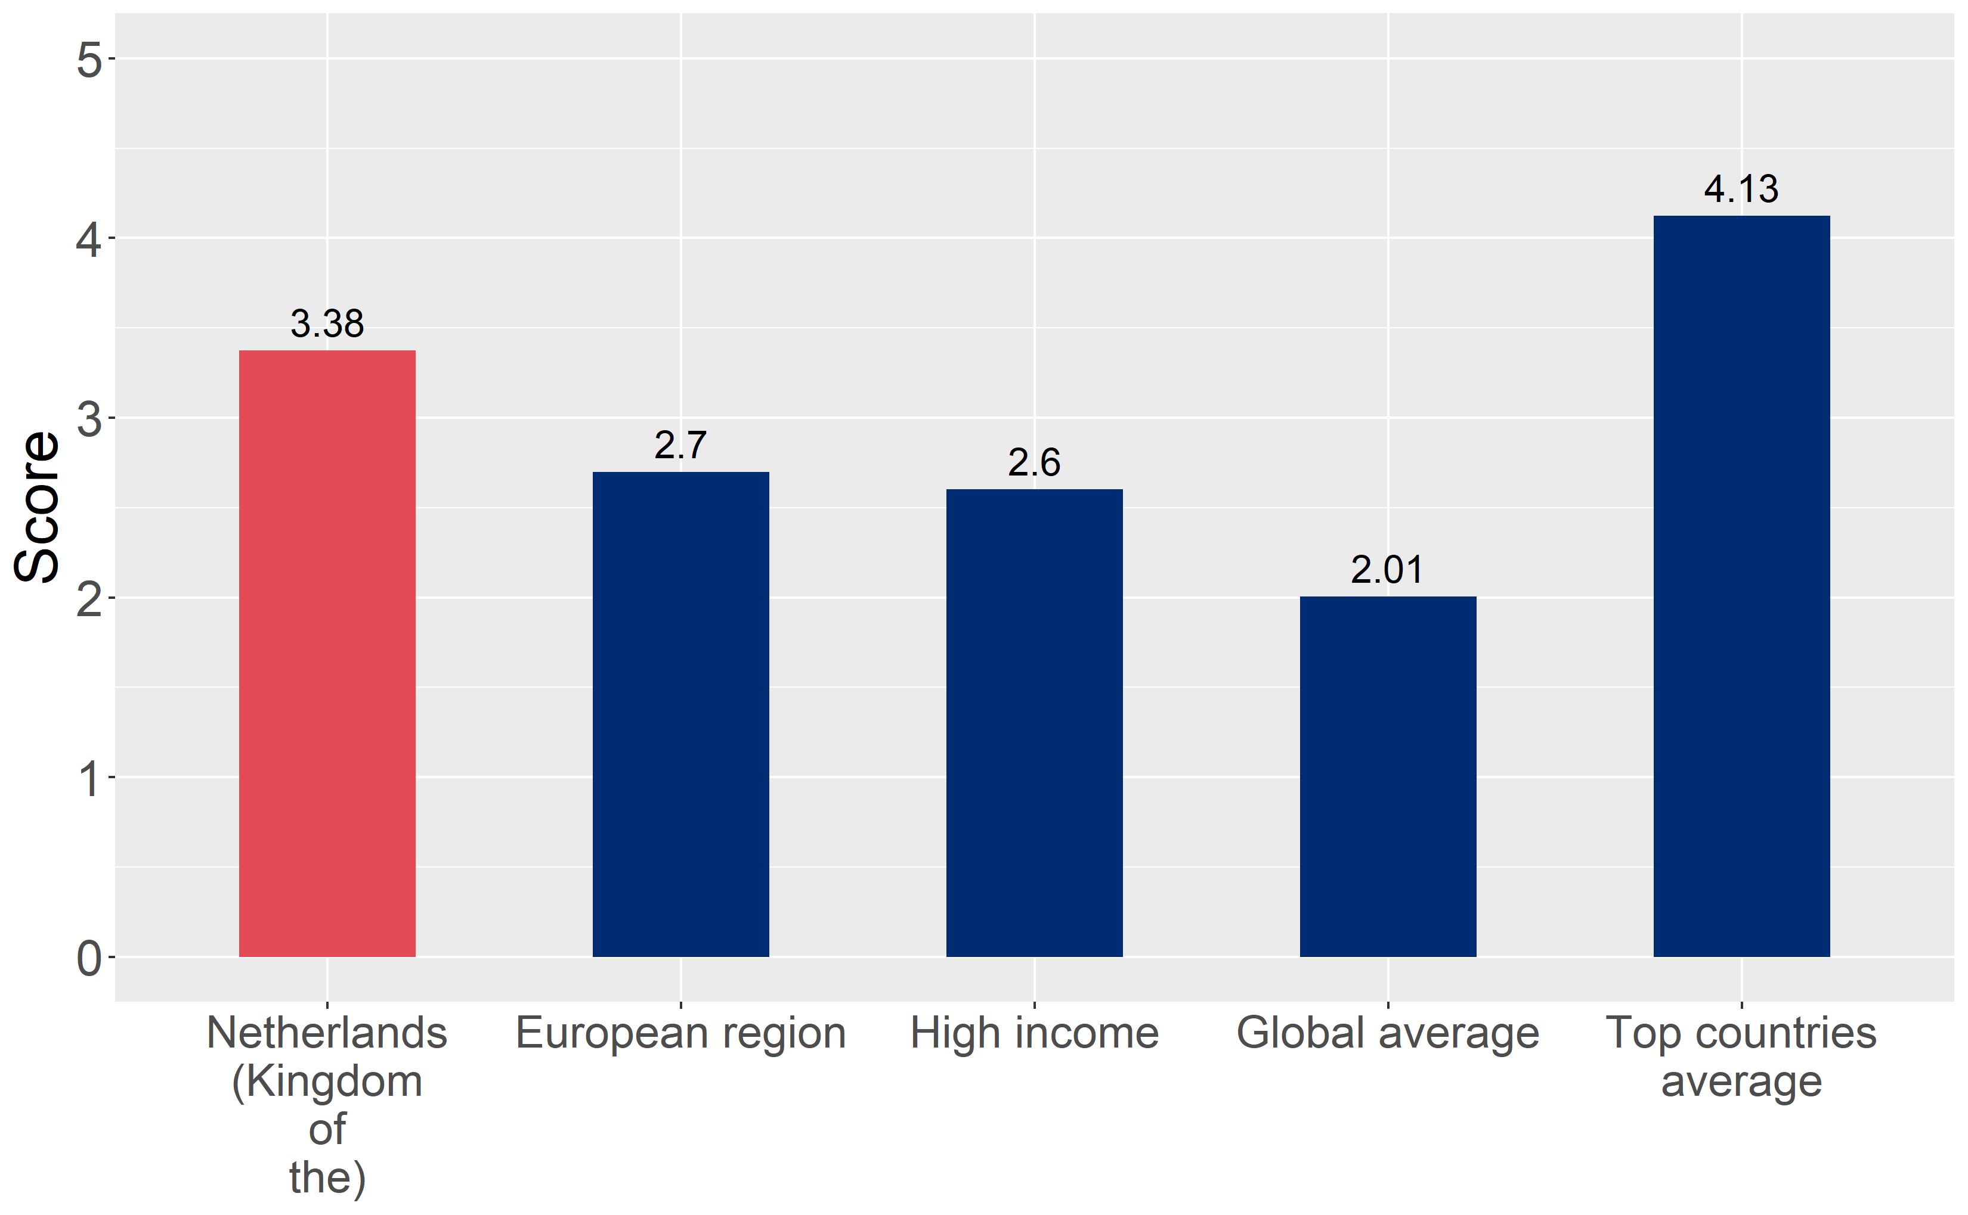
How does Netherlands (Kingdom of the) compare to other countries?
Netherlands (Kingdom of the)’s overall score in 2024 is compared to the average overall scores in its income group, region, the world, and top performers.

Slide 4
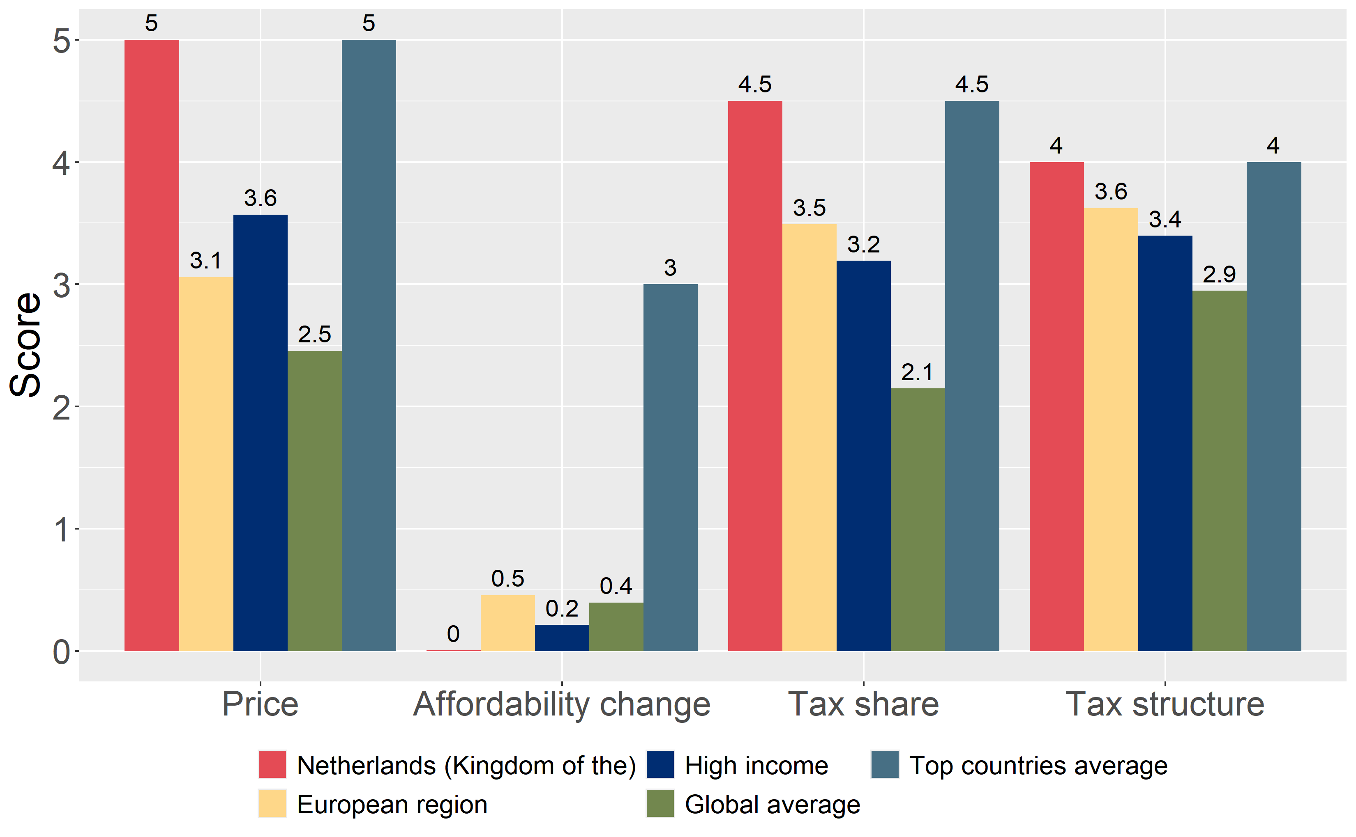
How does Netherlands (Kingdom of the) compare to other countries?
The components of Netherlands (Kingdom of the)’s score in 2024 are compared to component scores in the region, income group, world, and top performers.

Slide 5
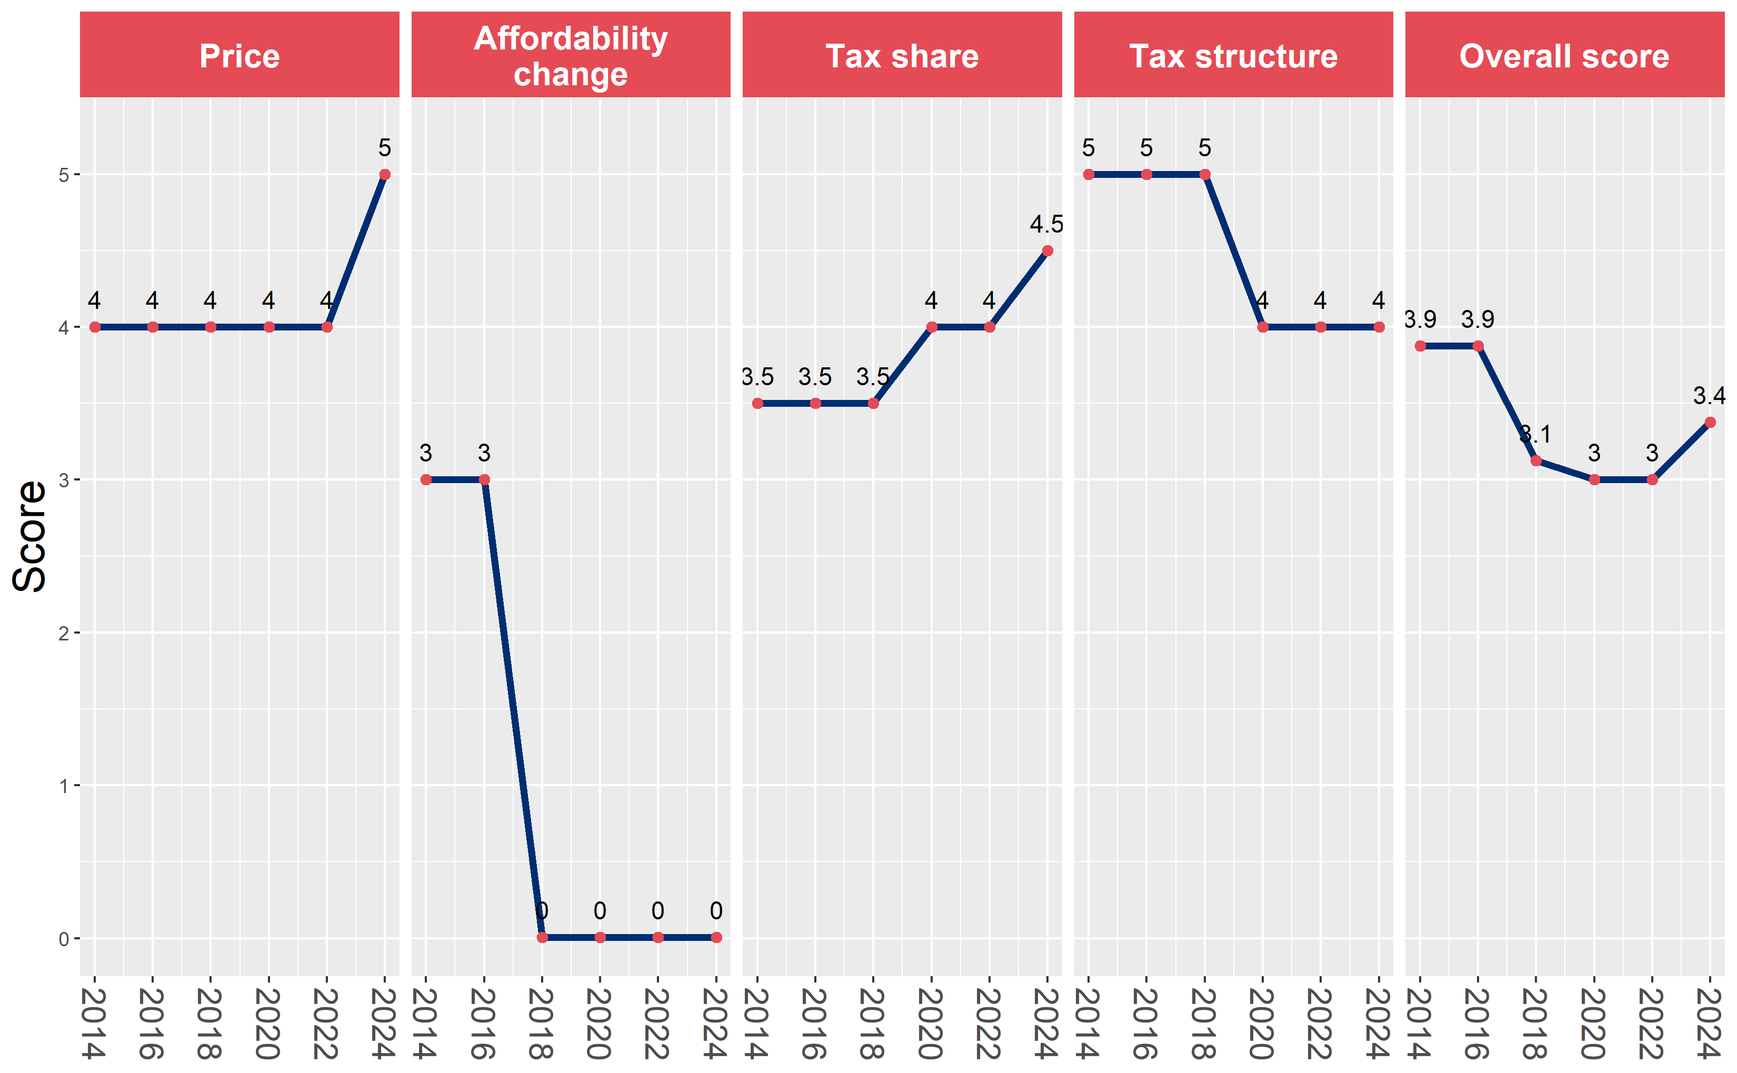
Netherlands (Kingdom of the)’s cigarette tax policies over time
Netherlands (Kingdom of the)’s overall and component scores are evaluated over a ten-year period, highlighting trends across all four Cigarette Tax Scorecard components.

