Slide 1
Scorecard presentation: Sri Lanka

Slide 2
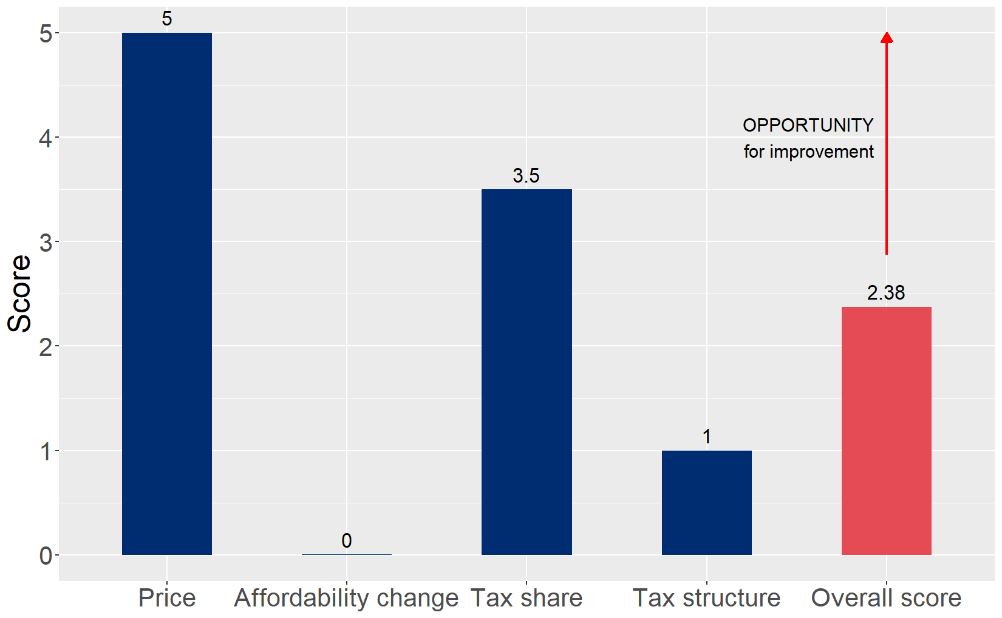
Cigarette tax policies in Sri Lanka, 2024
Four key tax components were assessed using a 5-point scale, with the overall score reflecting an average of Sri Lanka’s component scores. The score reflect the current strengths and opportunities in Sri Lanka to further increase tax revenue and improve health.

Slide 3
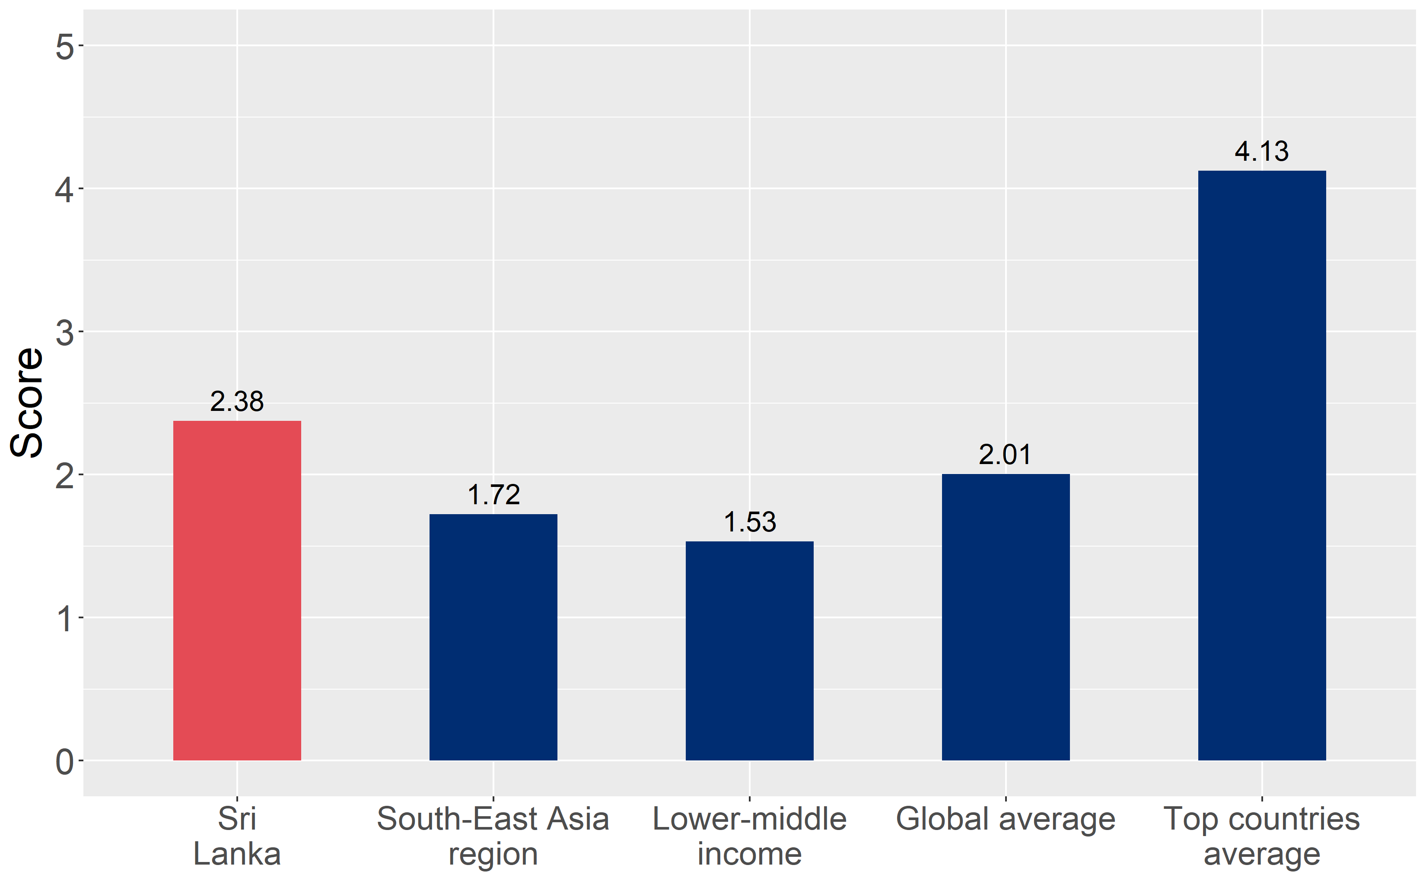
How does Sri Lanka compare to other countries?
Sri Lanka’s overall score in 2024 is compared to the average overall scores in its income group, region, the world, and top performers.

Slide 4
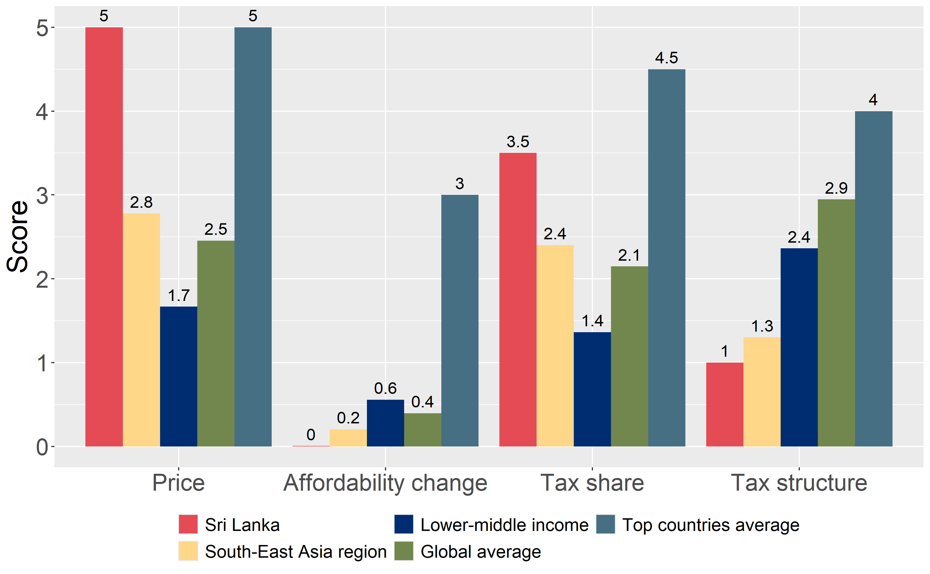
How does Sri Lanka compare to other countries?
The components of Sri Lanka’s score in 2024 are compared to component scores in the region, income group, world, and top performers.

Slide 5
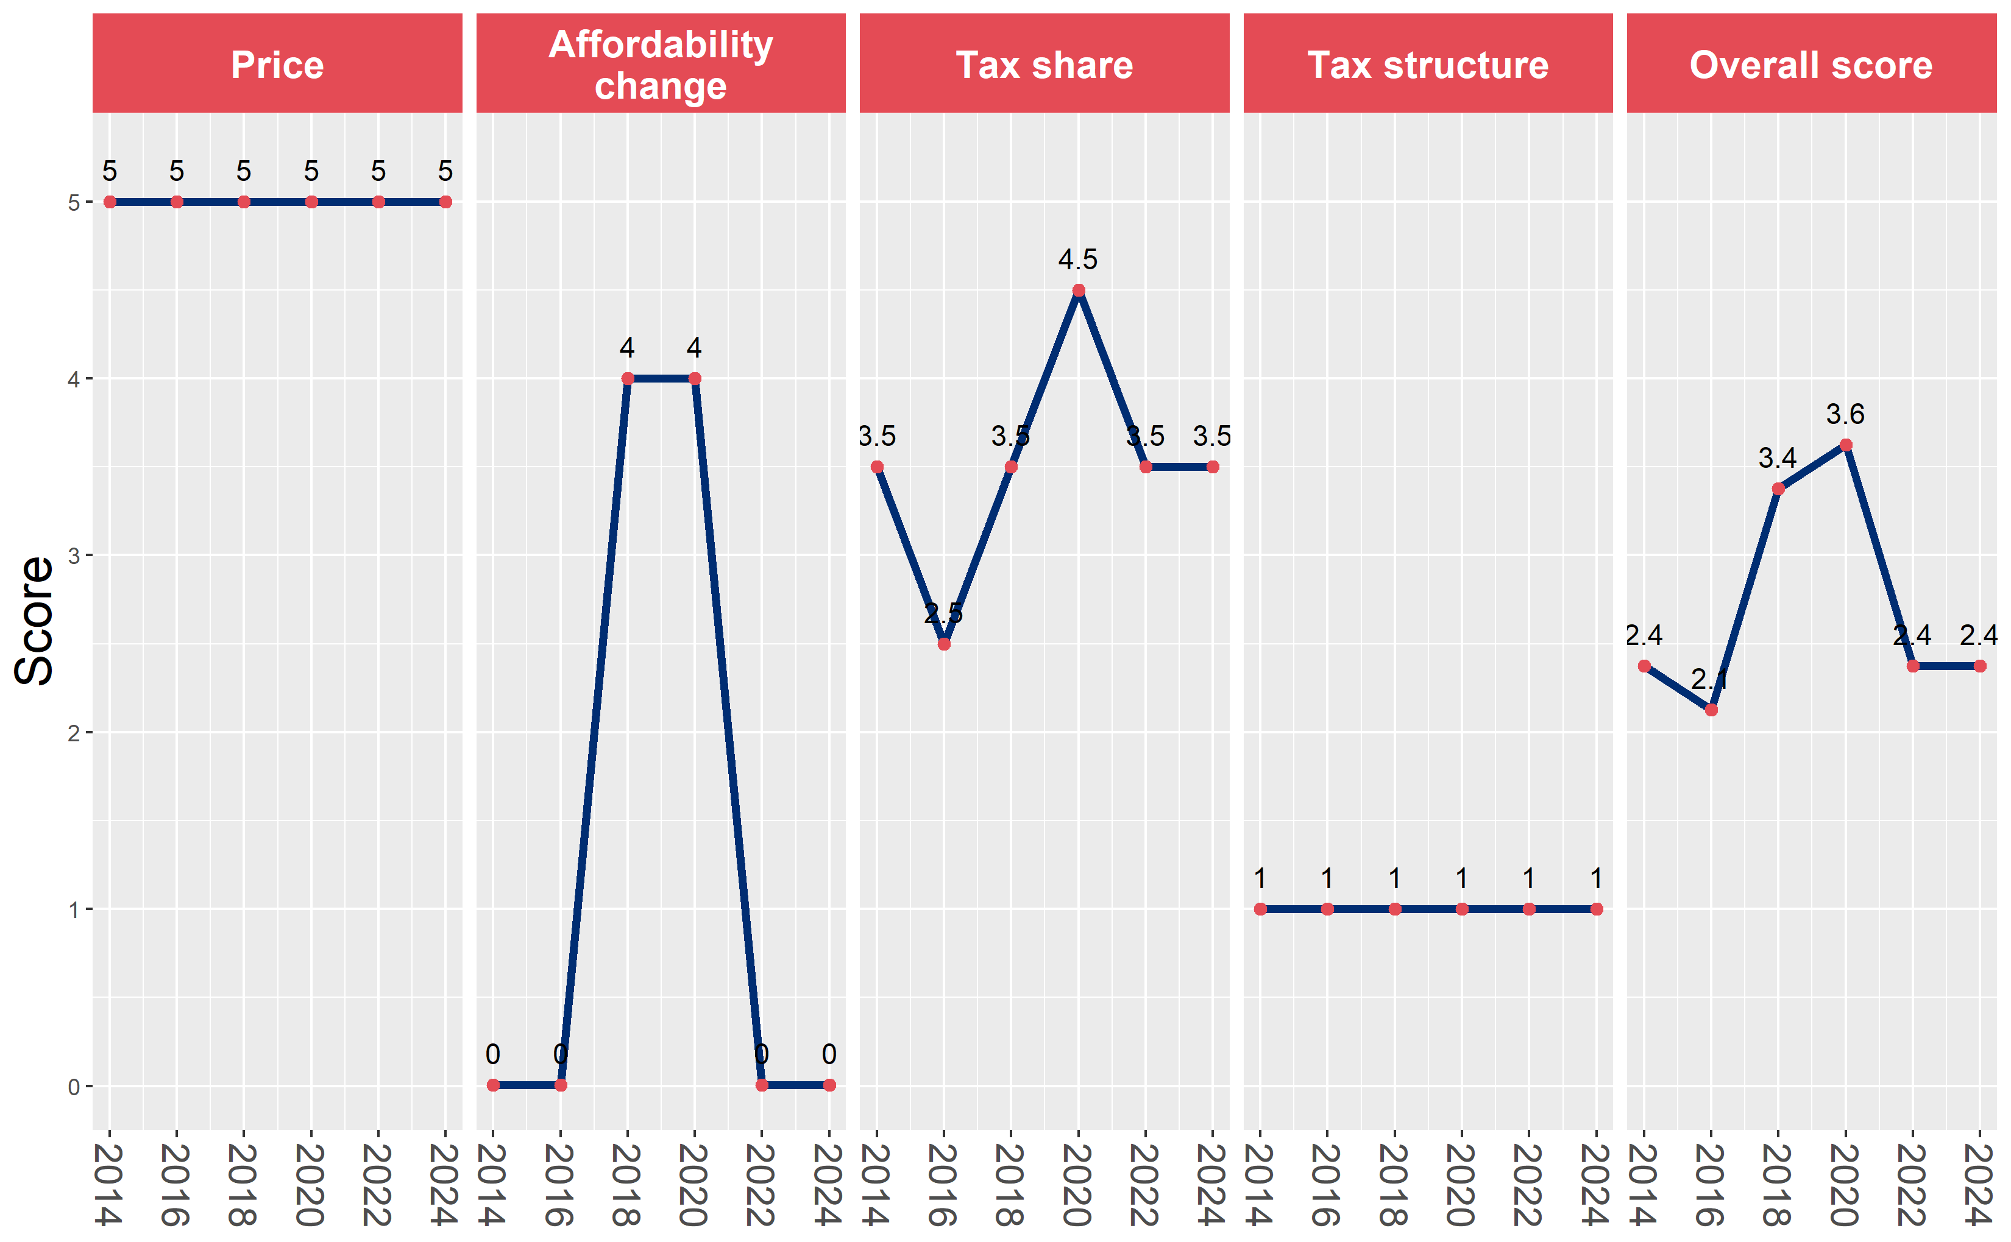
Sri Lanka’s cigarette tax policies over time
Sri Lanka’s overall and component scores are evaluated over a ten-year period, highlighting trends across all four Cigarette Tax Scorecard components.

