Slide 1
Scorecard presentation: Lao People’s Democratic Republic

Slide 2
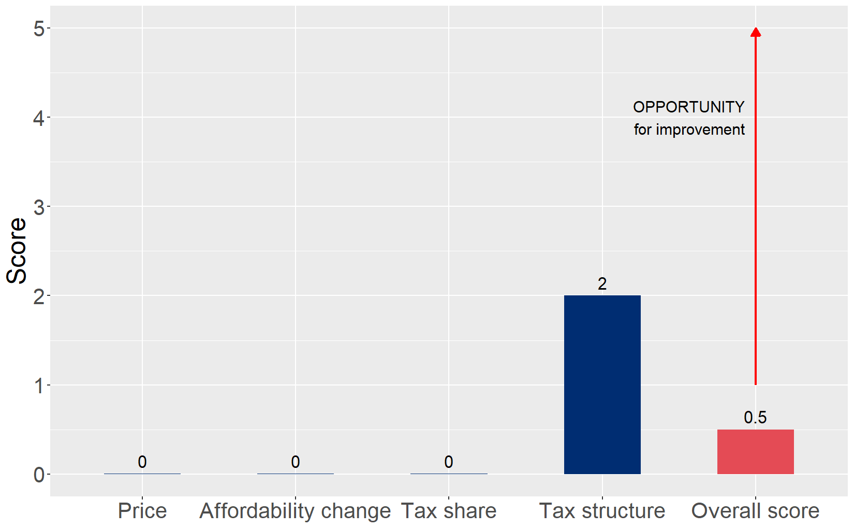
Cigarette tax policies in Lao People’s Democratic Republic, 2024
Four key tax components were assessed using a 5-point scale, with the overall score reflecting an average of Lao People’s Democratic Republic’s component scores. The score reflect the current strengths and opportunities in Lao People’s Democratic Republic to further increase tax revenue and improve health.

Slide 3
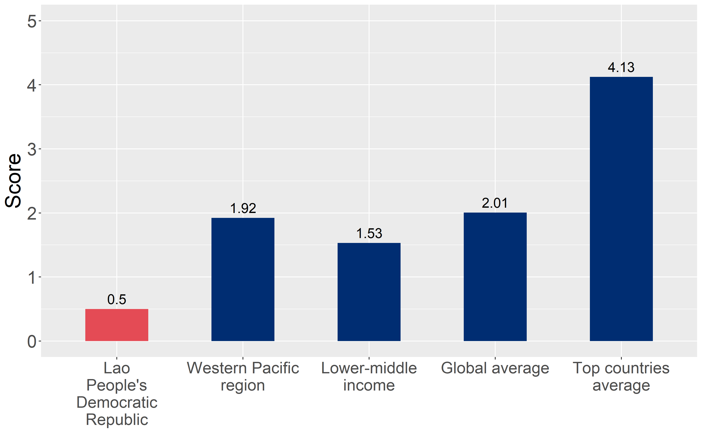
How does Lao People’s Democratic Republic compare to other countries?
Lao People’s Democratic Republic’s overall score in 2024 is compared to the average overall scores in its income group, region, the world, and top performers.

Slide 4
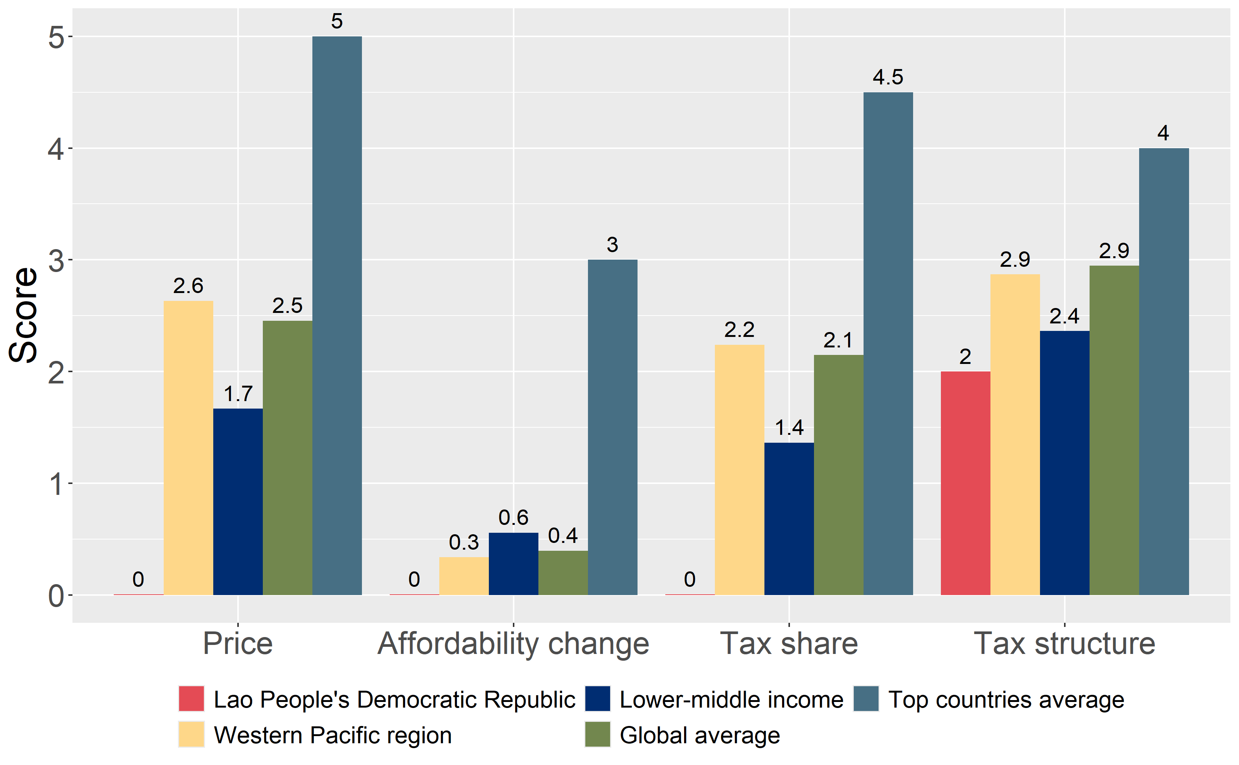
How does Lao People’s Democratic Republic compare to other countries?
The components of Lao People’s Democratic Republic’s score in 2024 are compared to component scores in the region, income group, world, and top performers.

Slide 5
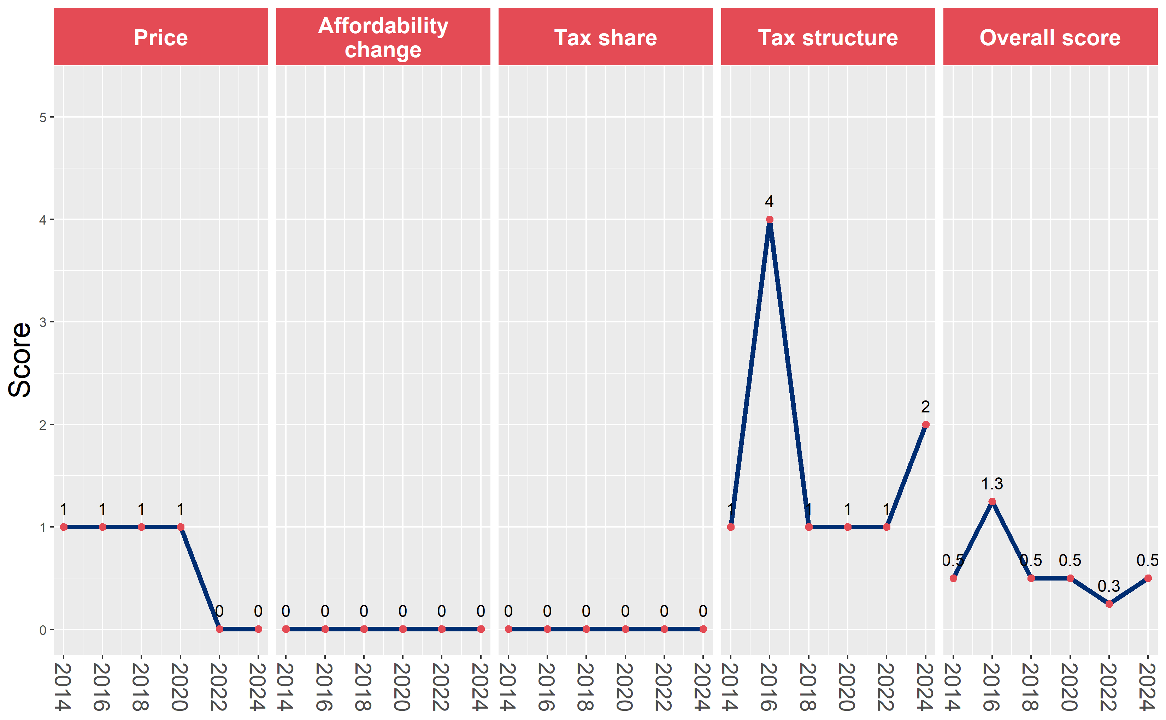
Lao People’s Democratic Republic’s cigarette tax policies over time
Lao People’s Democratic Republic’s overall and component scores are evaluated over a ten-year period, highlighting trends across all four Cigarette Tax Scorecard components.

