Slide 1
Scorecard presentation: Kyrgyzstan

Slide 2
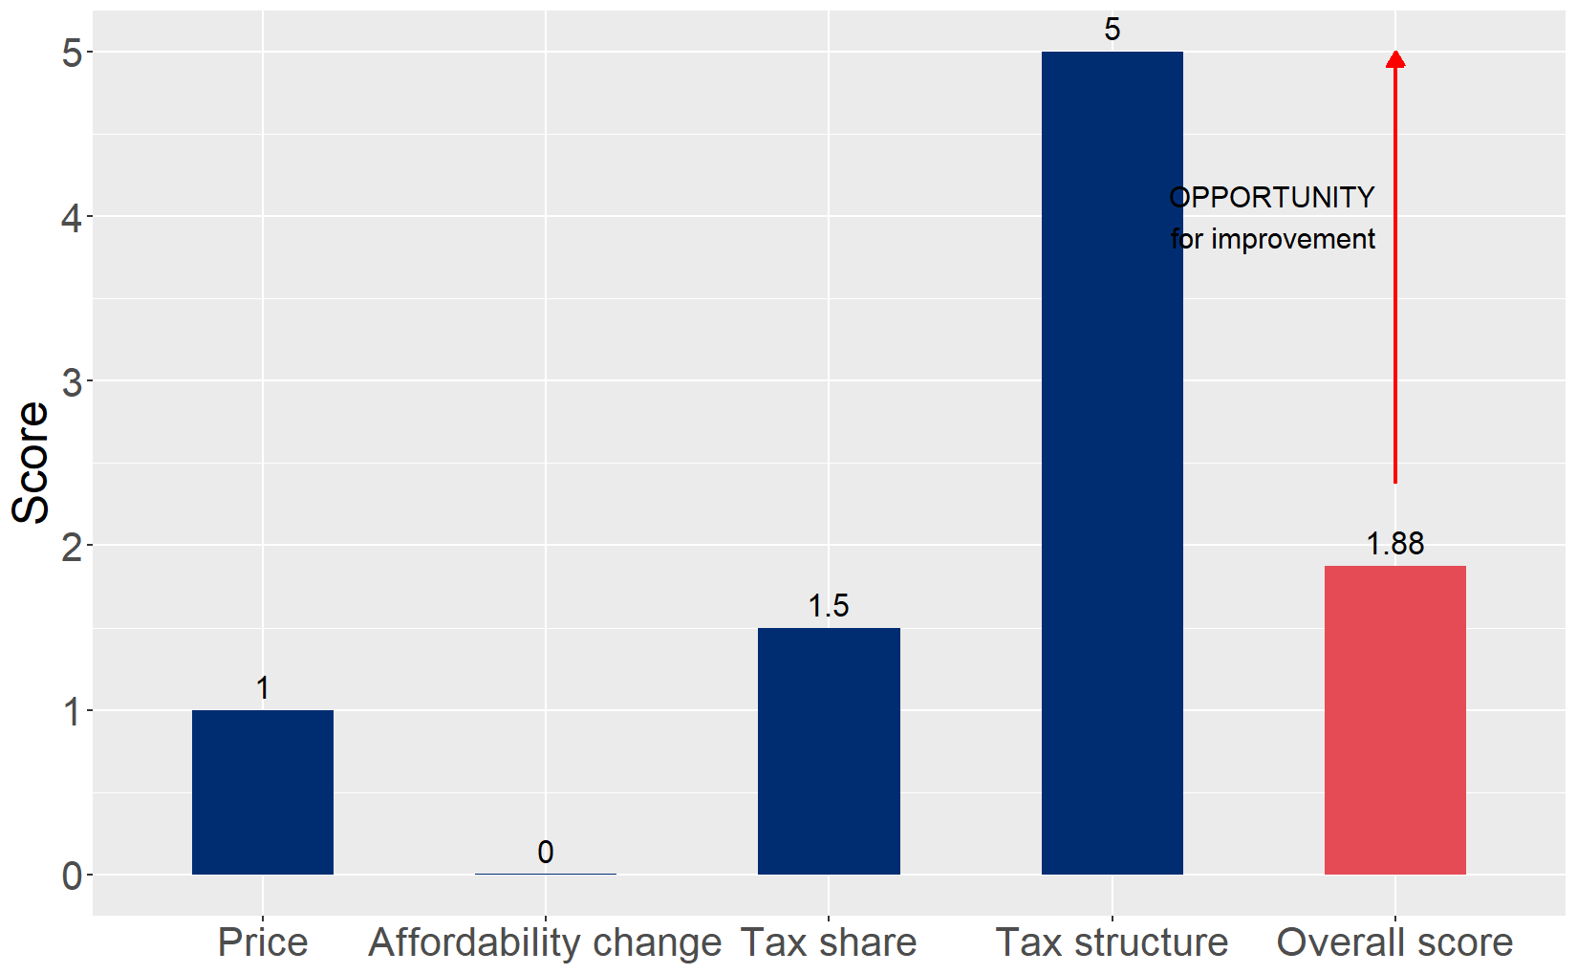
Cigarette tax policies in Kyrgyzstan, 2024
Four key tax components were assessed using a 5-point scale, with the overall score reflecting an average of Kyrgyzstan’s component scores. The score reflect the current strengths and opportunities in Kyrgyzstan to further increase tax revenue and improve health.

Slide 3
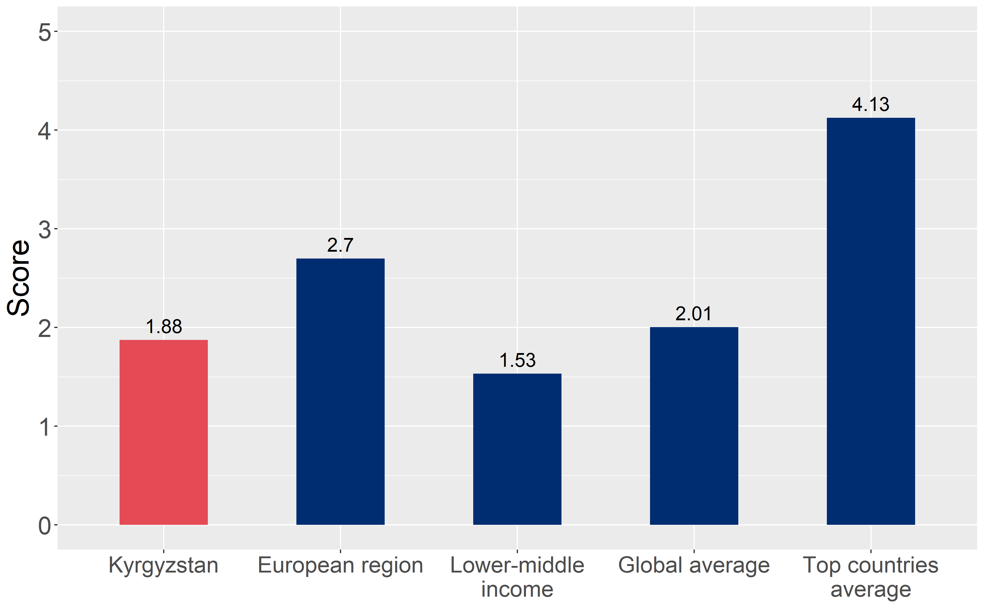
How does Kyrgyzstan compare to other countries?
Kyrgyzstan’s overall score in 2024 is compared to the average overall scores in its income group, region, the world, and top performers.

Slide 4
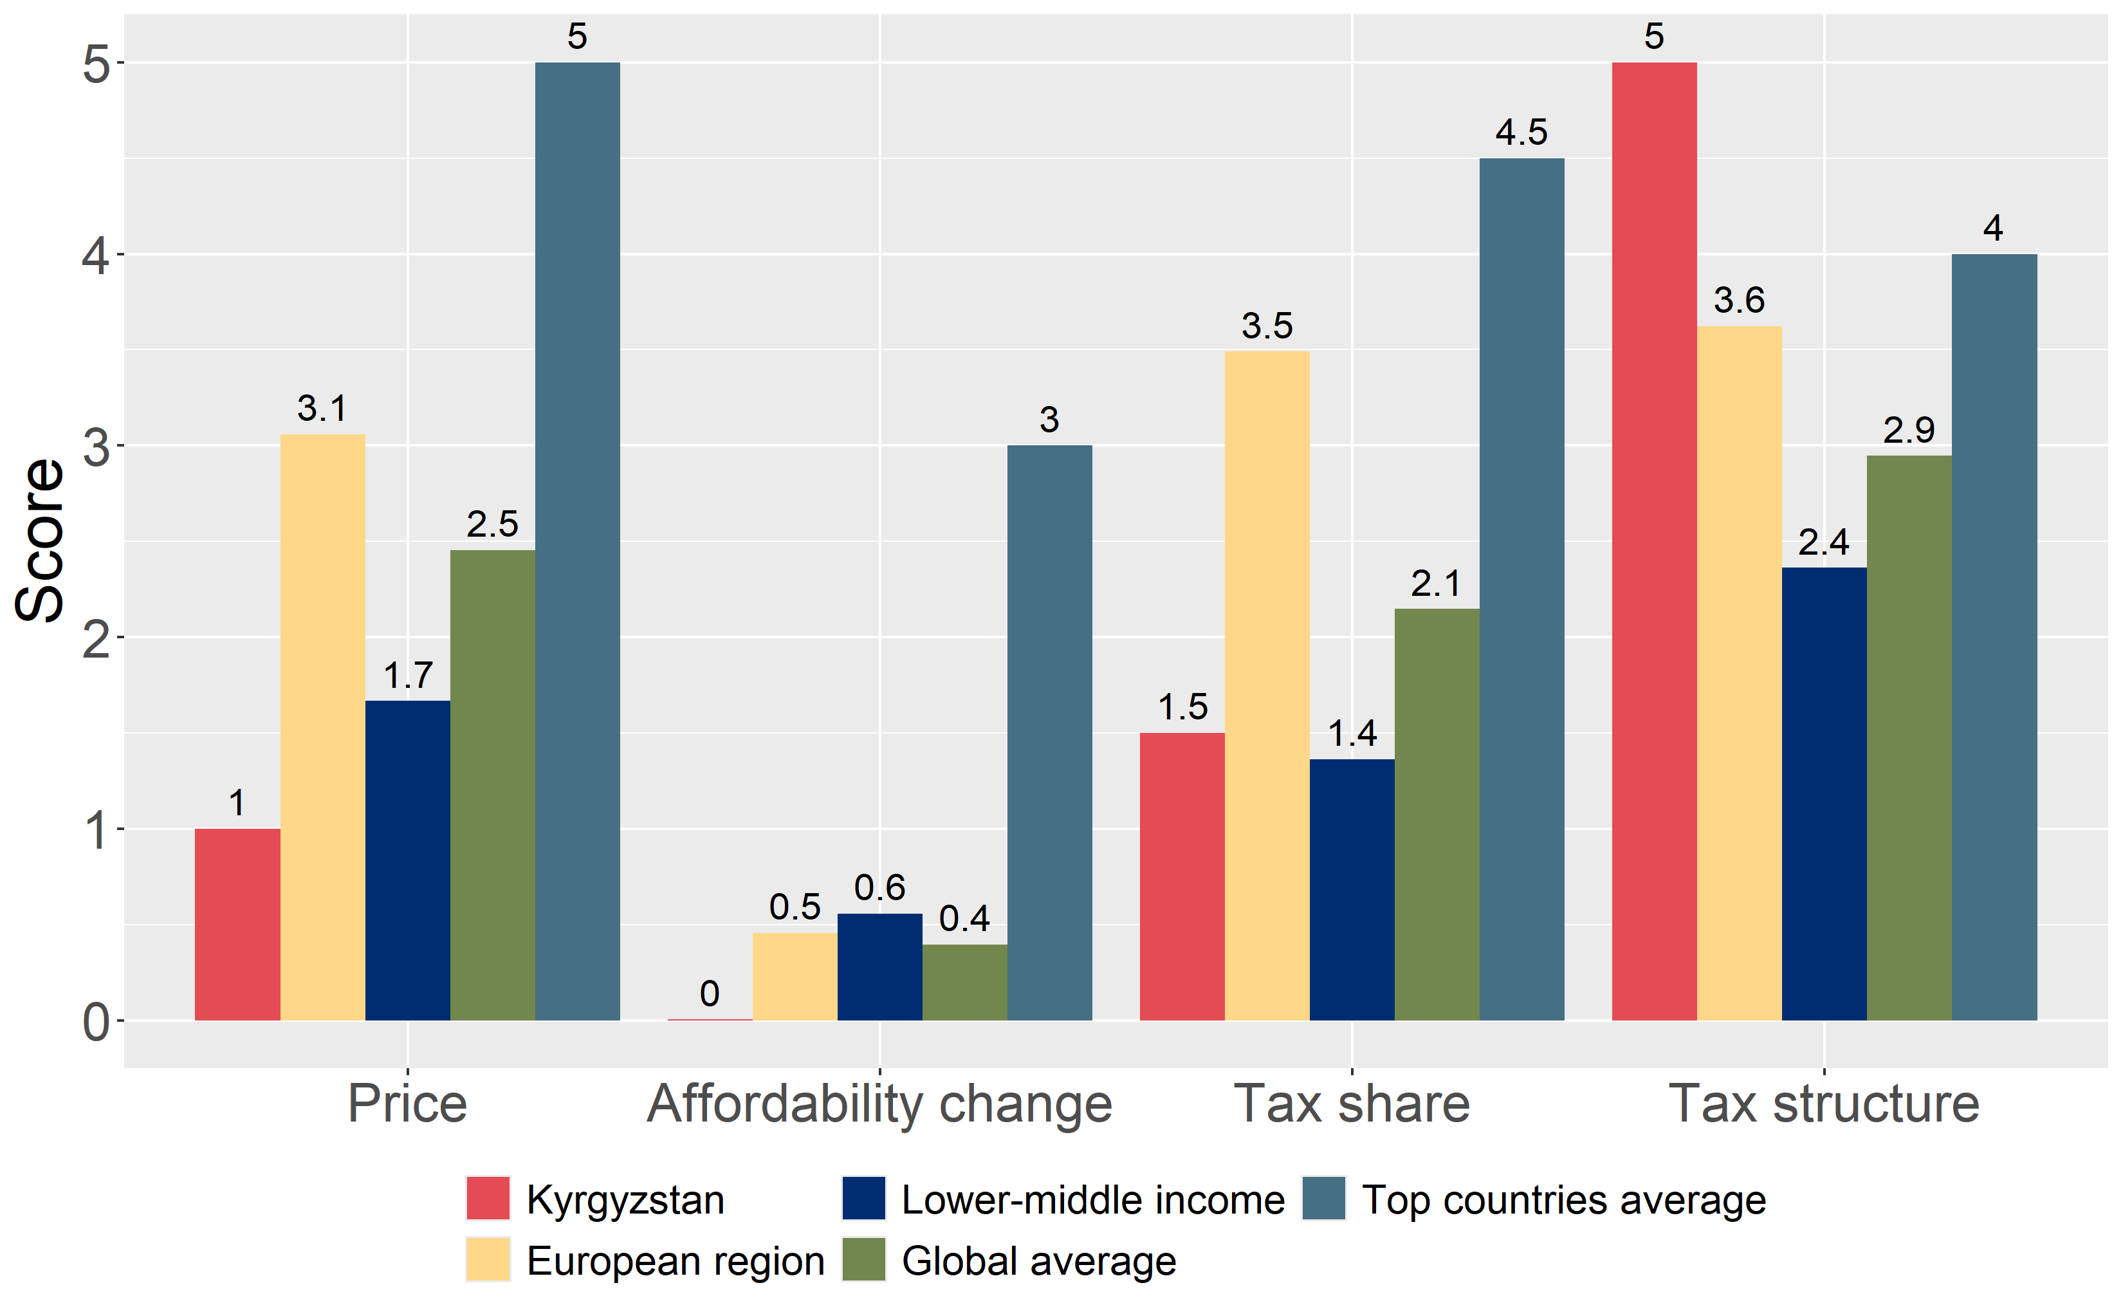
How does Kyrgyzstan compare to other countries?
The components of Kyrgyzstan’s score in 2024 are compared to component scores in the region, income group, world, and top performers.

Slide 5
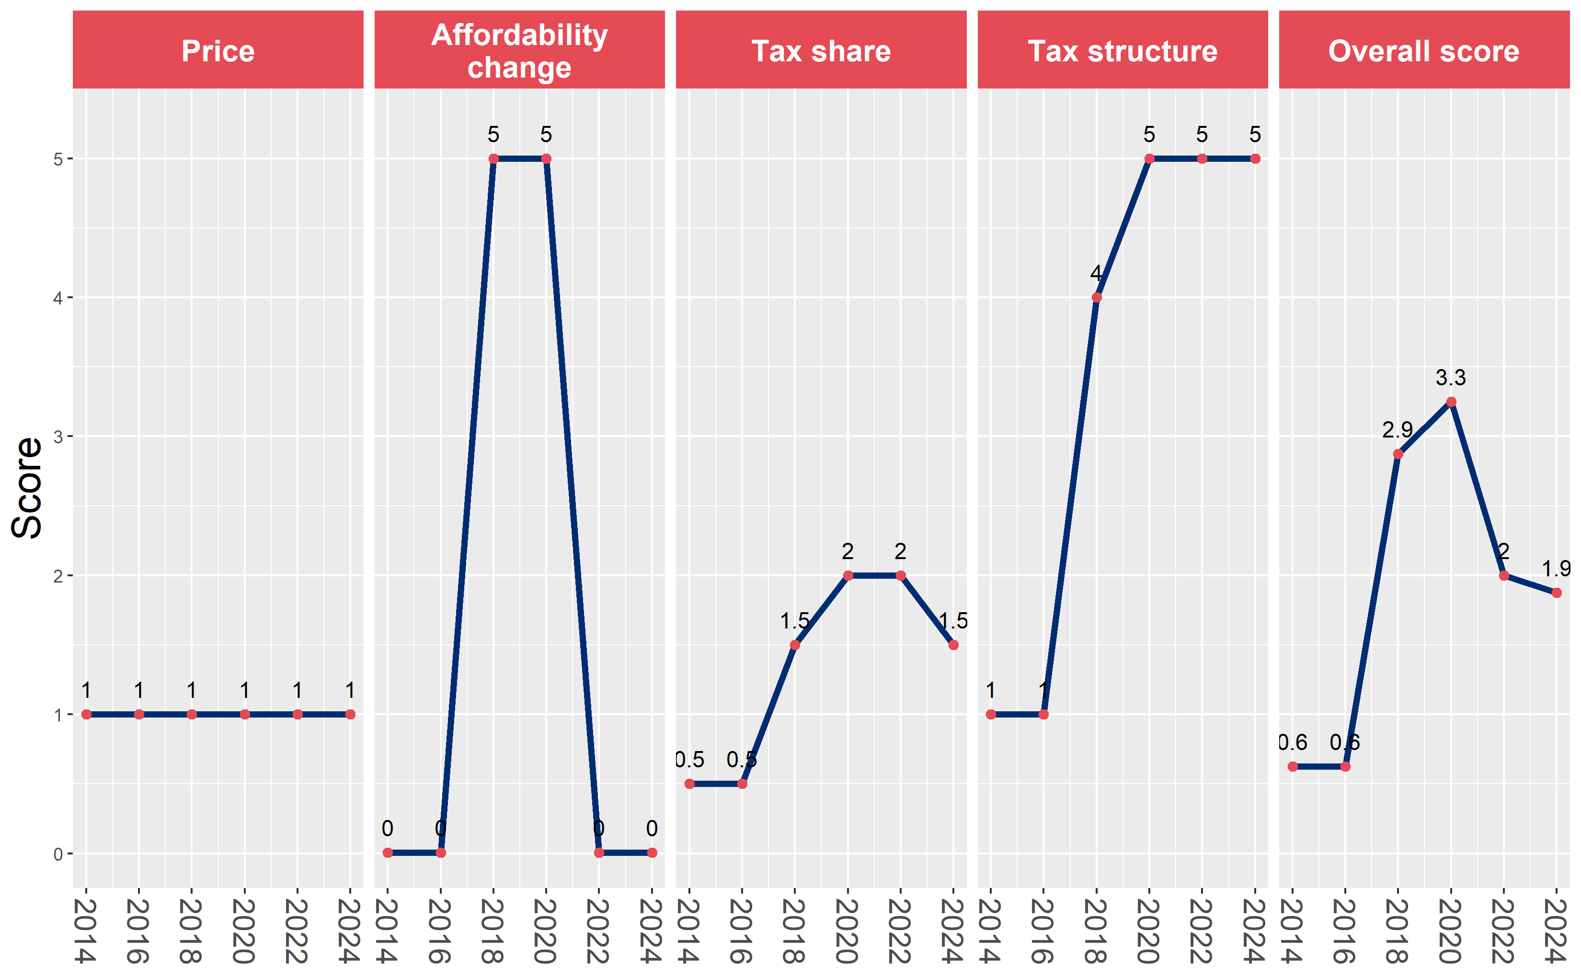
Kyrgyzstan’s cigarette tax policies over time
Kyrgyzstan’s overall and component scores are evaluated over a ten-year period, highlighting trends across all four Cigarette Tax Scorecard components.

