Slide 1
Scorecard presentation: Guinea-Bissau

Slide 2
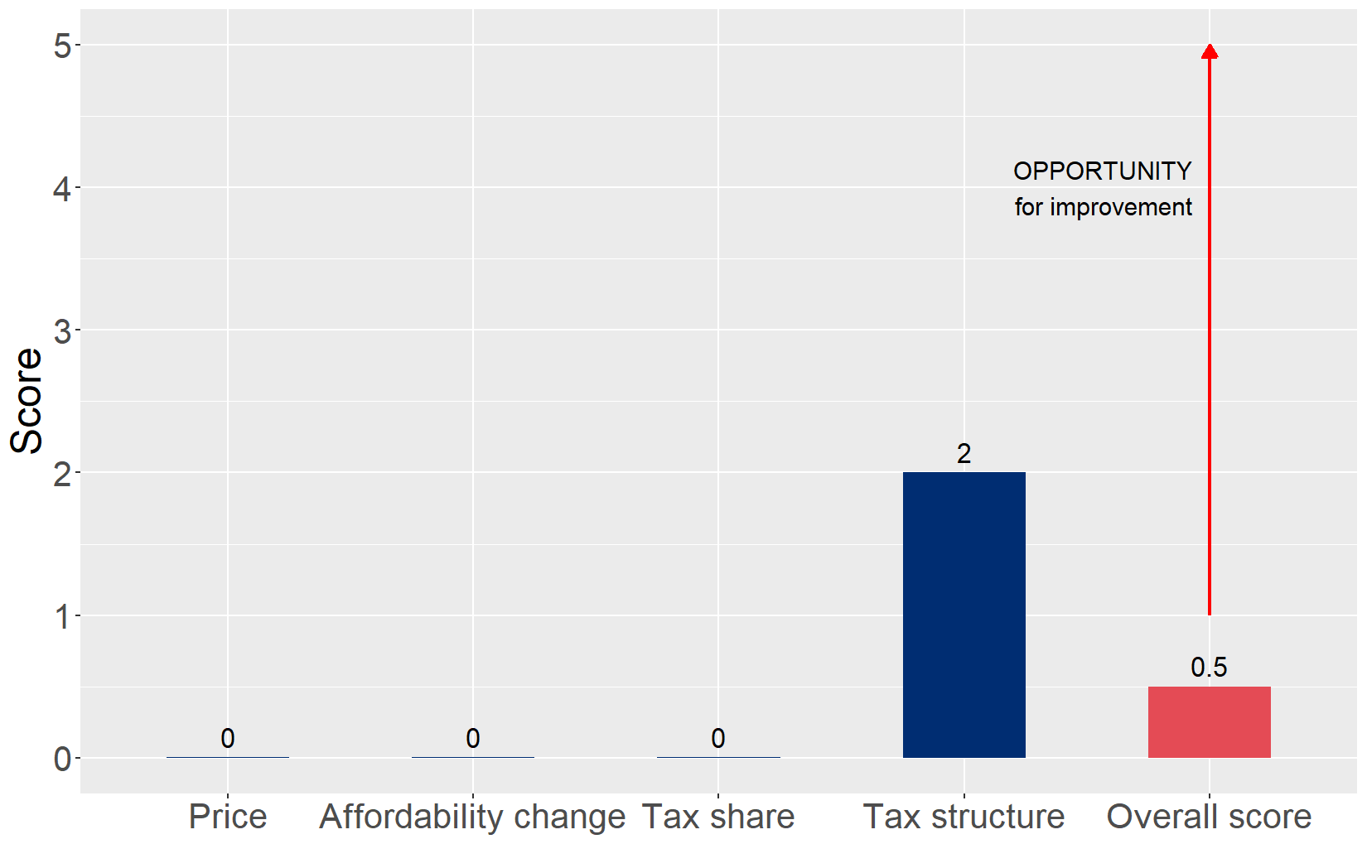
Cigarette tax policies in Guinea-Bissau, 2024
Four key tax components were assessed using a 5-point scale, with the overall score reflecting an average of Guinea-Bissau’s component scores. The score reflect the current strengths and opportunities in Guinea-Bissau to further increase tax revenue and improve health.

Slide 3
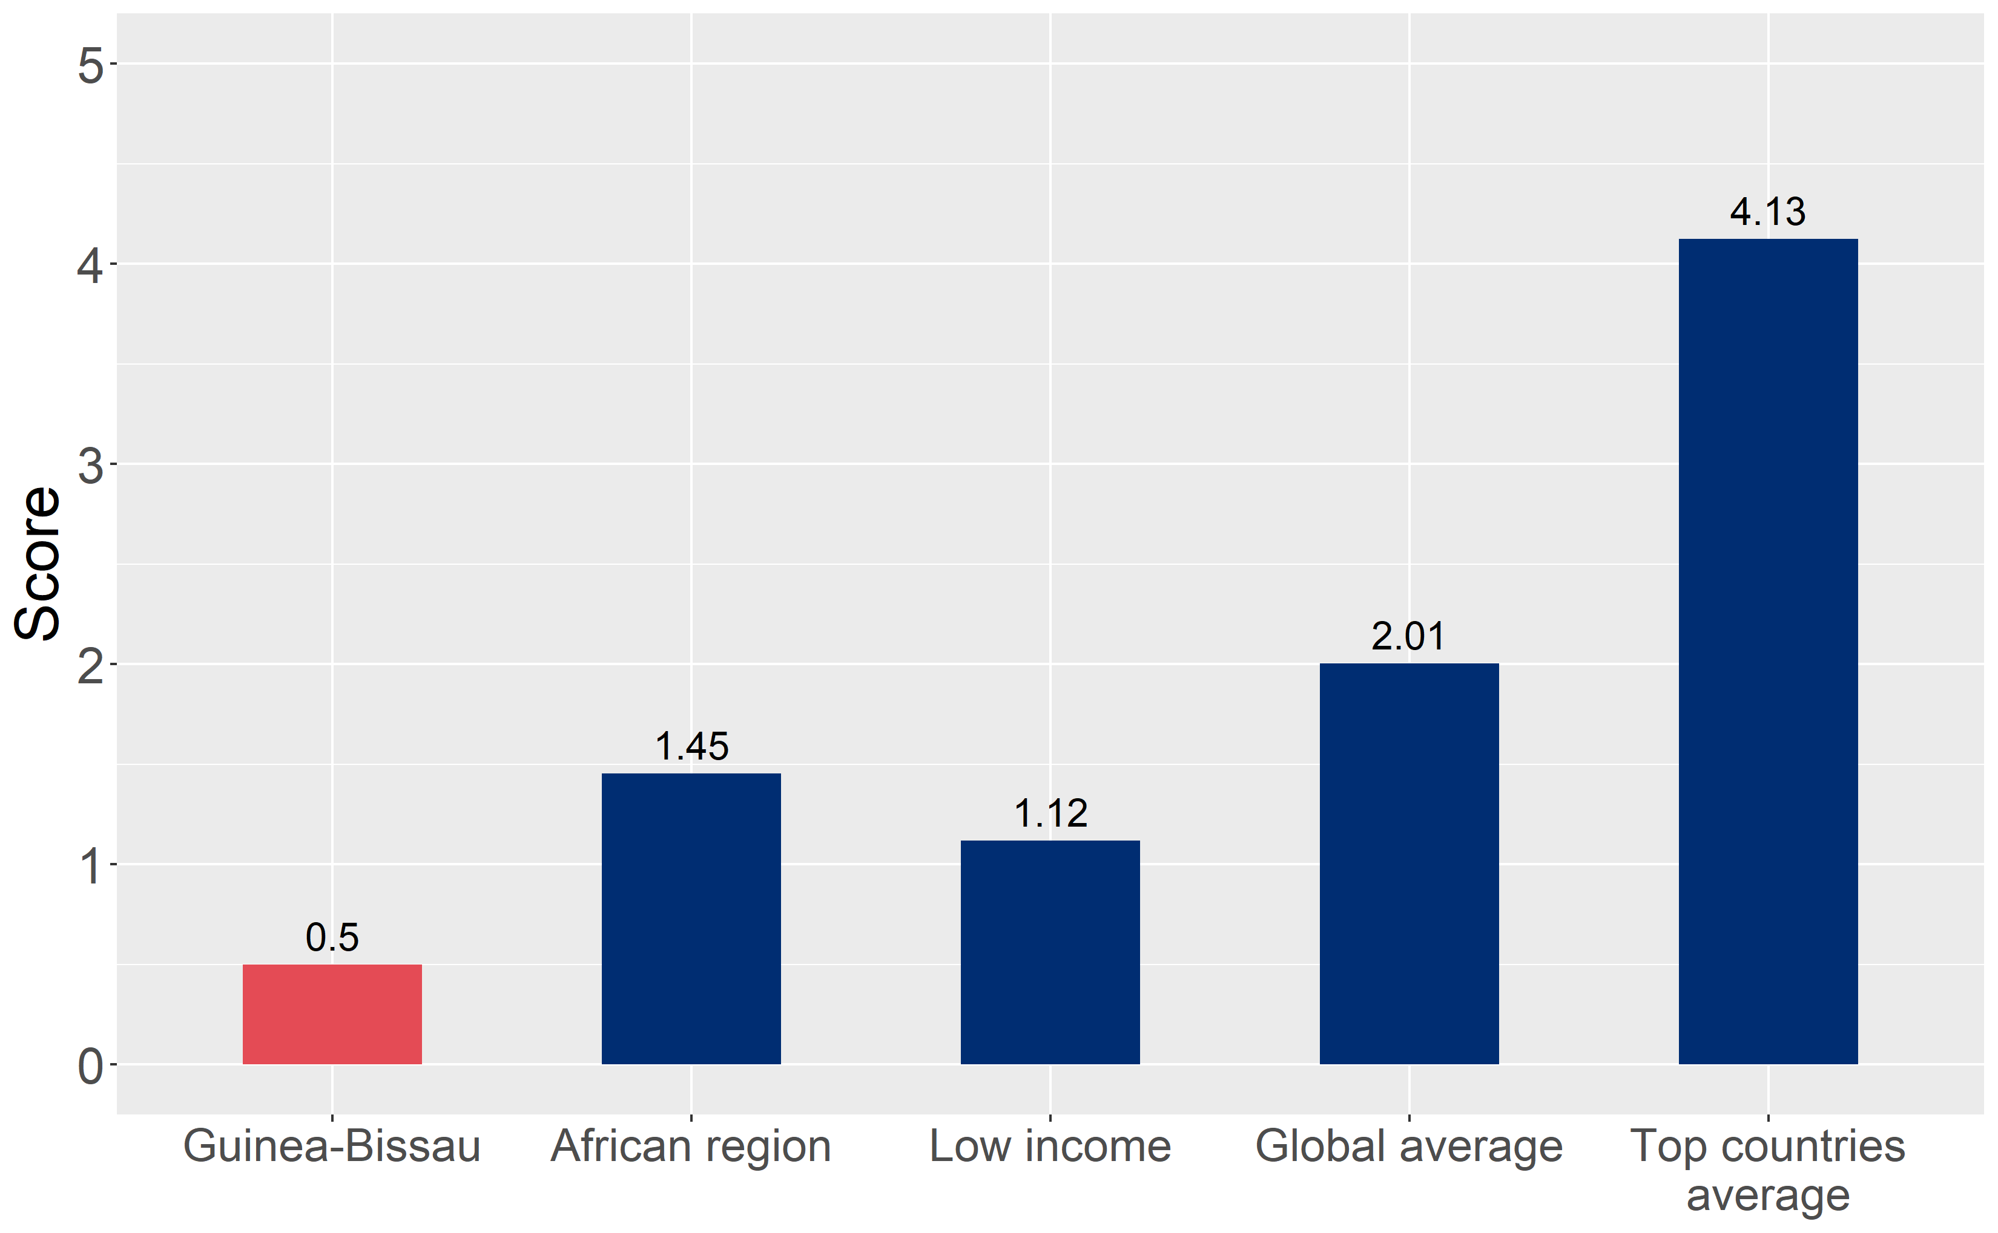
How does Guinea-Bissau compare to other countries?
Guinea-Bissau’s overall score in 2024 is compared to the average overall scores in its income group, region, the world, and top performers.

Slide 4
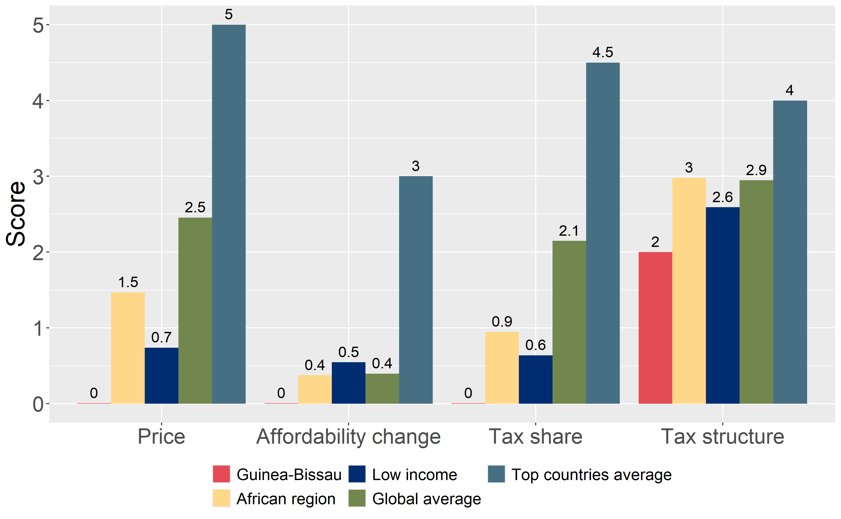
How does Guinea-Bissau compare to other countries?
The components of Guinea-Bissau’s score in 2024 are compared to component scores in the region, income group, world, and top performers.

Slide 5
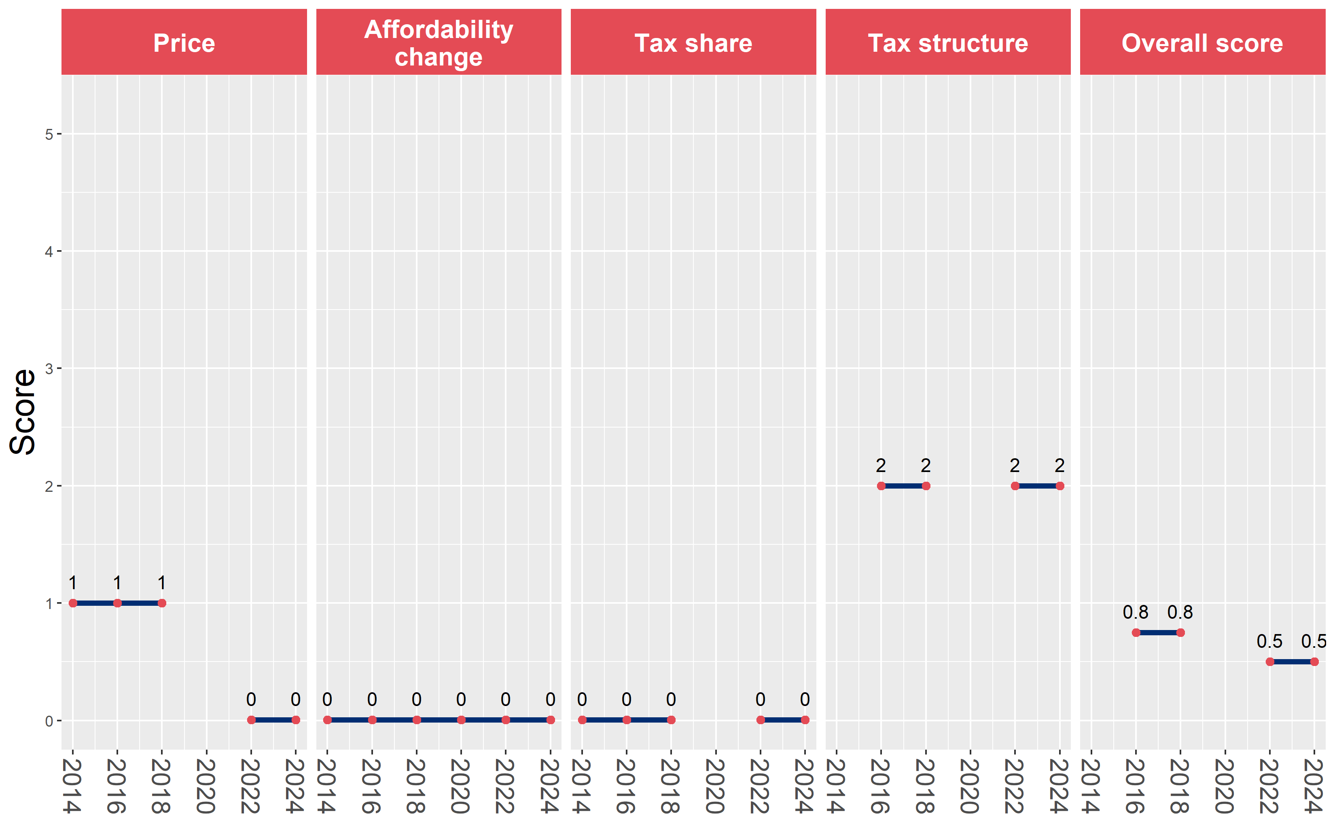
Guinea-Bissau’s cigarette tax policies over time
Guinea-Bissau’s overall and component scores are evaluated over a ten-year period, highlighting trends across all four Cigarette Tax Scorecard components.

