Slide 1
Scorecard presentation: United Kingdom of Great Britain and Northern Ireland

Slide 2
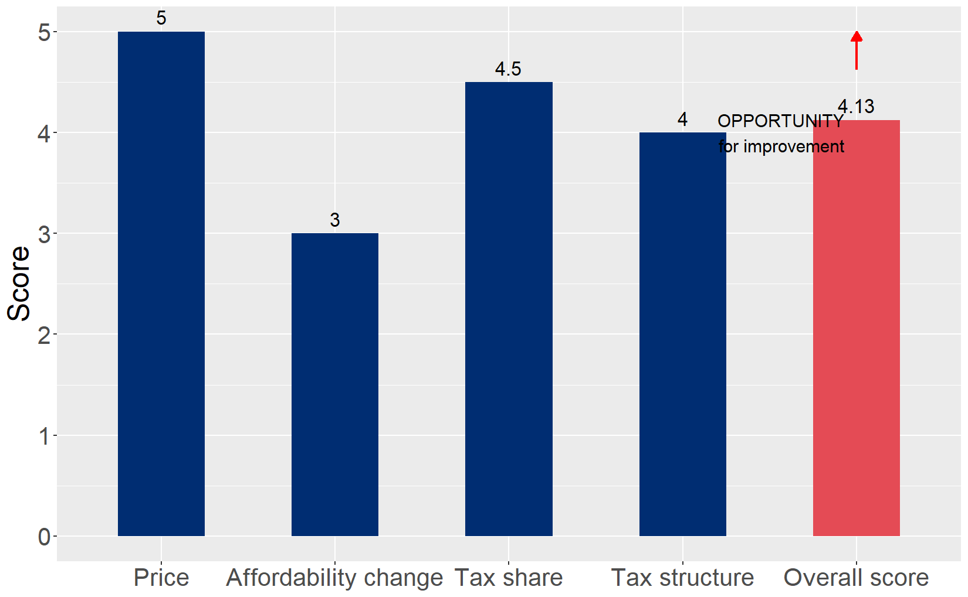
Cigarette tax policies in United Kingdom of Great Britain and Northern Ireland, 2024
Four key tax components were assessed using a 5-point scale, with the overall score reflecting an average of United Kingdom of Great Britain and Northern Ireland’s component scores. The score reflect the current strengths and opportunities in United Kingdom of Great Britain and Northern Ireland to further increase tax revenue and improve health.

Slide 3
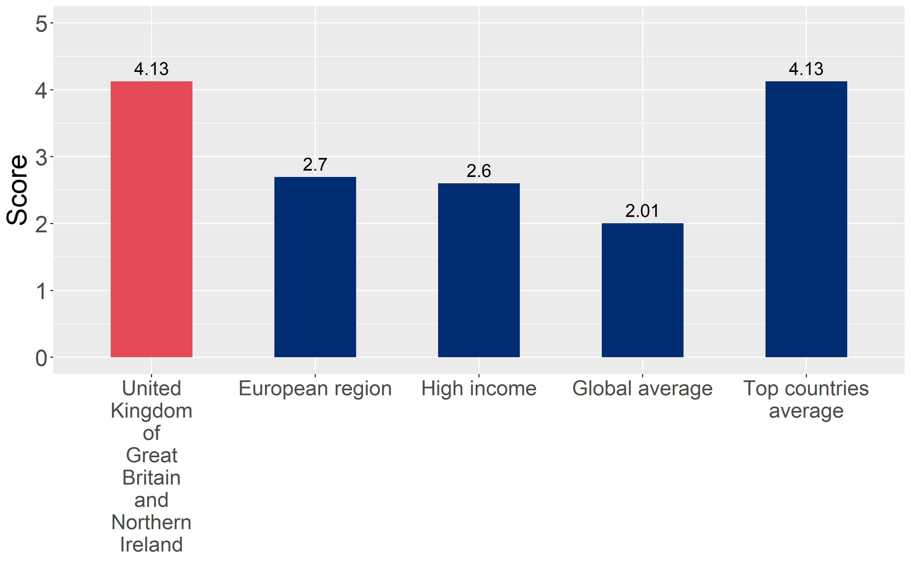
How does United Kingdom of Great Britain and Northern Ireland compare to other countries?
United Kingdom of Great Britain and Northern Ireland’s overall score in 2024 is compared to the average overall scores in its income group, region, the world, and top performers.

Slide 4
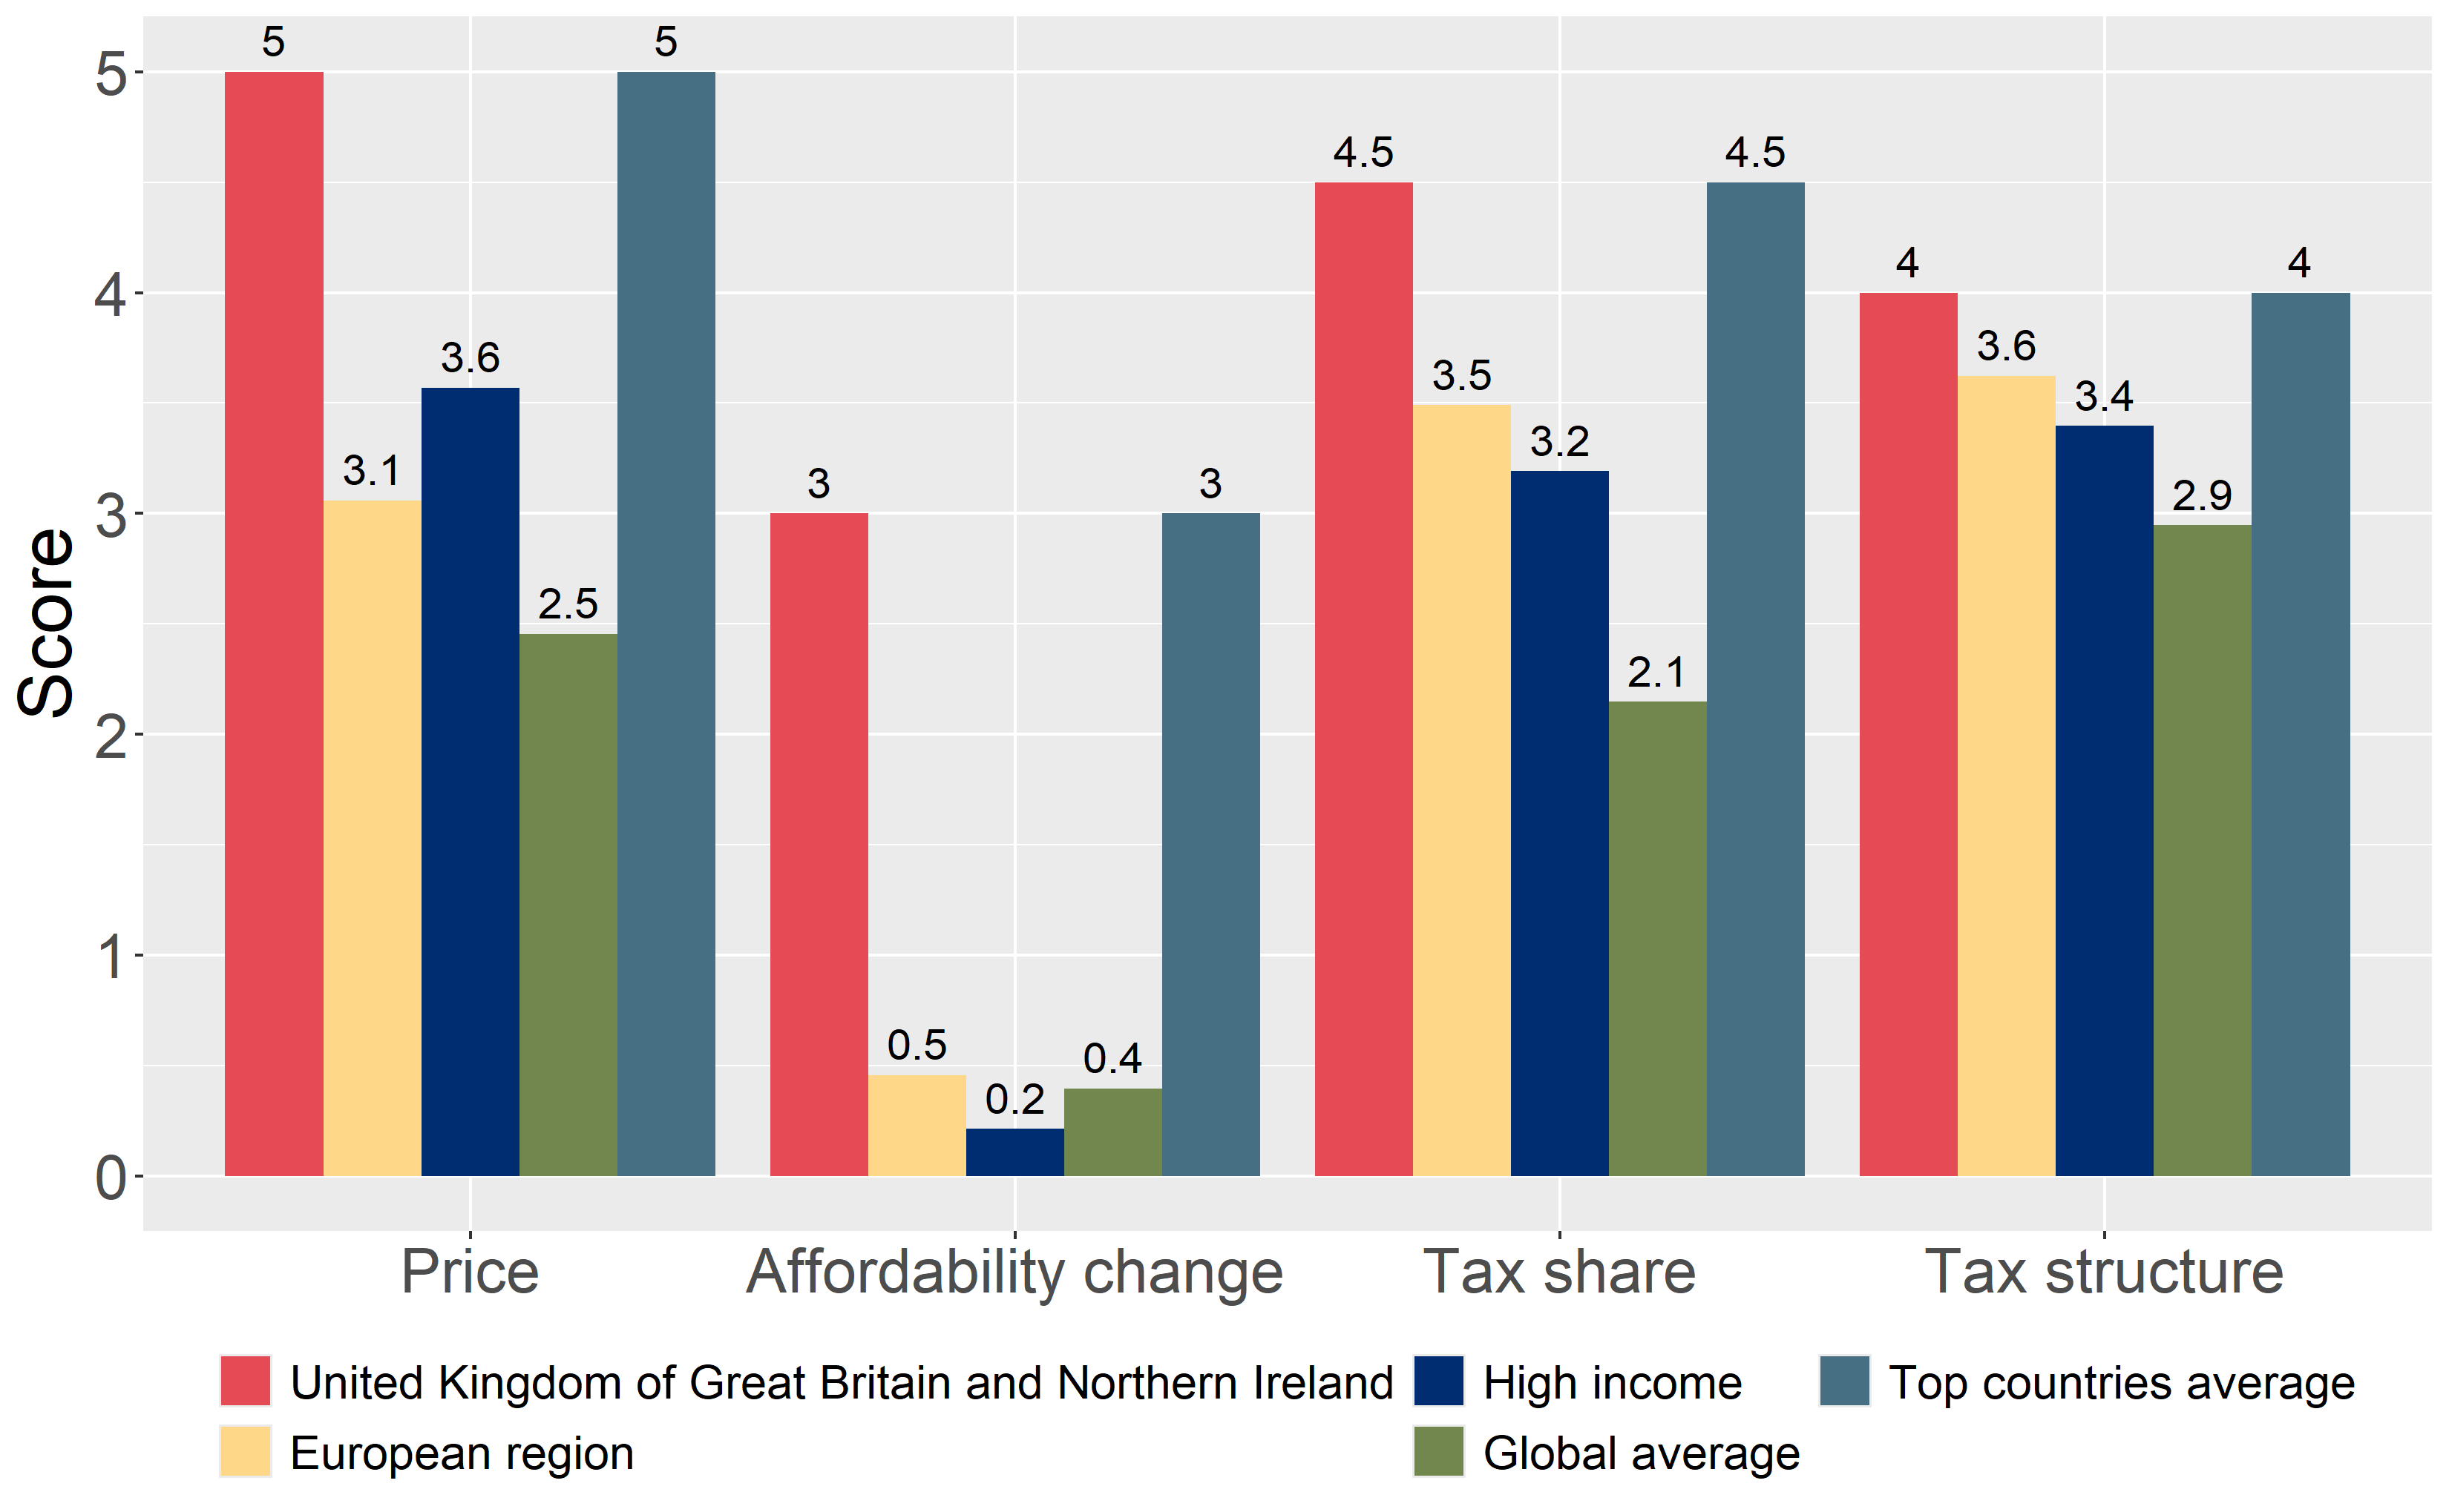
How does United Kingdom of Great Britain and Northern Ireland compare to other countries?
The components of United Kingdom of Great Britain and Northern Ireland’s score in 2024 are compared to component scores in the region, income group, world, and top performers.

Slide 5
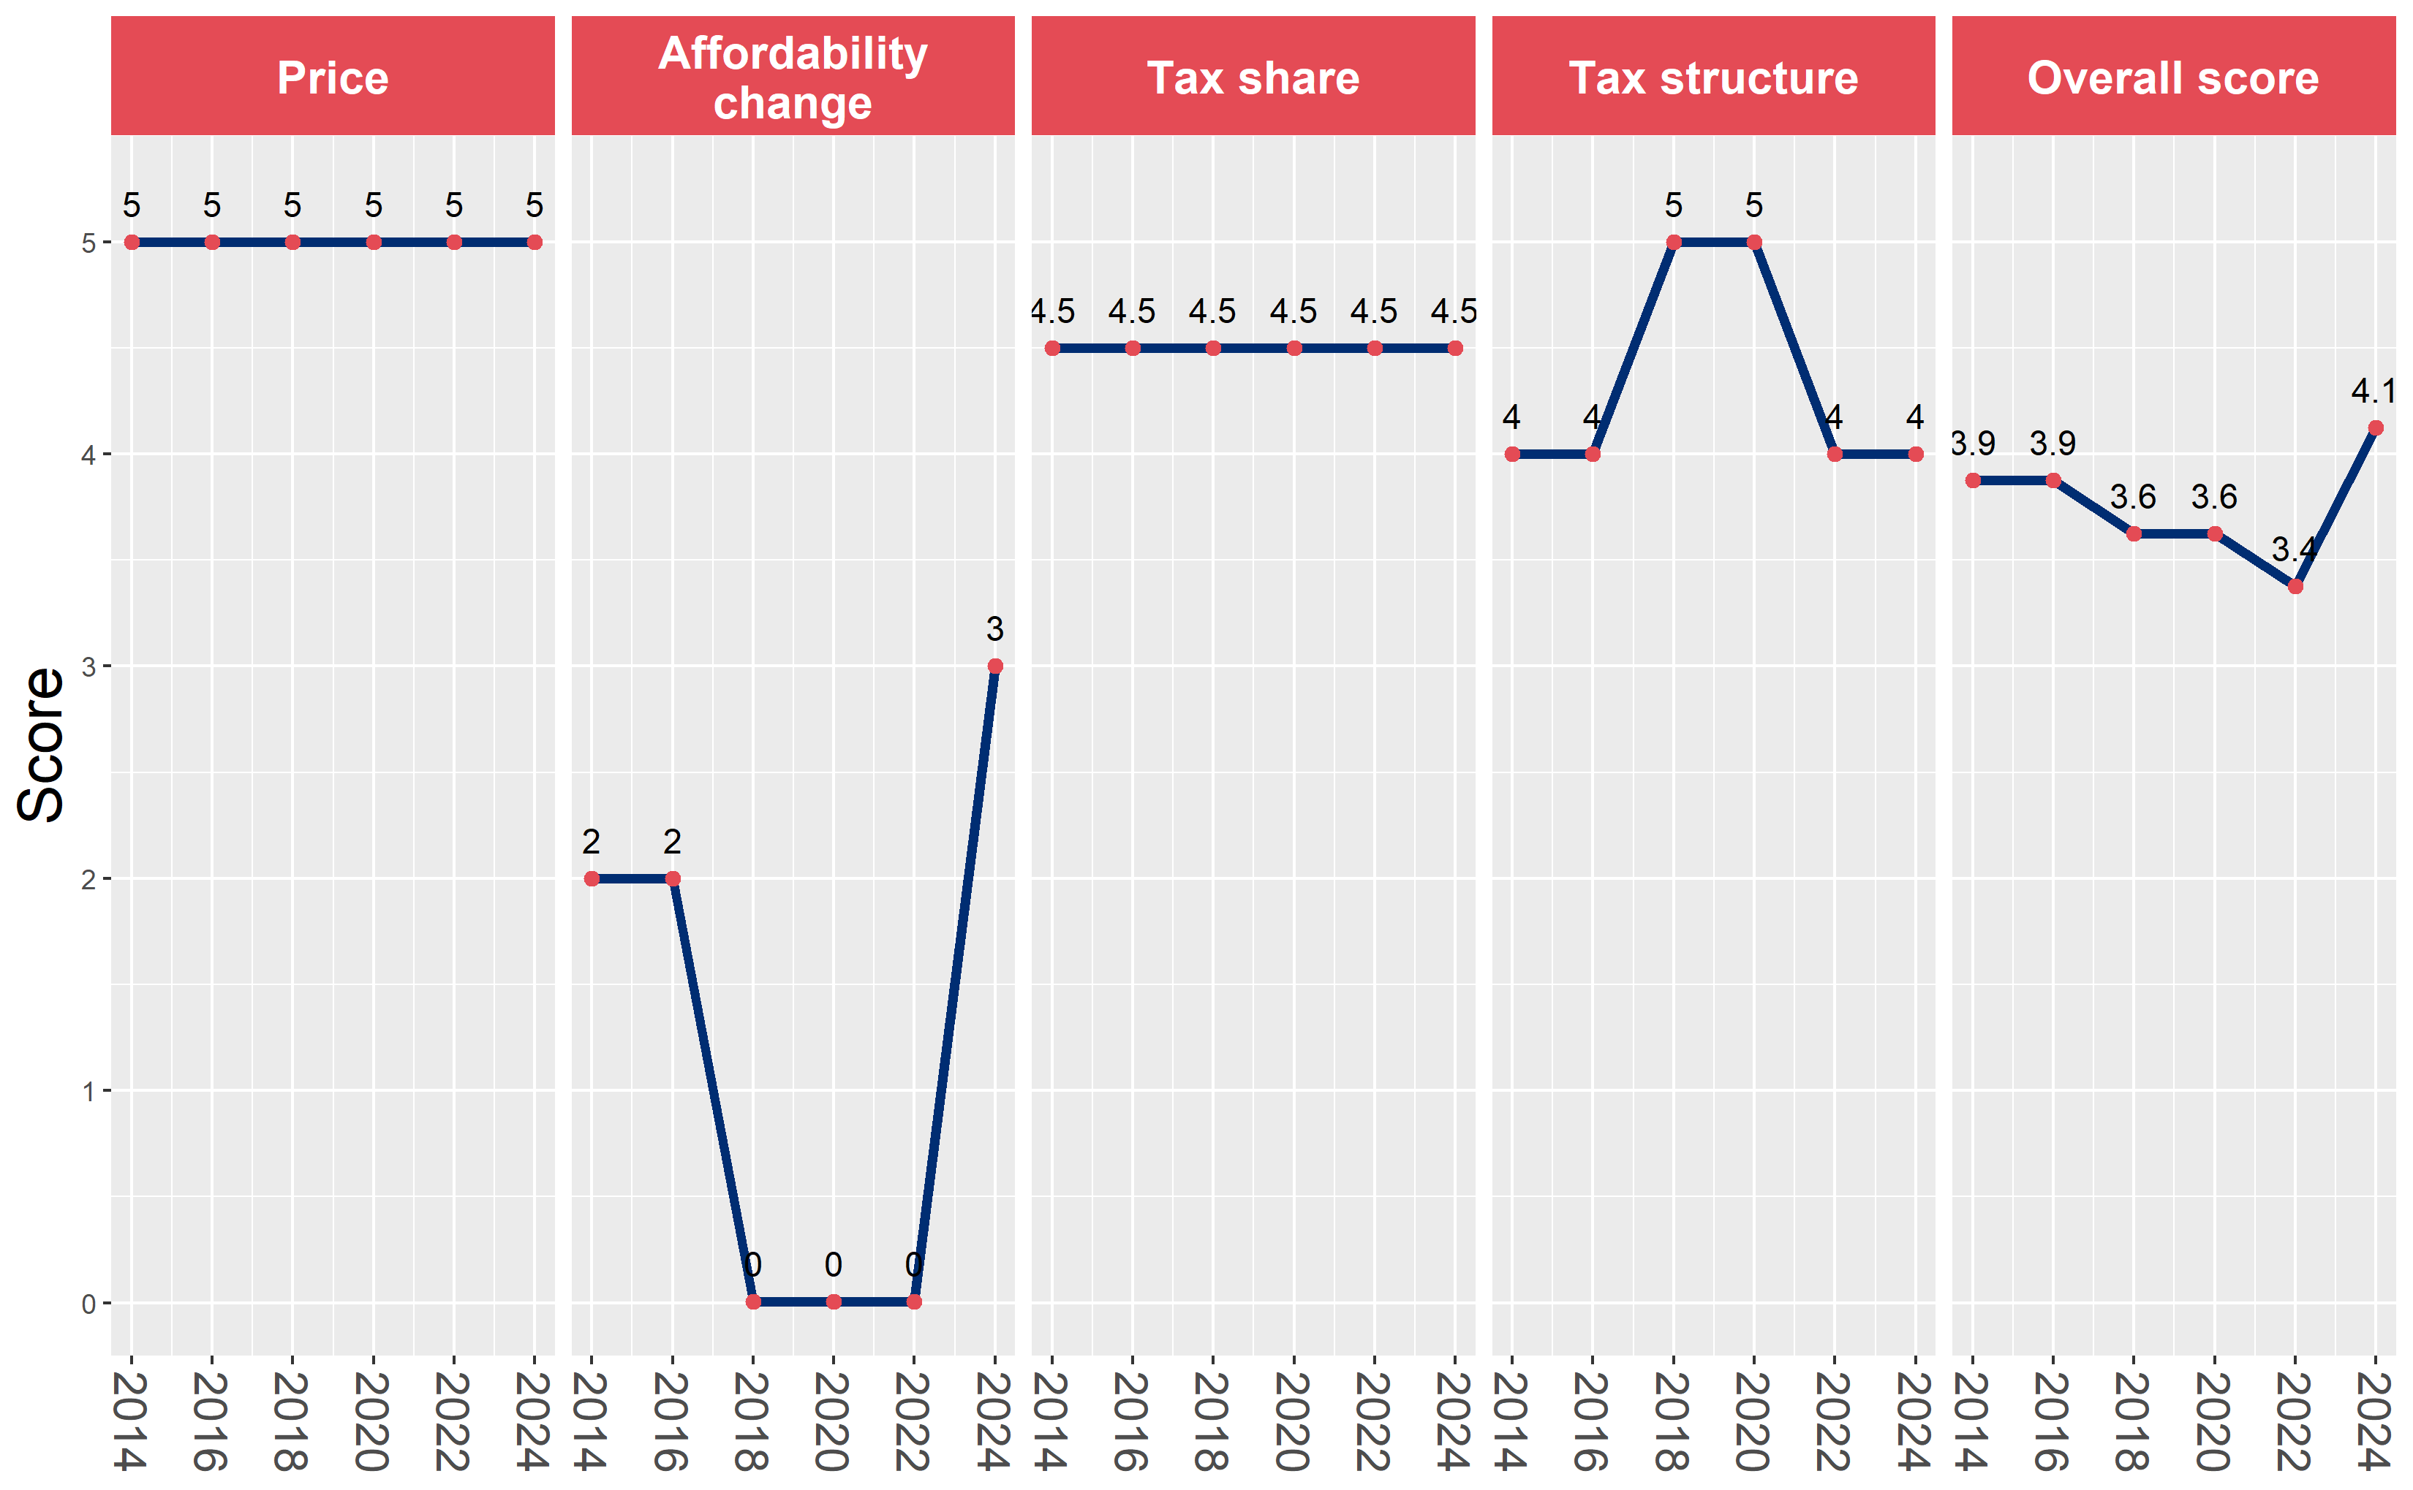
United Kingdom of Great Britain and Northern Ireland’s cigarette tax policies over time
United Kingdom of Great Britain and Northern Ireland’s overall and component scores are evaluated over a ten-year period, highlighting trends across all four Cigarette Tax Scorecard components.

