Slide 1
Scorecard presentation: Dominican Republic

Slide 2
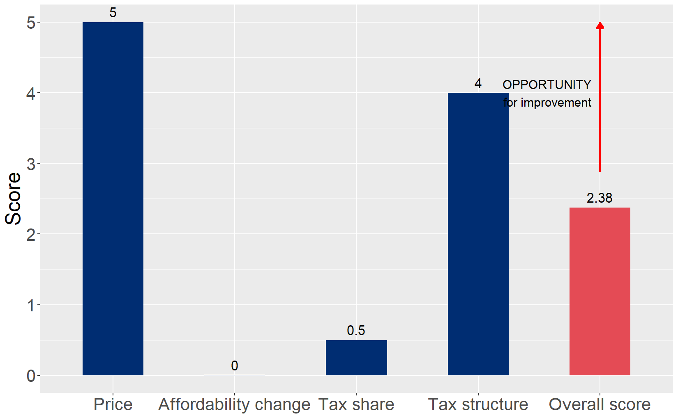
Cigarette tax policies in Dominican Republic, 2024
Four key tax components were assessed using a 5-point scale, with the overall score reflecting an average of Dominican Republic’s component scores. The score reflect the current strengths and opportunities in Dominican Republic to further increase tax revenue and improve health.

Slide 3
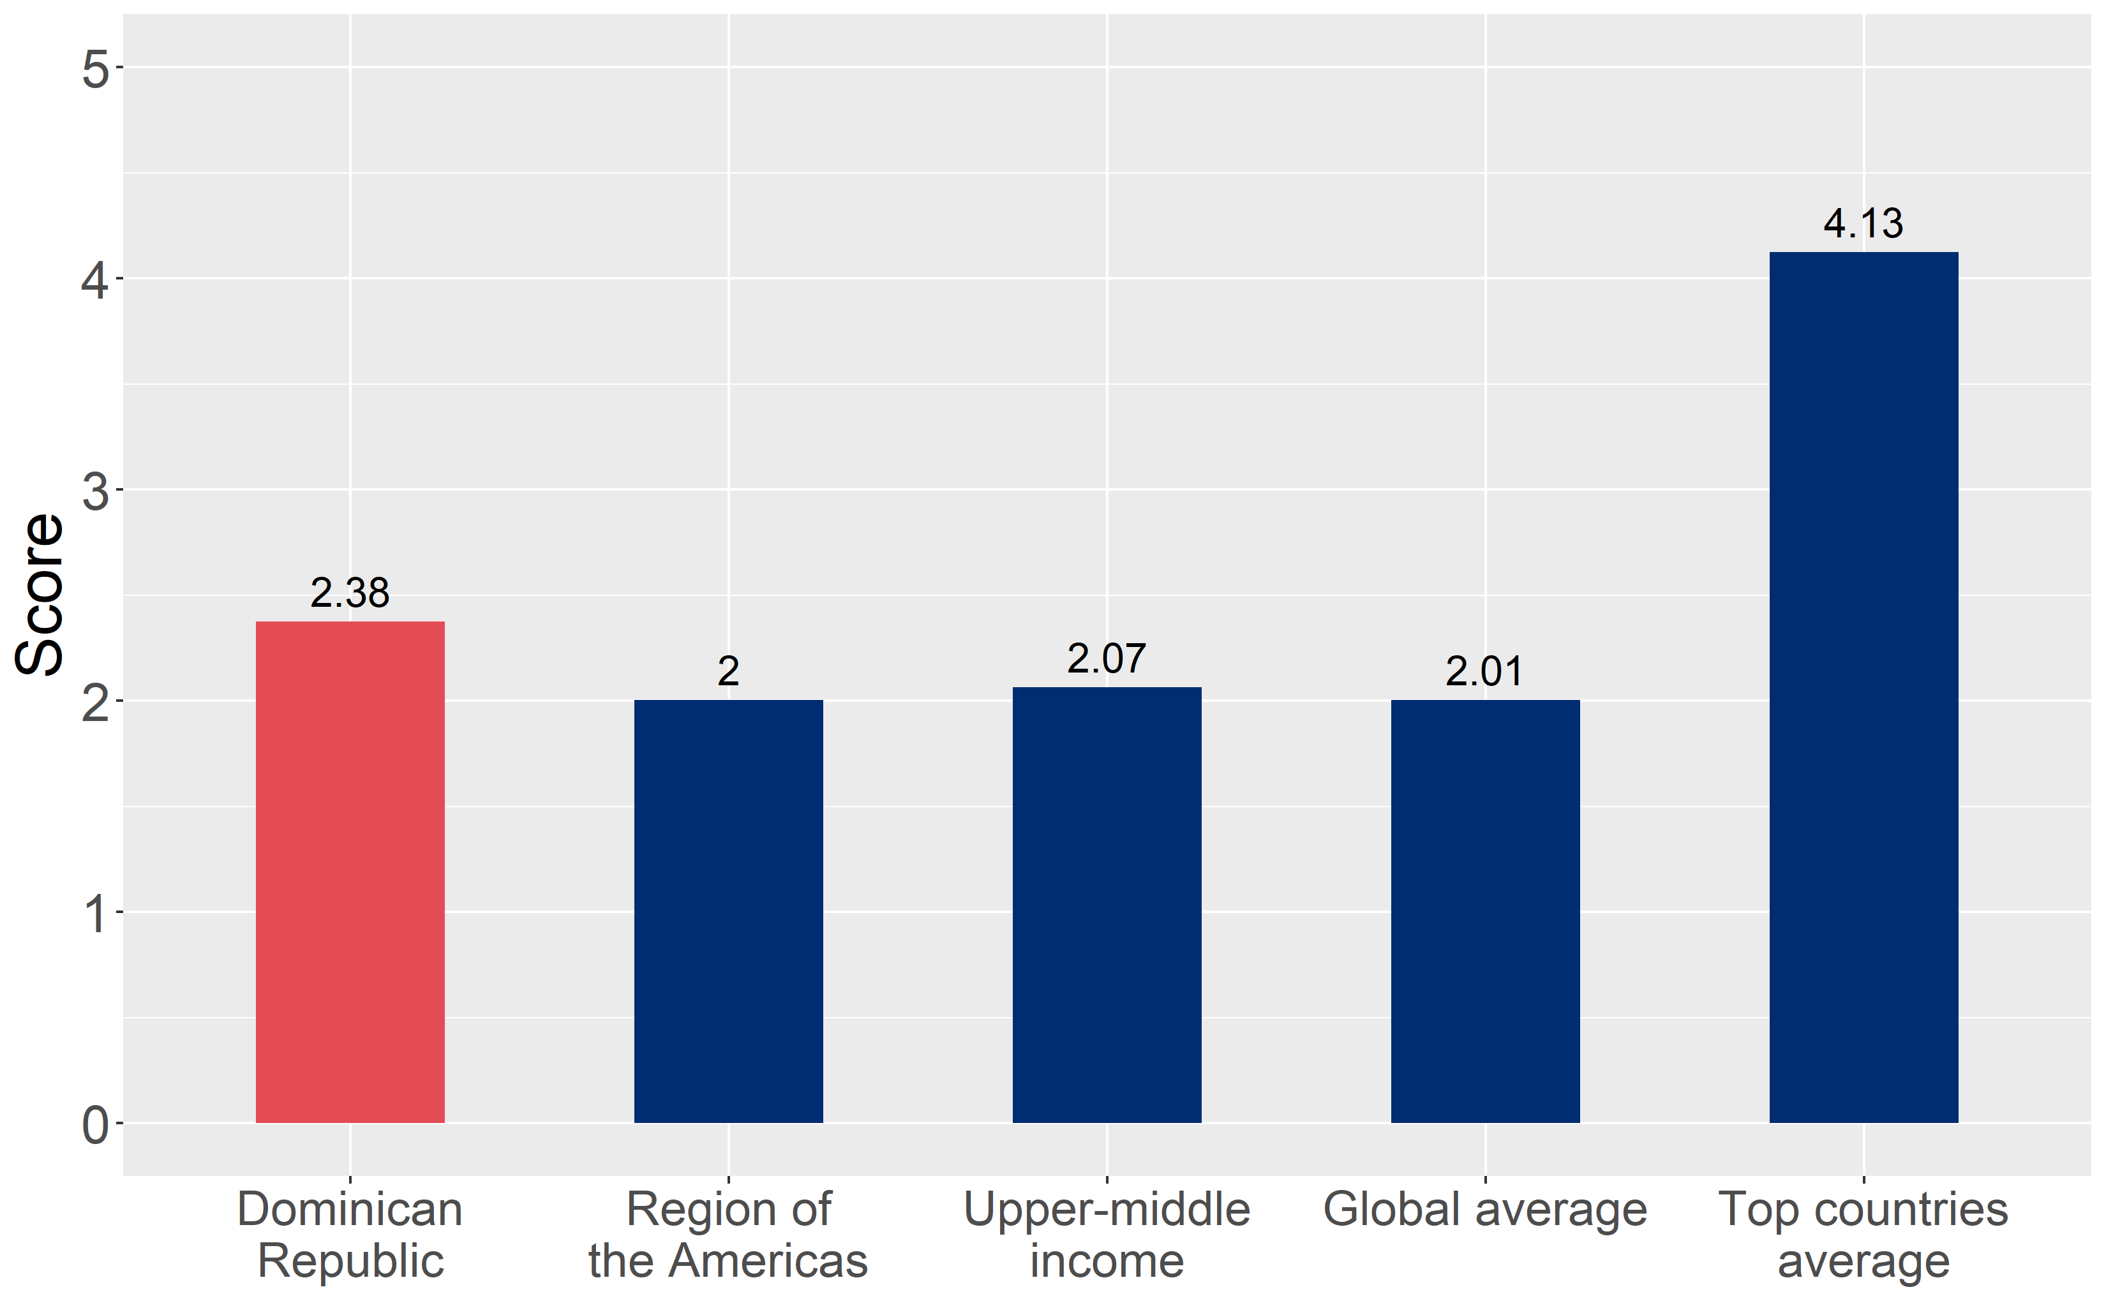
How does Dominican Republic compare to other countries?
Dominican Republic’s overall score in 2024 is compared to the average overall scores in its income group, region, the world, and top performers.

Slide 4
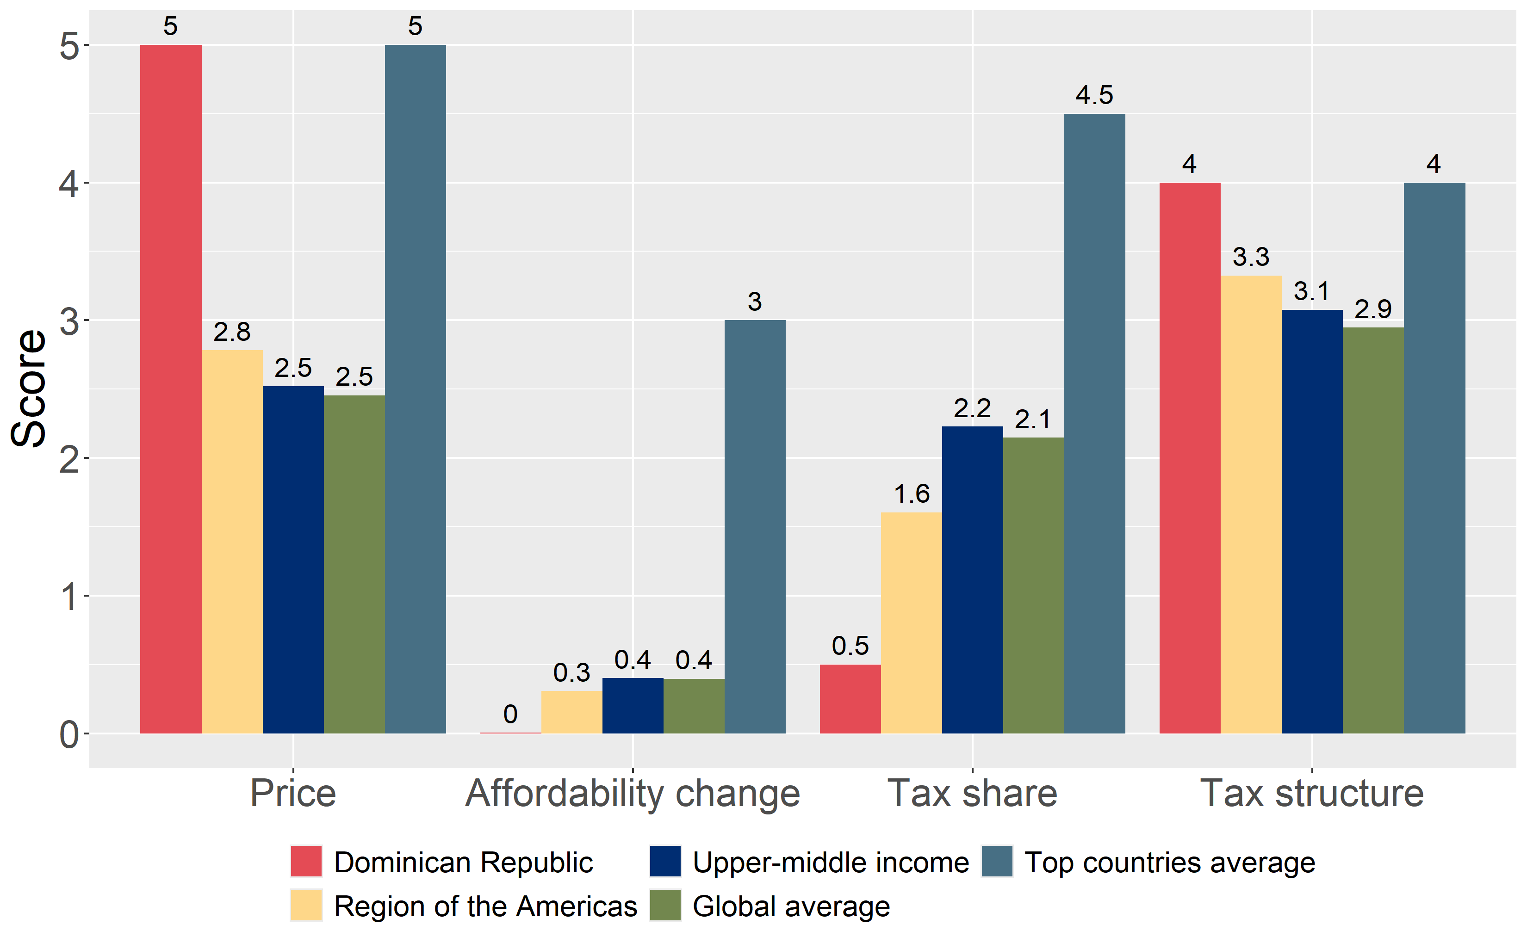
How does Dominican Republic compare to other countries?
The components of Dominican Republic’s score in 2024 are compared to component scores in the region, income group, world, and top performers.

Slide 5
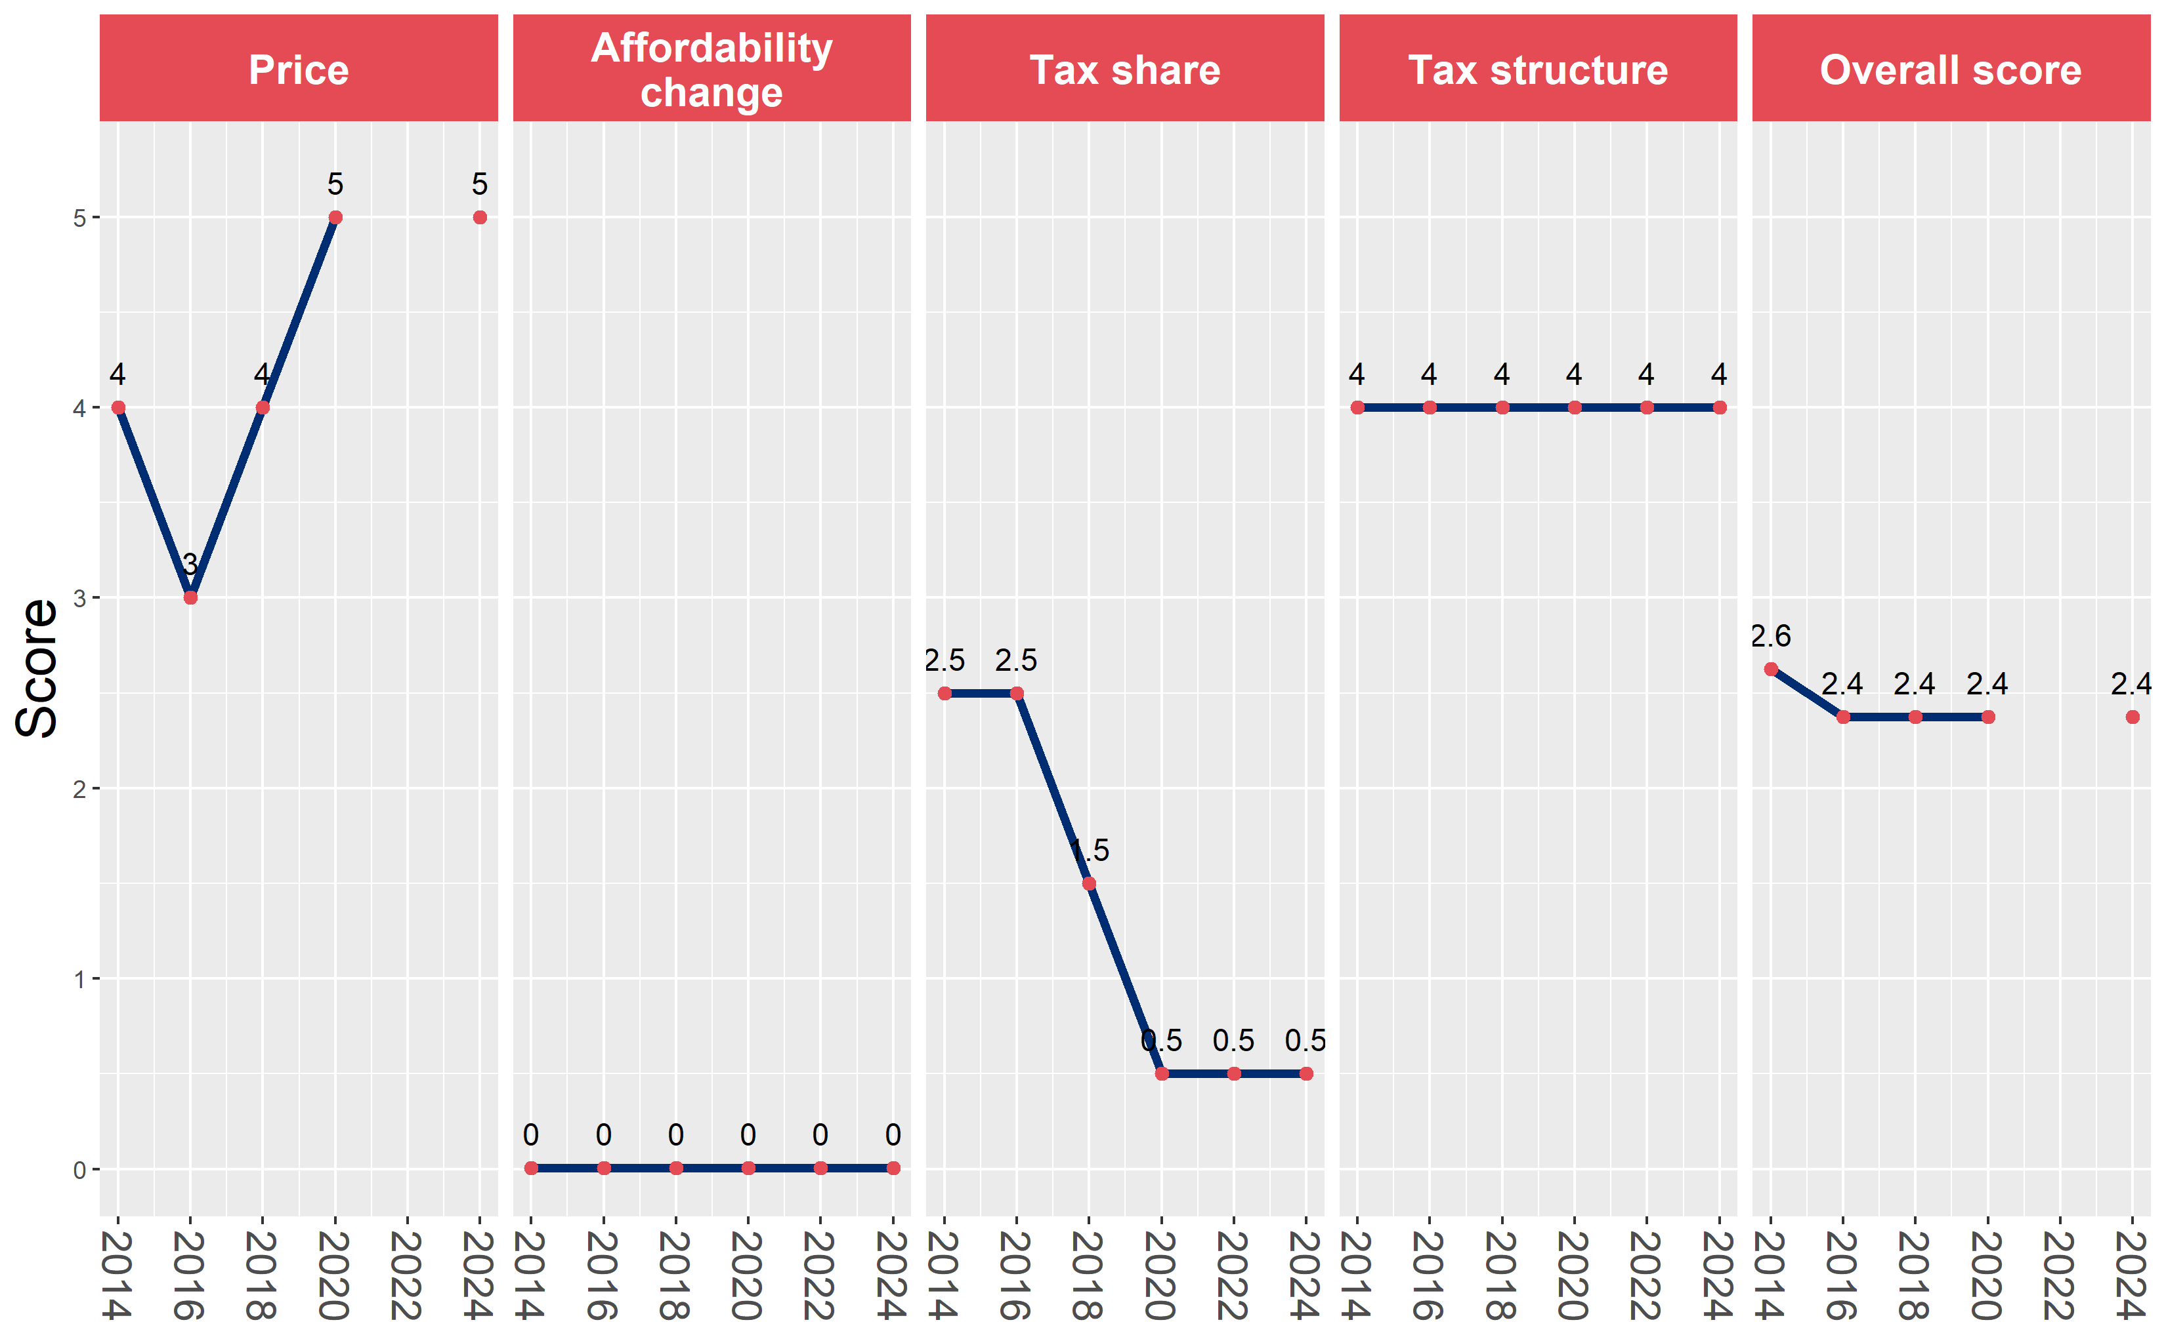
Dominican Republic’s cigarette tax policies over time
Dominican Republic’s overall and component scores are evaluated over a ten-year period, highlighting trends across all four Cigarette Tax Scorecard components.

