Slide 1
Scorecard presentation: Democratic Republic of the Congo

Slide 2
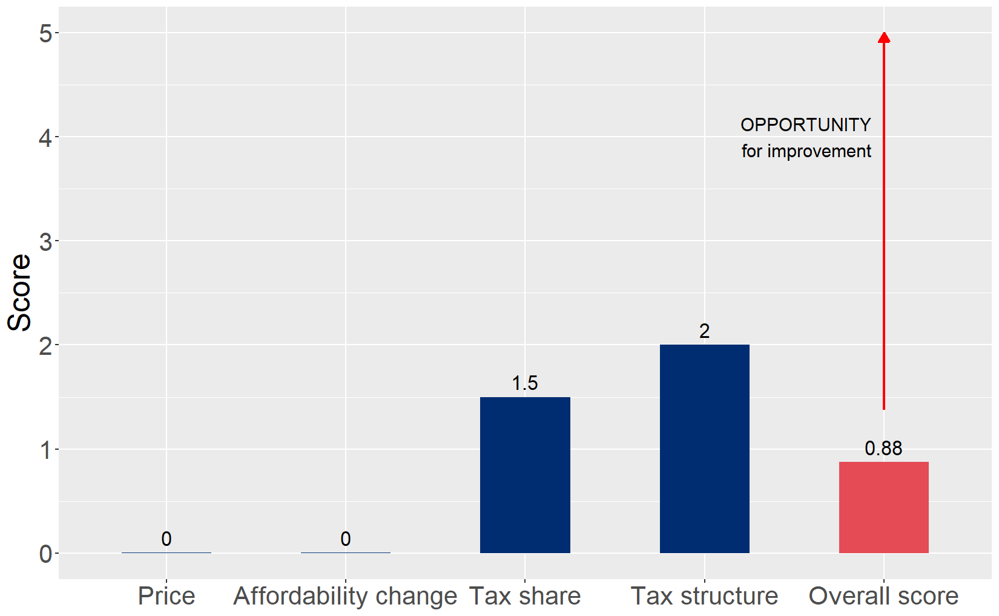
Cigarette tax policies in Democratic Republic of the Congo, 2024
Four key tax components were assessed using a 5-point scale, with the overall score reflecting an average of Democratic Republic of the Congo’s component scores. The score reflect the current strengths and opportunities in Democratic Republic of the Congo to further increase tax revenue and improve health.

Slide 3
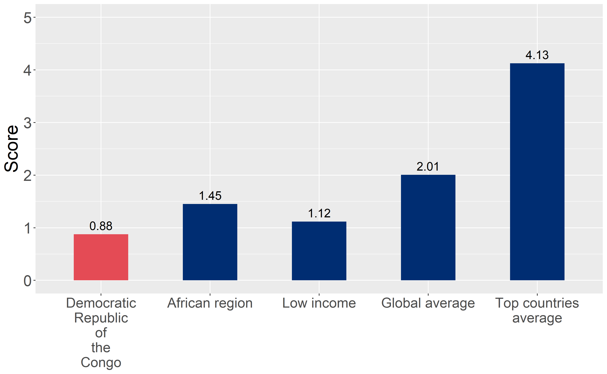
How does Democratic Republic of the Congo compare to other countries?
Democratic Republic of the Congo’s overall score in 2024 is compared to the average overall scores in its income group, region, the world, and top performers.

Slide 4
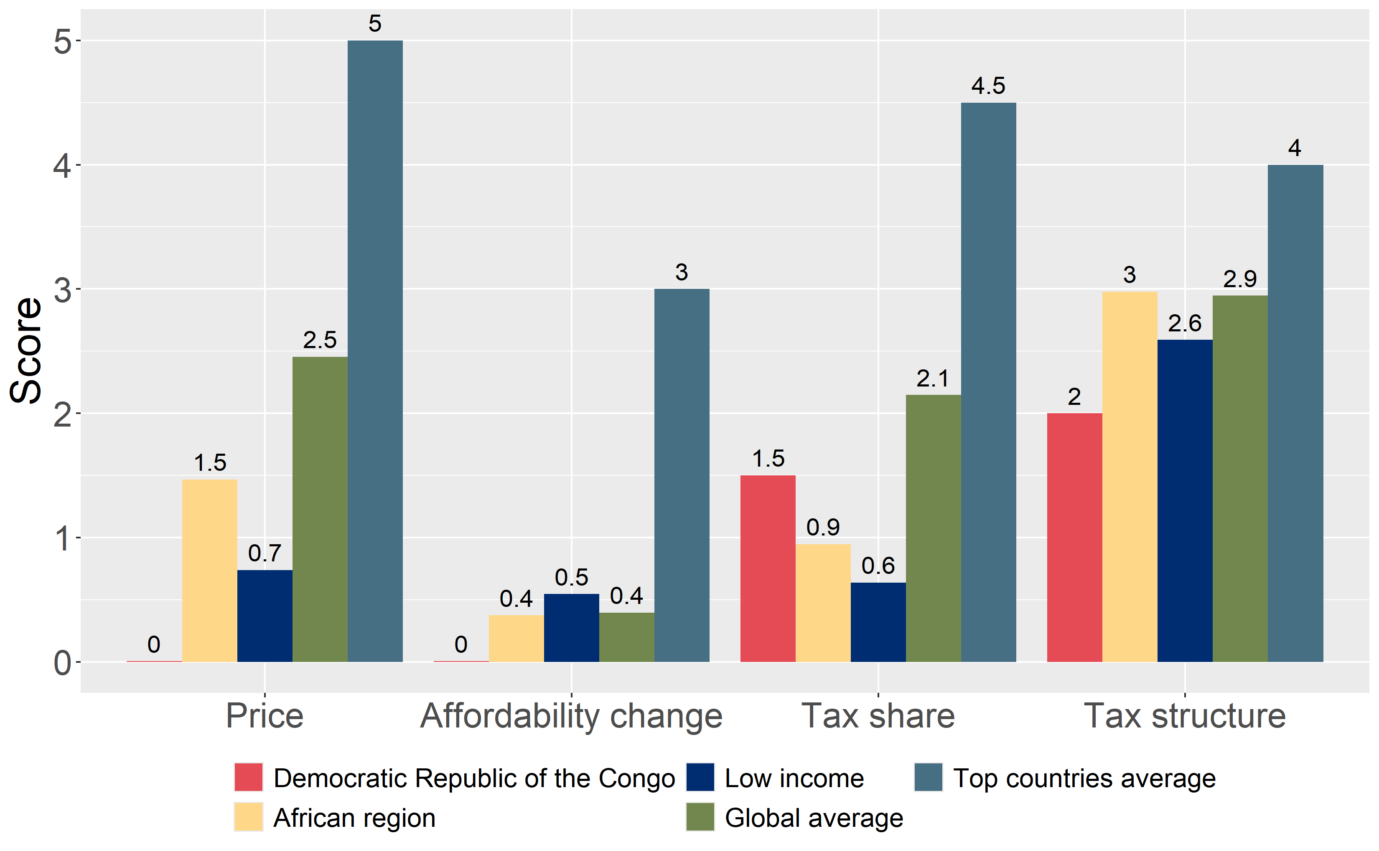
How does Democratic Republic of the Congo compare to other countries?
The components of Democratic Republic of the Congo’s score in 2024 are compared to component scores in the region, income group, world, and top performers.

Slide 5
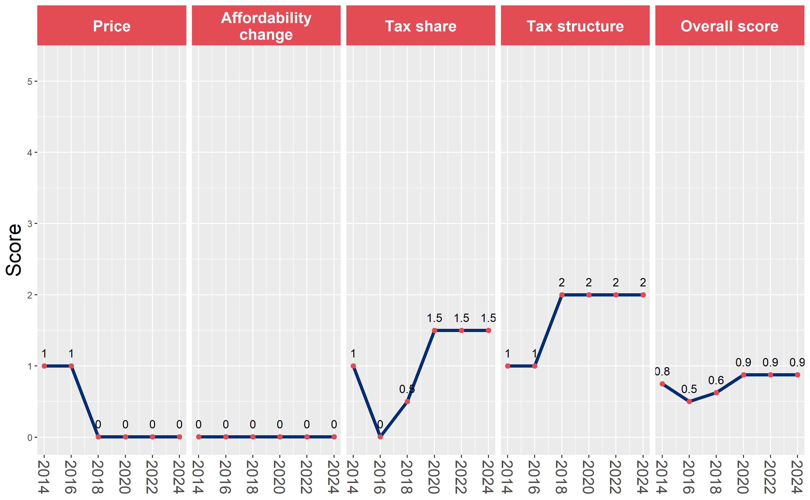
Democratic Republic of the Congo’s cigarette tax policies over time
Democratic Republic of the Congo’s overall and component scores are evaluated over a ten-year period, highlighting trends across all four Cigarette Tax Scorecard components.

