Slide 1
Scorecard presentation: Burkina Faso

Slide 2
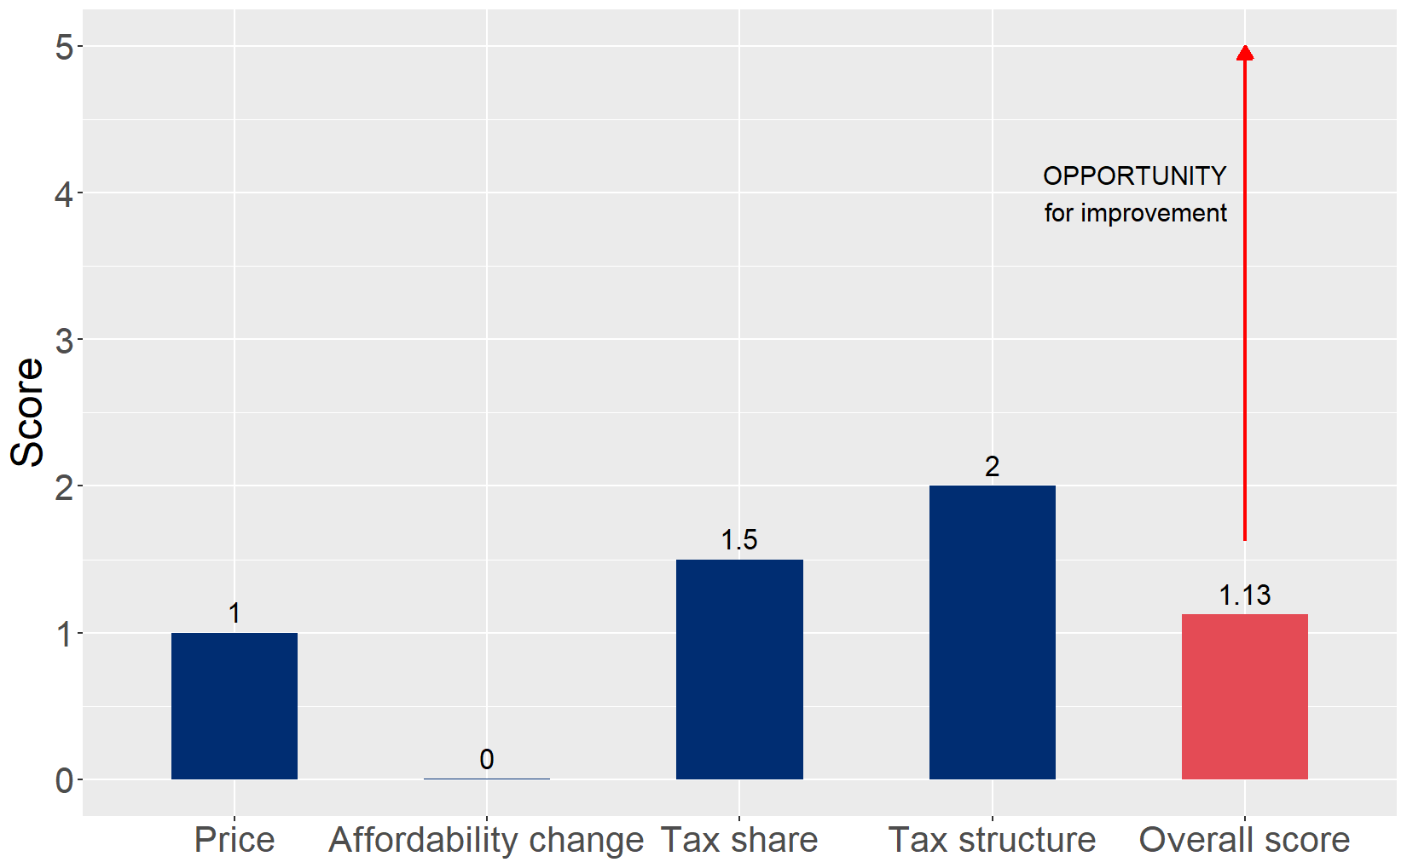
Cigarette tax policies in Burkina Faso, 2024
Four key tax components were assessed using a 5-point scale, with the overall score reflecting an average of Burkina Faso’s component scores. The score reflect the current strengths and opportunities in Burkina Faso to further increase tax revenue and improve health.

Slide 3
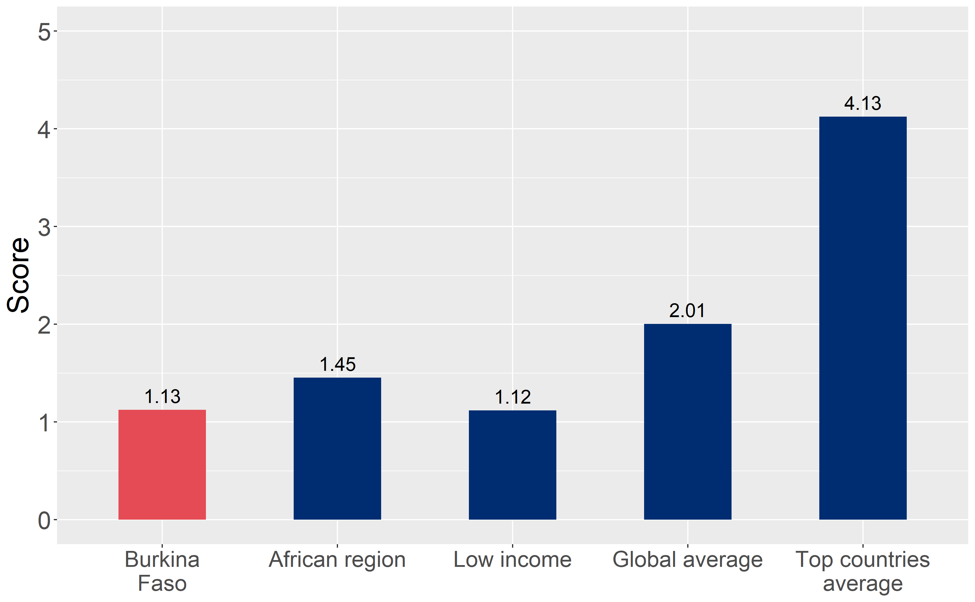
How does Burkina Faso compare to other countries?
Burkina Faso’s overall score in 2024 is compared to the average overall scores in its income group, region, the world, and top performers.

Slide 4
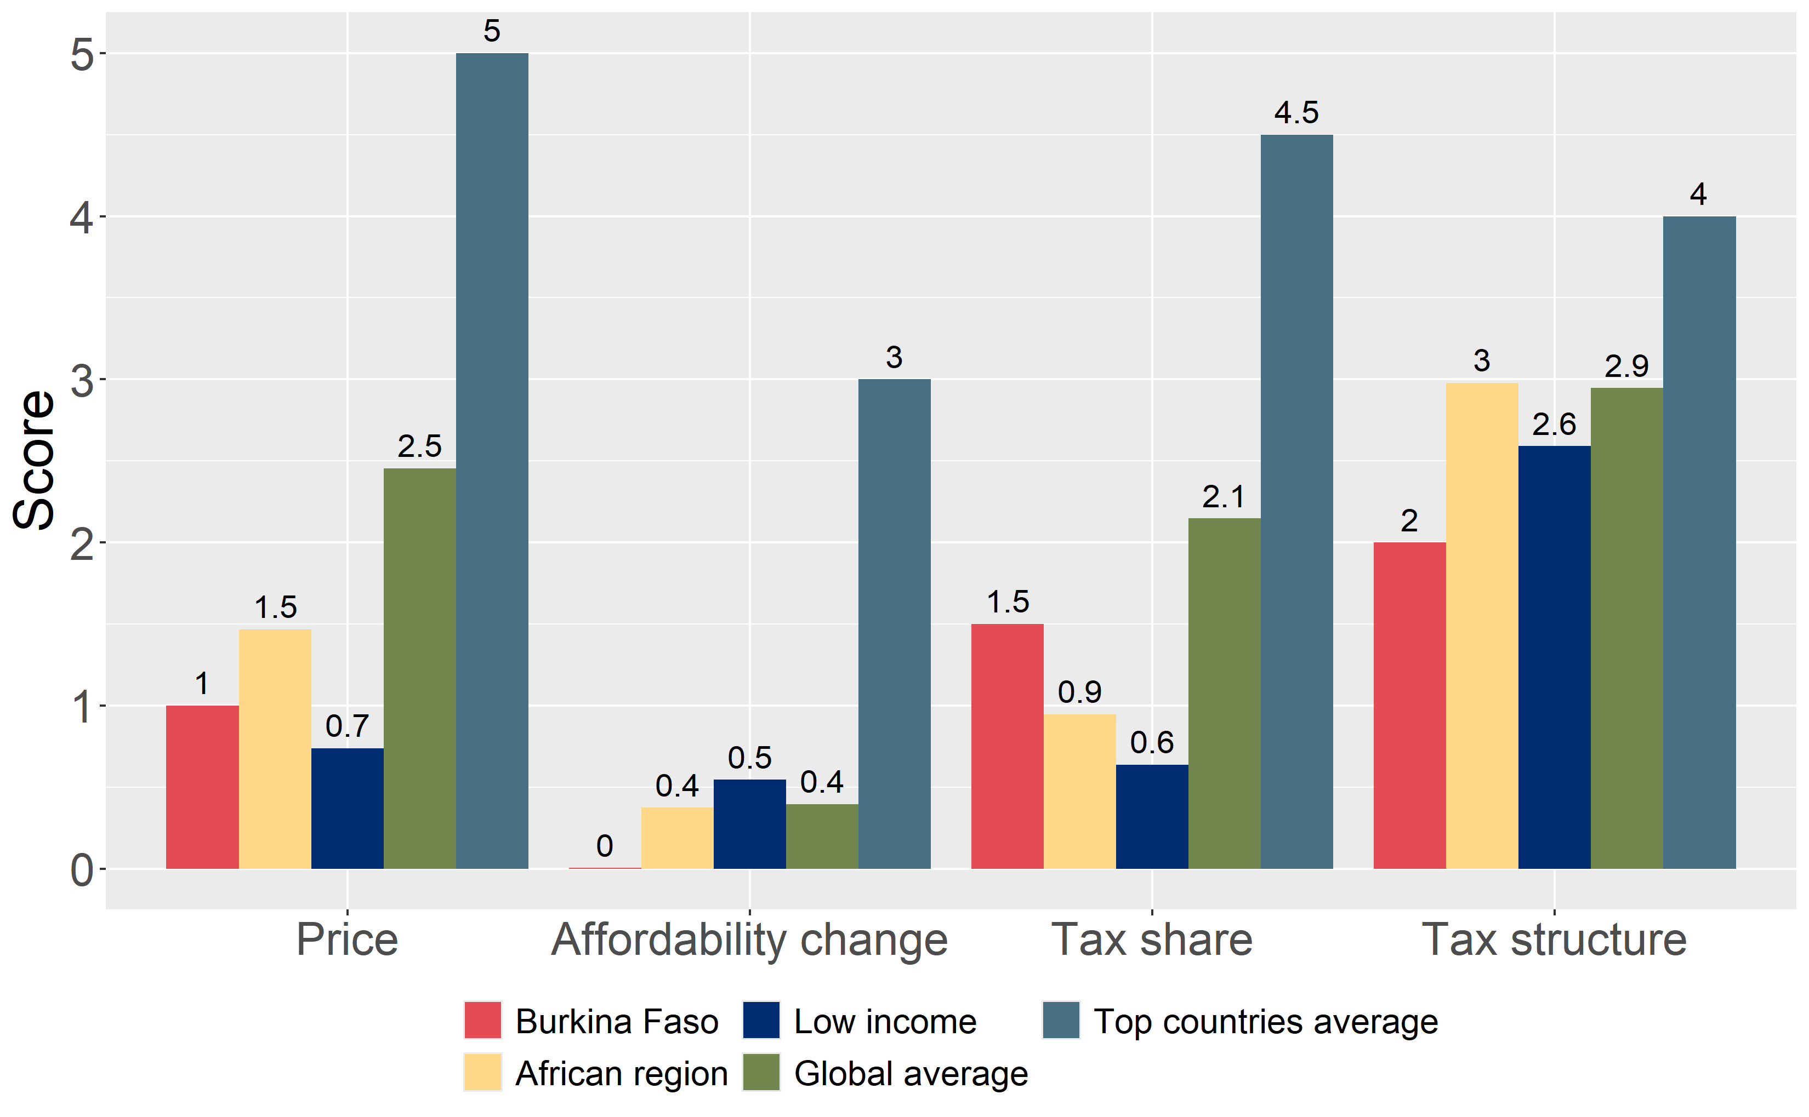
How does Burkina Faso compare to other countries?
The components of Burkina Faso’s score in 2024 are compared to component scores in the region, income group, world, and top performers.

Slide 5
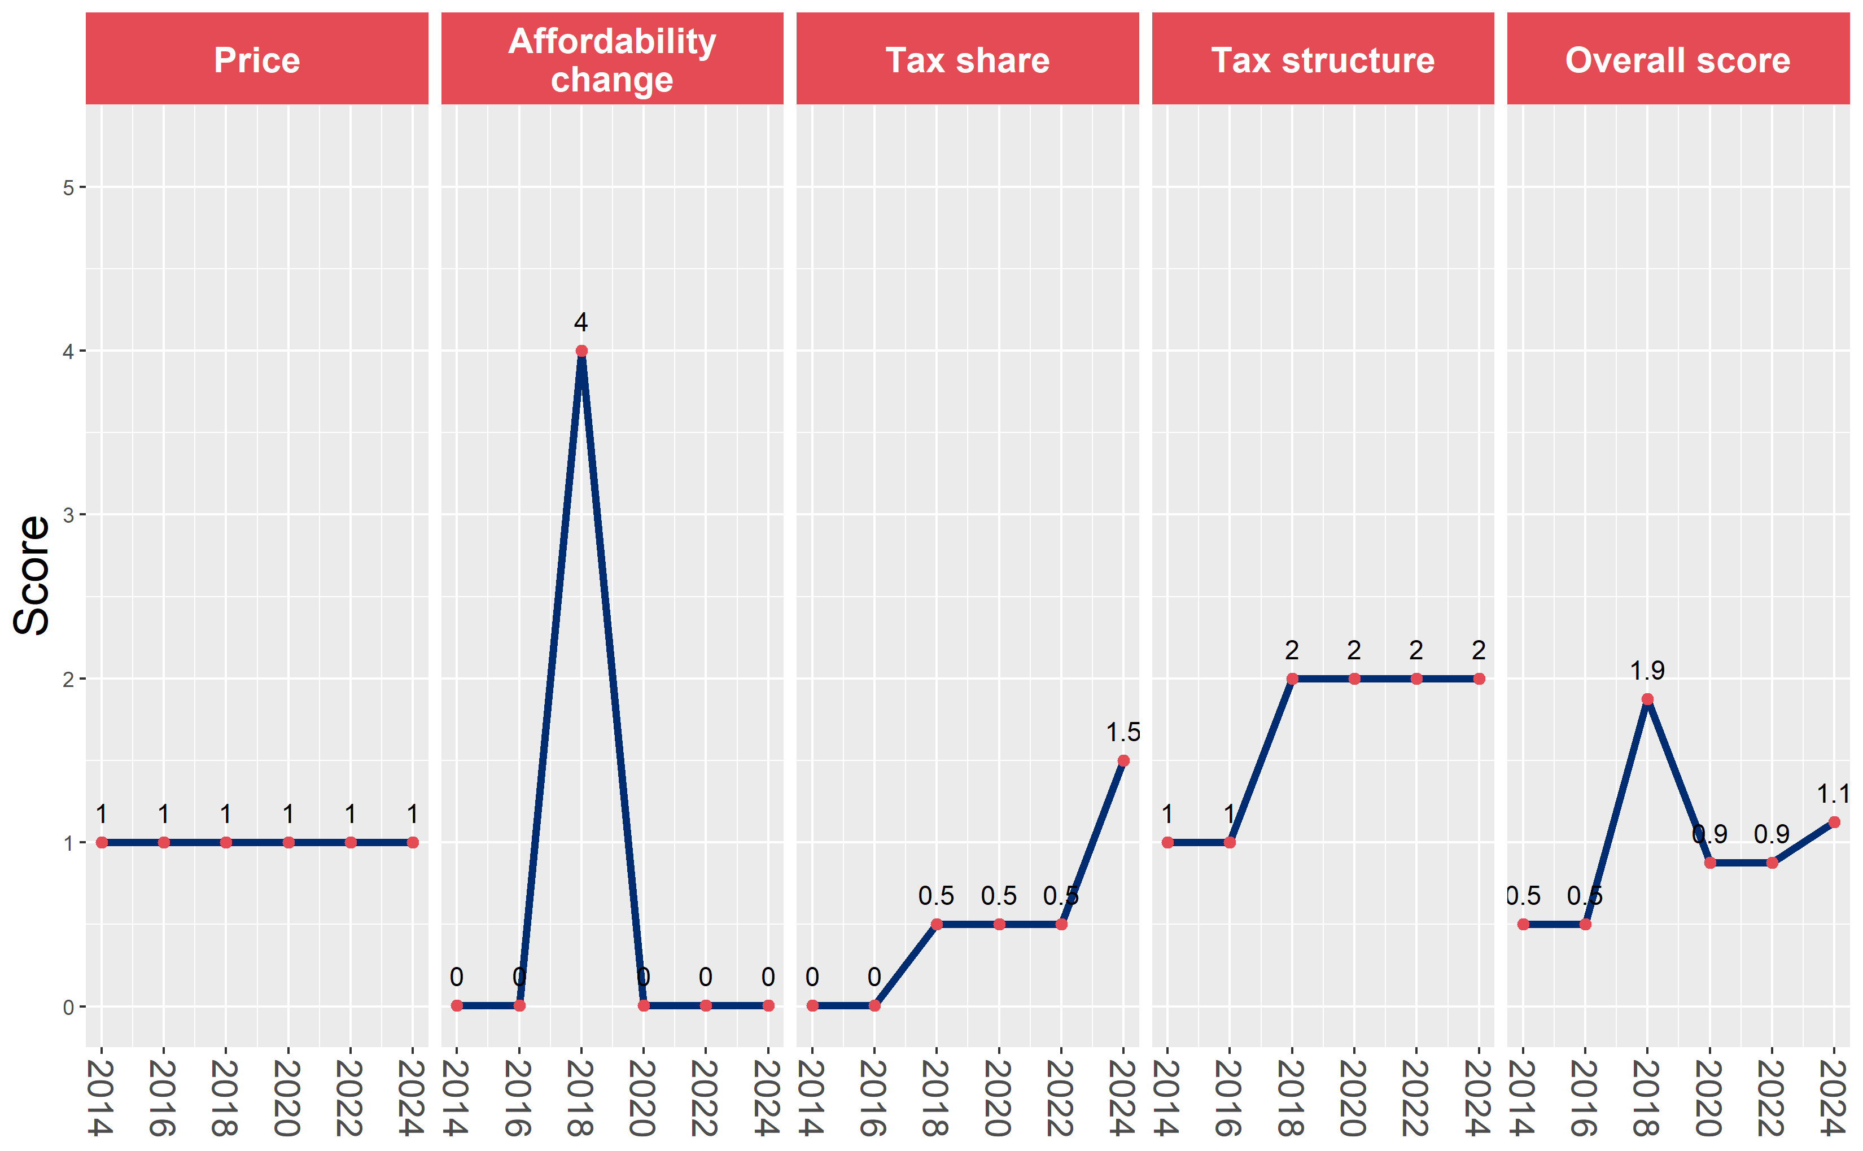
Burkina Faso’s cigarette tax policies over time
Burkina Faso’s overall and component scores are evaluated over a ten-year period, highlighting trends across all four Cigarette Tax Scorecard components.

