Slide 1
Scorecard presentation: Bosnia and Herzegovina

Slide 2
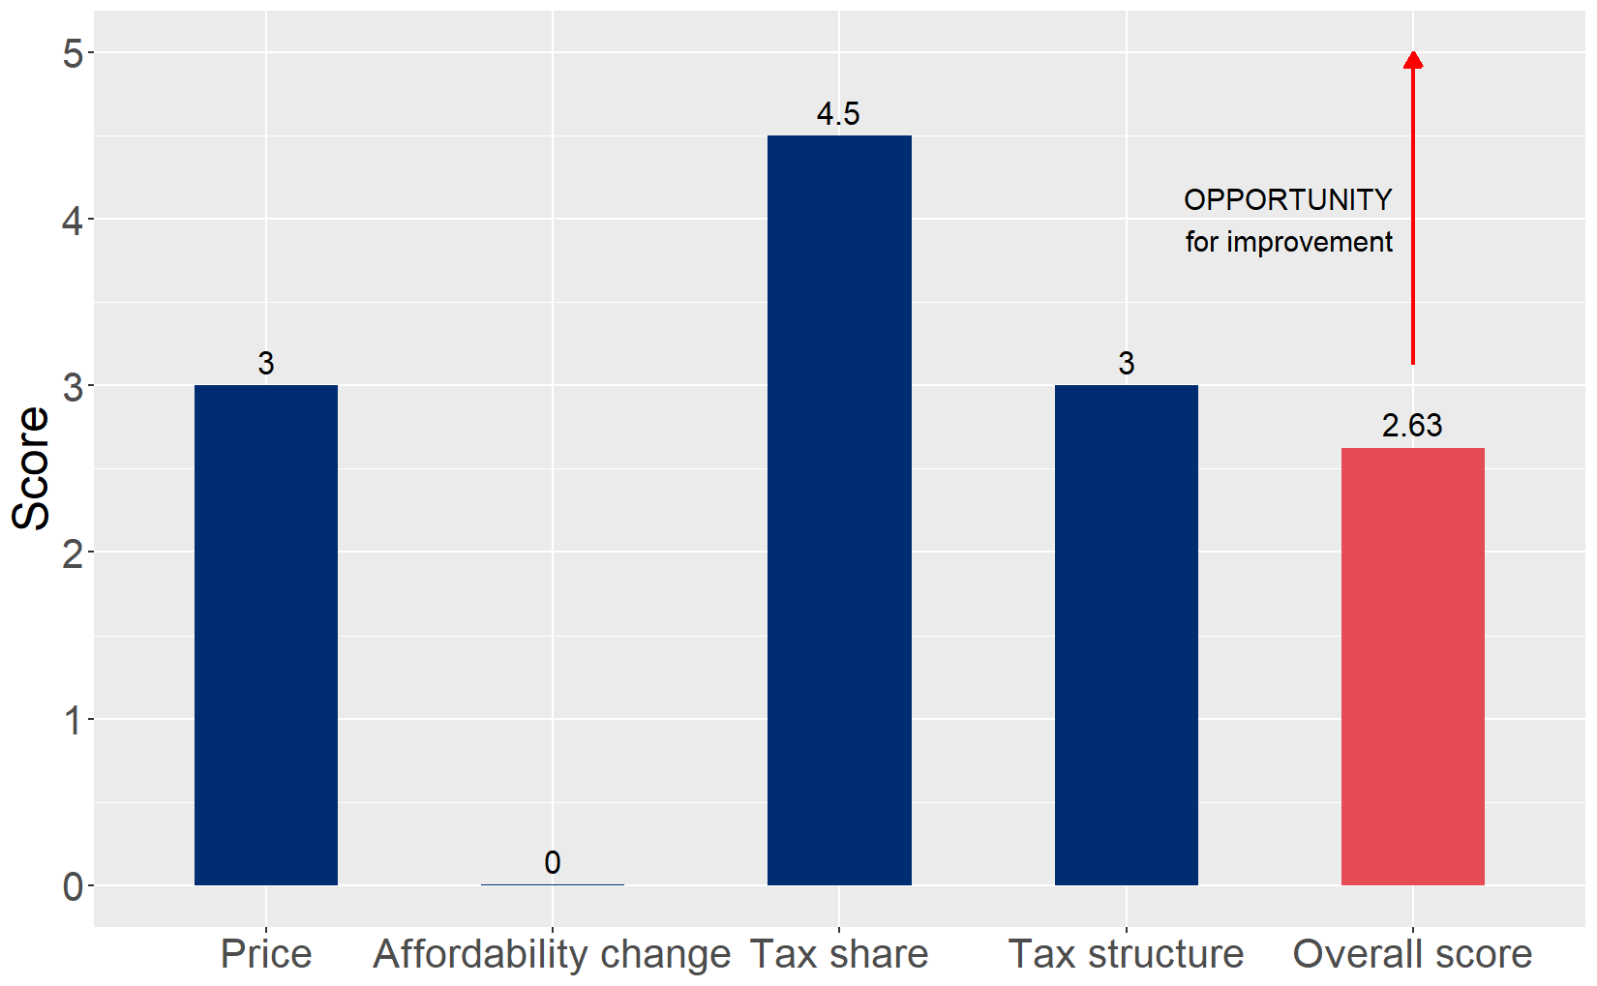
Cigarette tax policies in Bosnia and Herzegovina, 2024
Four key tax components were assessed using a 5-point scale, with the overall score reflecting an average of Bosnia and Herzegovina’s component scores. The score reflect the current strengths and opportunities in Bosnia and Herzegovina to further increase tax revenue and improve health.

Slide 3
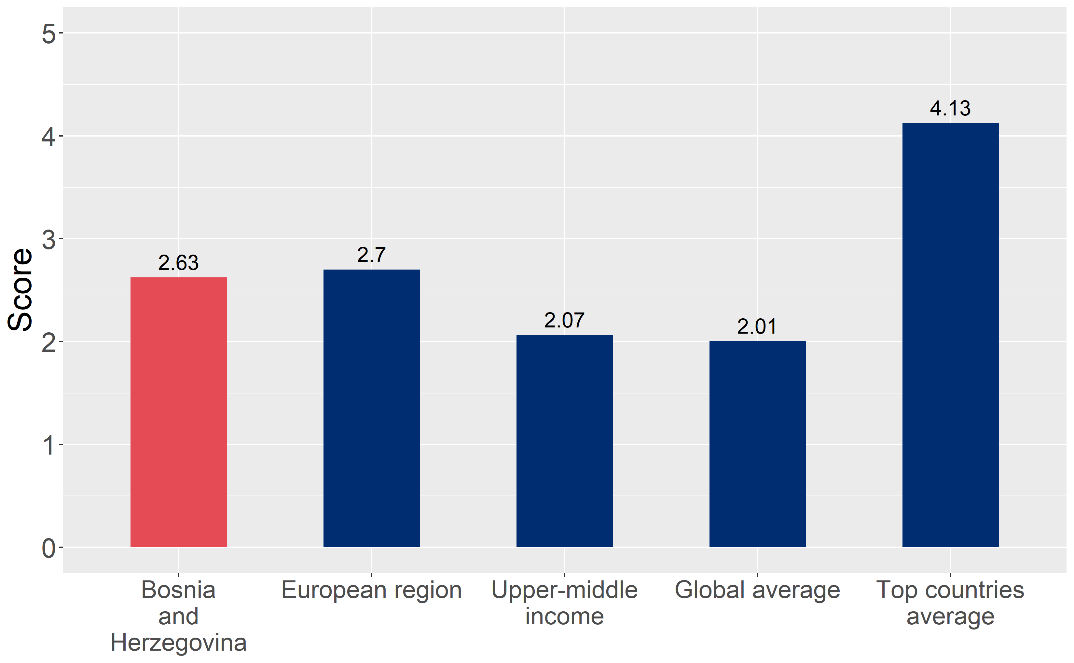
How does Bosnia and Herzegovina compare to other countries?
Bosnia and Herzegovina’s overall score in 2024 is compared to the average overall scores in its income group, region, the world, and top performers.

Slide 4
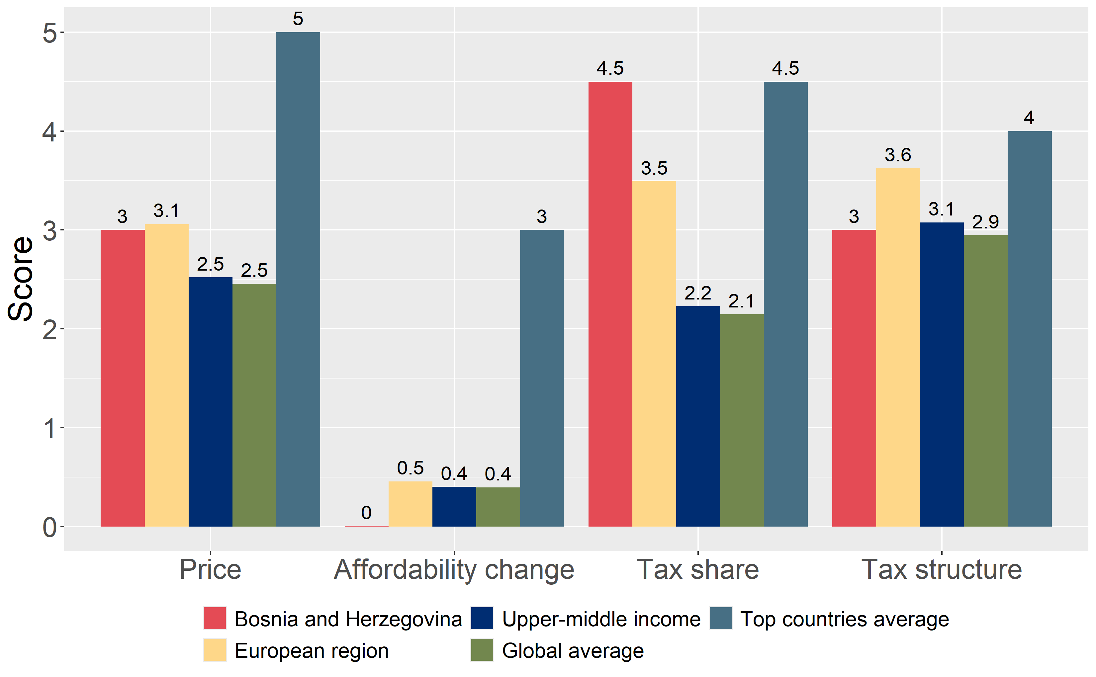
How does Bosnia and Herzegovina compare to other countries?
The components of Bosnia and Herzegovina’s score in 2024 are compared to component scores in the region, income group, world, and top performers.

Slide 5
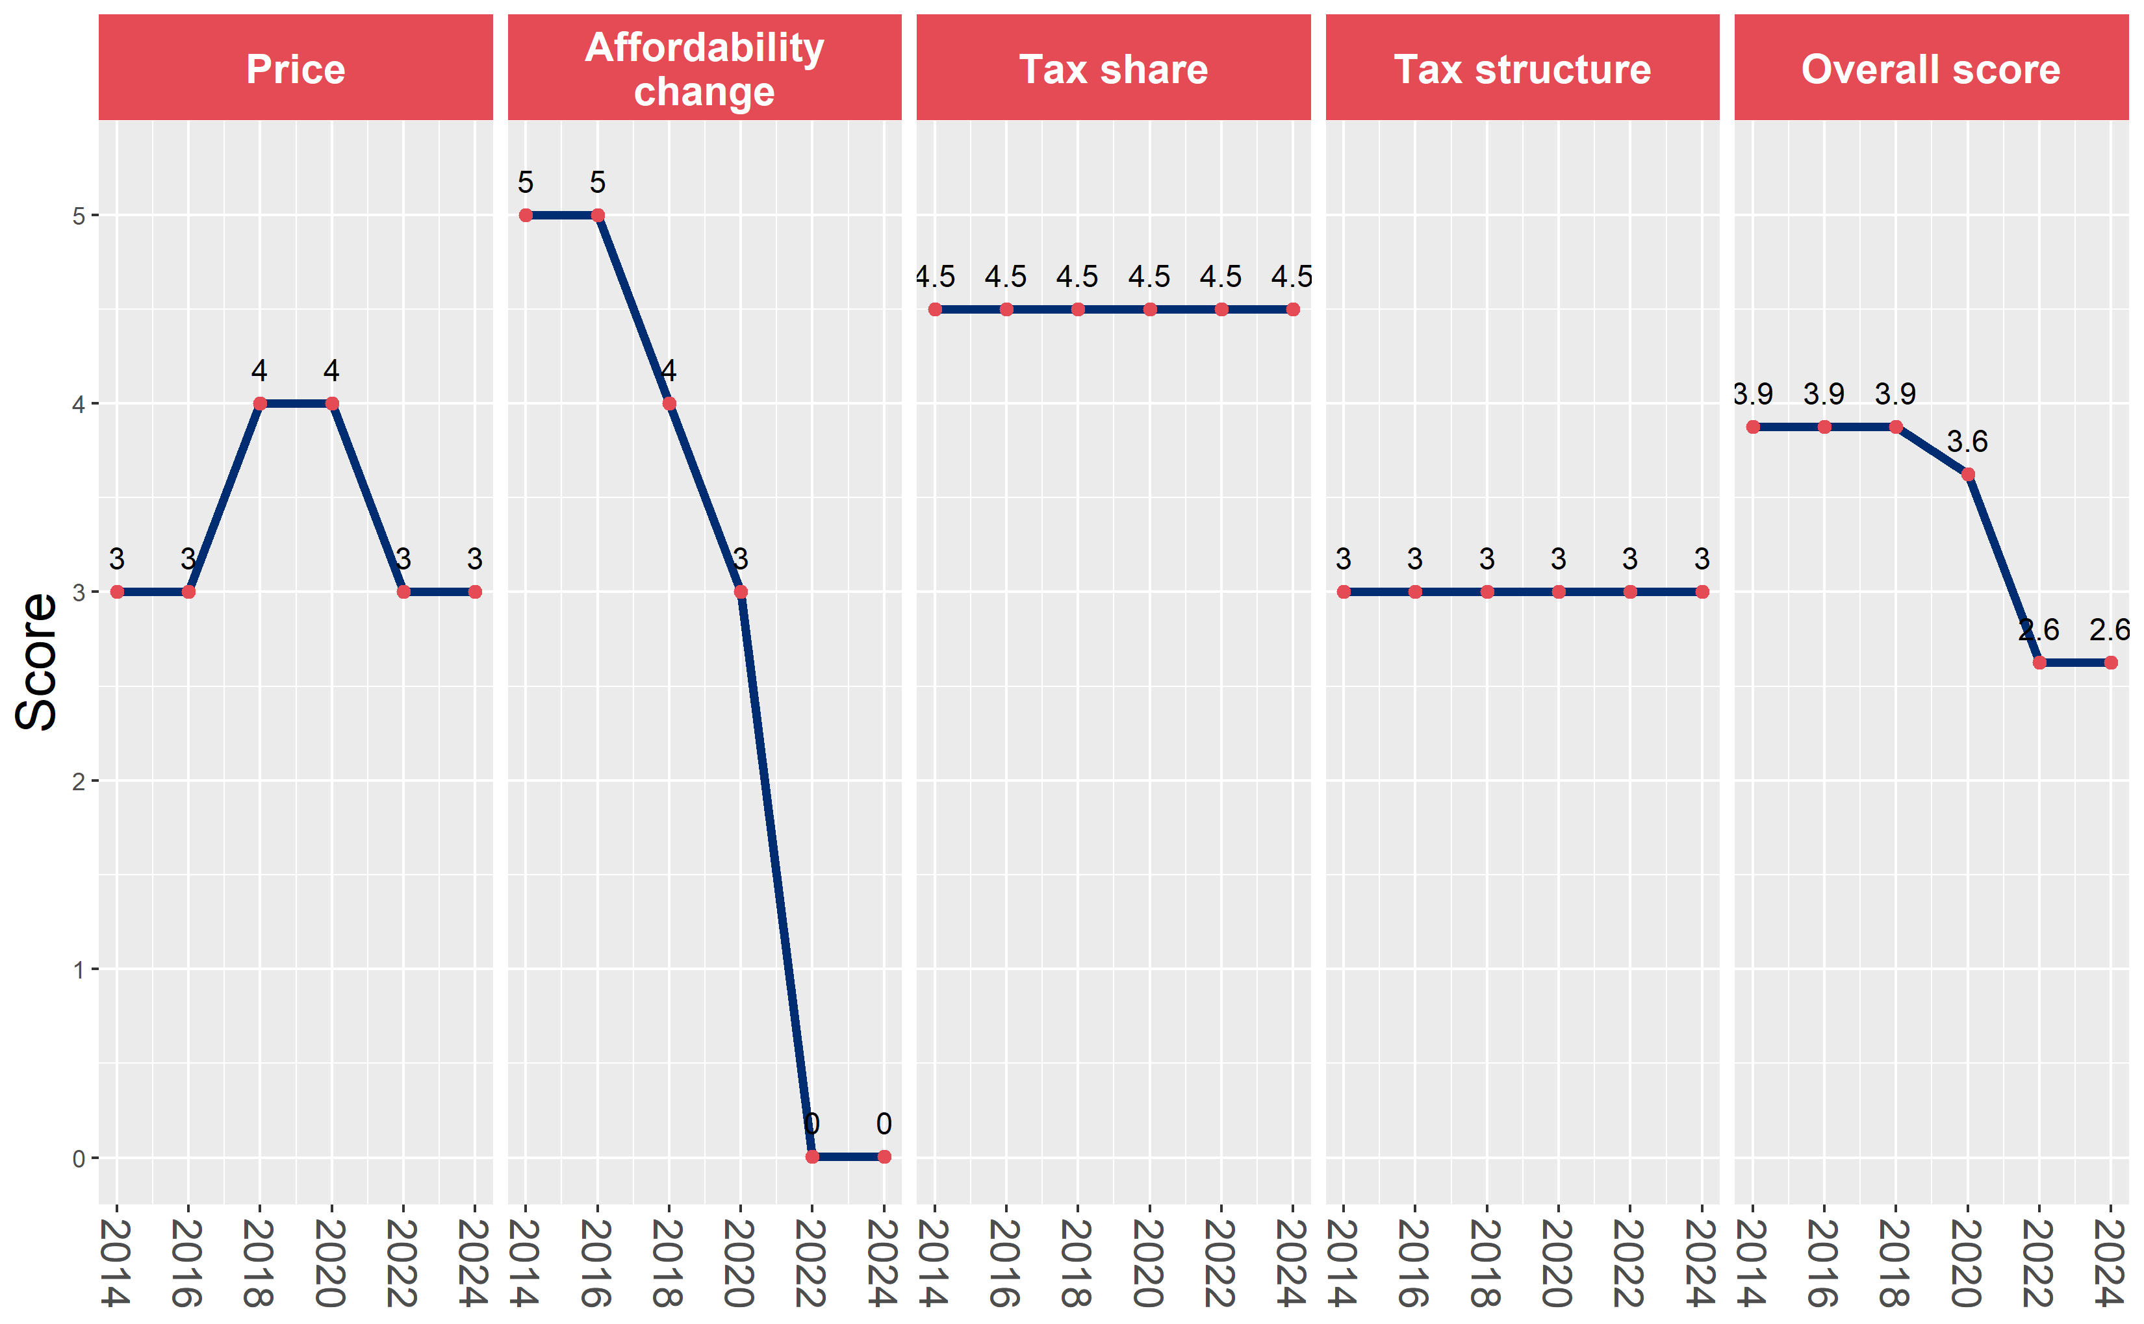
Bosnia and Herzegovina’s cigarette tax policies over time
Bosnia and Herzegovina’s overall and component scores are evaluated over a ten-year period, highlighting trends across all four Cigarette Tax Scorecard components.

