Slide 1
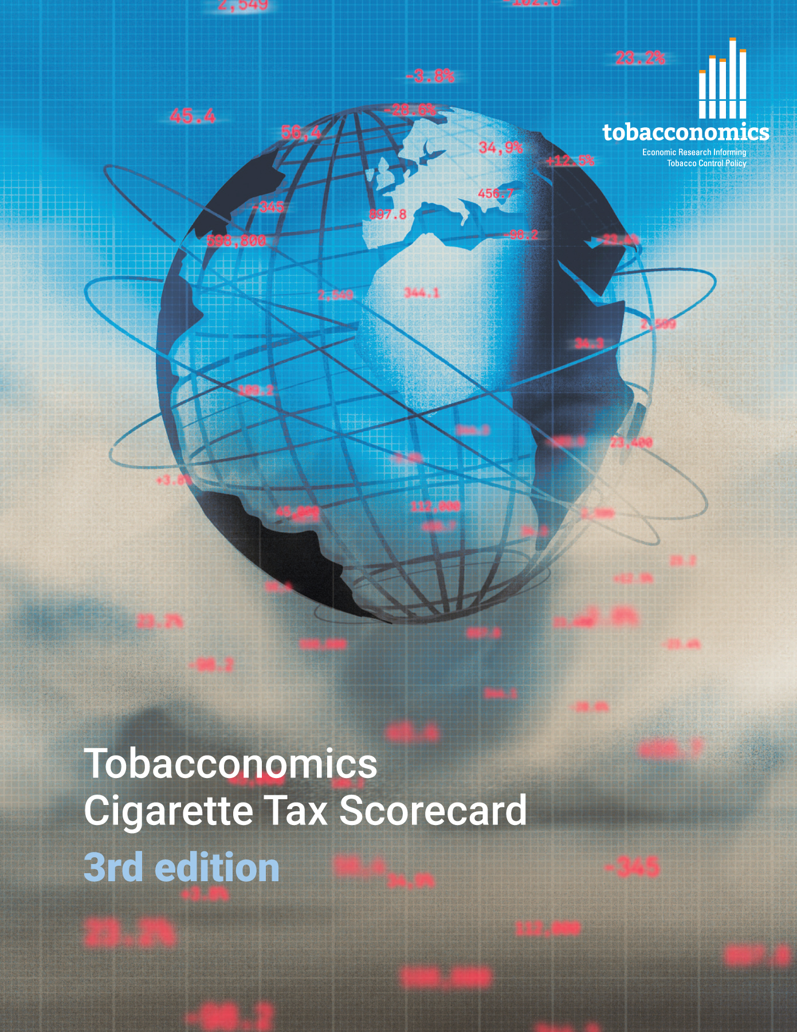
Cigarette tax policies in Viet Nam, 2022
4 key tax components were assessed using a 5-point scale, with the overall score reflecting an average of Viet Nam’s component scores.
The scores reflect the current strengths and opportunities in Viet Nam to further increase tax revenue and improve health.
OPPORTUNITY
for improvement
www.tobacconomics.org | @tobacconomics | Tobacconomics Cigarette Tax Scorecard (3rd edition)

Slide 2
How does Viet Nam compare to other countries?
Viet Nam’s overall score in 2022 is compared to the average overall scores in its income group, region, the world, and top performers.
www.tobacconomics.org | @tobacconomics | Tobacconomics Cigarette Tax Scorecard (3rd edition)

Slide 3
How does Viet Nam compare to other countries?
The components of Viet Nam’s score in 2022 are compared to component scores in the region, income group, world, and top performers.
AFFORDABILITY CHANGE AND TAX SHARE
require the most improvement.
www.tobacconomics.org | @tobacconomics | Tobacconomics Cigarette Tax Scorecard (3rd edition)

Slide 4
Viet Nam’s cigarette tax policies over time
Viet Nam’s overall score largely stayed the same, although it decreased slightly from 2020 to 2022 due to a decrease in the tax share of price.
www.tobacconomics.org | @tobacconomics | Tobacconomics Cigarette Tax Scorecard (3rd edition)

