Slide 1
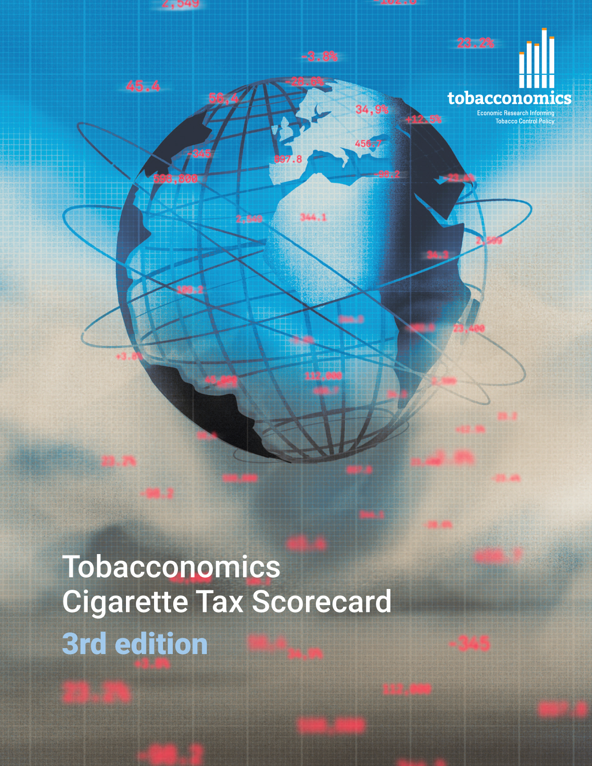
Cigarette tax policies in United Republic of Tanzania, 2022
4 key tax components were assessed using a 5-point scale, with the overall score reflecting an average of United Republic of Tanzania’ component scores.
The scores reflect the current strengths and opportunities in United Republic of Tanzania to further increase tax revenue and improve health.
OPPORTUNITY
for improvement
www.tobacconomics.org | @tobacconomics | Tobacconomics Cigarette Tax Scorecard (3rd edition)

Slide 2
How does United Republic of Tanzania compare to other countries?
United Republic of Tanzania’s overall score in 2022 is compared to the average overall scores in its income group, region, the world, and top performers.
www.tobacconomics.org | @tobacconomics | Tobacconomics Cigarette Tax Scorecard (3rd edition)

Slide 3
How does United Republic of Tanzania compare to other countries?
The components of United Republic of Tanzania’s score in 2022 are compared to component scores in the region, income group, world, and top performers.
AFFORDABILITY CHANGE & TAX SHARE
require the most improvement.
www.tobacconomics.org | @tobacconomics | Tobacconomics Cigarette Tax Scorecard (3rd edition)

Slide 4
United Republic of Tanzania’s cigarette tax policies over time
United Republic of Tanzania's overall score remained relatively constant over time. There was a decrease in the cigarette price between 2016 and 2018, then it recovered.
www.tobacconomics.org | @tobacconomics | Tobacconomics Cigarette Tax Scorecard (3rd edition)

