Slide 1
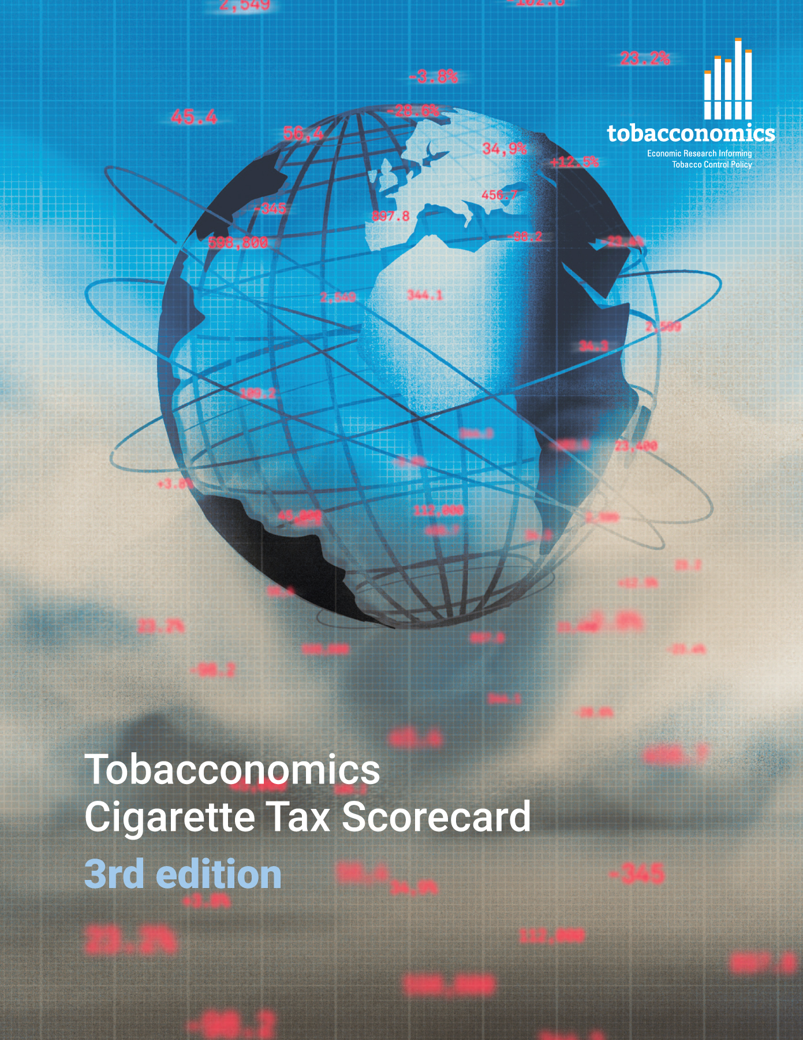
Cigarette tax policies in Trinidad and Tobago, 2022
4 key tax components were assessed using a 5-point scale, with the overall score reflecting an average of Trinidad and Tobago’s component scores.
The scores reflect the current strengths and opportunities in Trinidad and Tobago to further increase tax revenue and improve health.
OPPORTUNITY
for improvement
www.tobacconomics.org | @tobacconomics | Tobacconomics Cigarette Tax Scorecard (3rd edition)

Slide 2
How does Trinidad and Tobago compare to other countries?
Trinidad and Tobago’s overall score in 2022 is compared to the average overall scores in its income group, region, the world, and top performers.
www.tobacconomics.org | @tobacconomics | Tobacconomics Cigarette Tax Scorecard (3rd edition)

Slide 3
How does Trinidad and Tobago compare to other countries?
The components of Trinidad and Tobago’s score in 2022 are compared to component scores in the region, income group, world, and top performers.
AFFORDABILITY CHANGE AND TAX SHARE
require the most improvement.
www.tobacconomics.org | @tobacconomics | Tobacconomics Cigarette Tax Scorecard (3rd edition)

Slide 4
Trinidad and Tobago’s cigarette tax policies over time
Trinidad and Tobago's overall scores decreased from 2020 to 2022 largely due to a failure to reduce affordability.
www.tobacconomics.org | @tobacconomics | Tobacconomics Cigarette Tax Scorecard (3rd edition)

