Slide 1
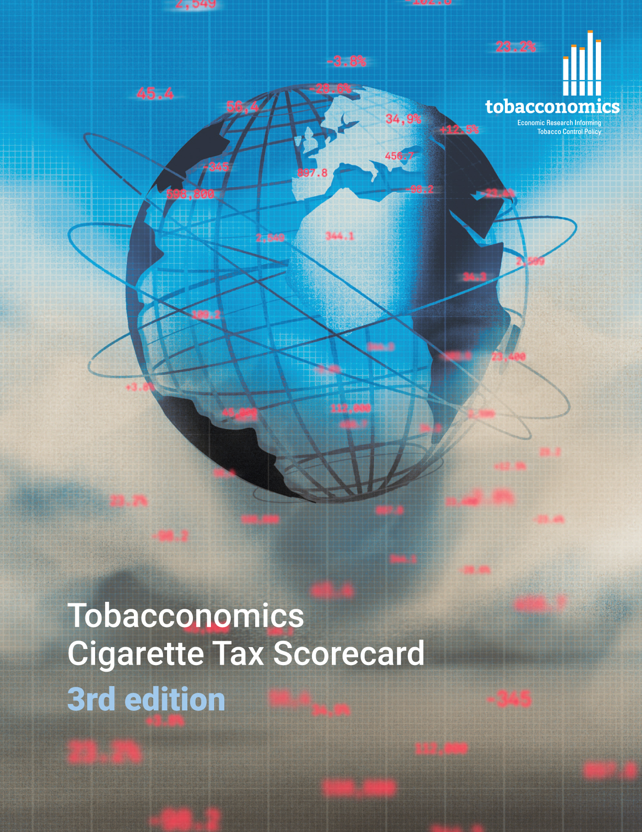
Cigarette tax policies in Tajikistan, 2022
4 key tax components were assessed using a 5-point scale, with the overall score reflecting an average of Tajikistan’s component scores.
The scores reflect the current strengths and opportunities in Tajikistan to further increase tax revenue and improve health.
OPPORTUNITY
for improvement
www.tobacconomics.org | @tobacconomics | Tobacconomics Cigarette Tax Scorecard (3rd edition)

Slide 2
How does Tajikistan compare to other countries?
Tajikistan’s overall score in 2022 is compared to the average overall scores in its income group, region, the world, and top performers.
www.tobacconomics.org | @tobacconomics | Tobacconomics Cigarette Tax Scorecard (3rd edition)

Slide 3
How does Tajikistan compare to other countries?
The components of Tajikistan’s score in 2022 are compared to component scores in the region, income group, world, and top performers.
AFFORDABILITY CHANGE
requires the most improvement.
www.tobacconomics.org | @tobacconomics | Tobacconomics Cigarette Tax Scorecard (3rd edition)

Slide 4
Tajikistan’s cigarette tax policies over time
Tajikistan's overall score increased from 2014 to 2022 with fluctuations in between due to an increase in the tax share of price and an improvement in the tax structure, yet a failure to reduce affordability.
www.tobacconomics.org | @tobacconomics | Tobacconomics Cigarette Tax Scorecard (3rd edition)

