Slide 1
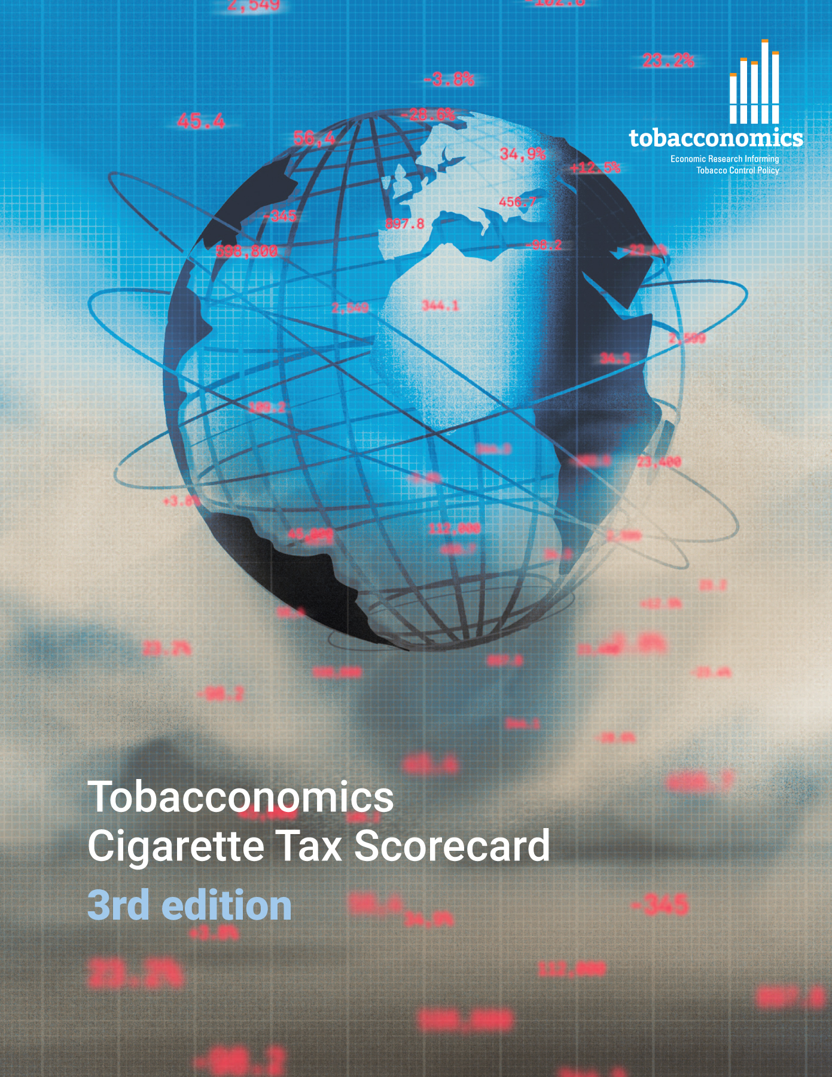
Cigarette tax policies in Eswatini, 2022
4 key tax components were assessed using a 5-point scale, with the overall score reflecting an average of Eswatini’s component scores.
The scores reflect the current strengths and opportunities in Eswatini to further increase tax revenue and improve health.
OPPORTUNITY
for improvement
www.tobacconomics.org | @tobacconomics | Tobacconomics Cigarette Tax Scorecard (3rd edition)

Slide 2
How does Eswatini compare to other countries?
Eswatini’s overall score in 2022 is compared to the average overall scores in its income group, region, the world, and top performers.
www.tobacconomics.org | @tobacconomics | Tobacconomics Cigarette Tax Scorecard (3rd edition)

Slide 3
How does Eswatini compare to other countries?
The components of Estonia’s score in 2022 are compared to component scores in the region, income group, world, and top performers.
AFFORDABILITY CHANGE & TAX SHARE
require the most improvement.
www.tobacconomics.org | @tobacconomics | Tobacconomics Cigarette Tax Scorecard (3rd edition)

Slide 4
Eswatini’s cigarette tax policies over time
Eswatini's overall score increased over time due to a reduction in cigarette affordability over time and a small increase in the tax share of price.
www.tobacconomics.org | @tobacconomics | Tobacconomics Cigarette Tax Scorecard (3rd edition)

