Slide 1
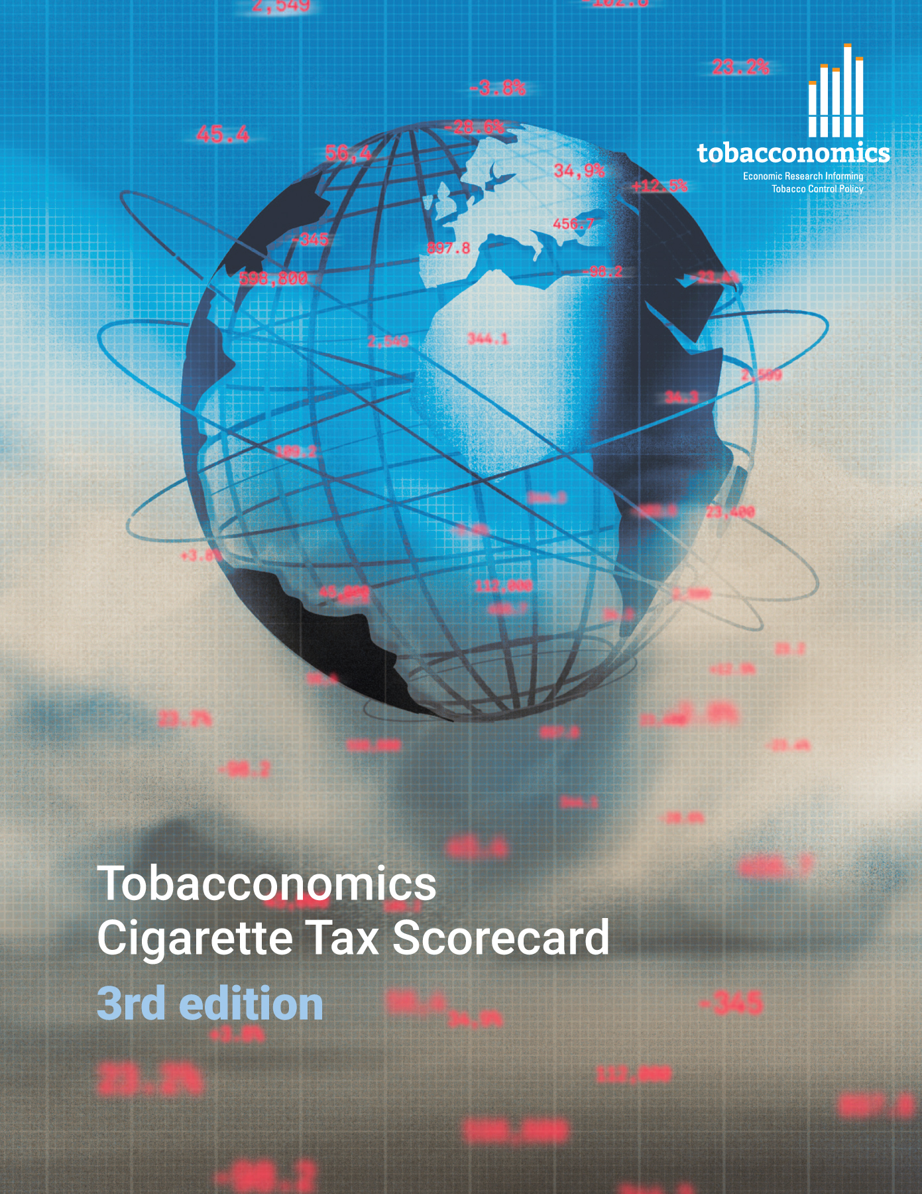
Cigarette tax policies in El Salvador, 2022
4 key tax components were assessed using a 5-point scale, with the overall score reflecting an average of El Salvador’s component scores.
The scores reflect the current strengths and opportunities in El Salvador to further increase tax revenue and improve health.
OPPORTUNITY
for improvement
www.tobacconomics.org | @tobacconomics | Tobacconomics Cigarette Tax Scorecard (3rd edition)

Slide 2
How does El Salvador compare to other countries?
El Salvador’s overall score in 2022 is compared to the average overall scores in its income group, region, the world, and top performers.
www.tobacconomics.org | @tobacconomics | Tobacconomics Cigarette Tax Scorecard (3rd edition)

Slide 3
How does El Salvador compare to other countries?
The components of El Salvador’s score in 2022 are compared to component scores in the region, income group, world, and top performers.
AFFORDABILITY CHANGE
requires the most improvement.
www.tobacconomics.org | @tobacconomics | Tobacconomics Cigarette Tax Scorecard (3rd edition)

Slide 4
El Salvador’s cigarette tax policies over time
El Salvador's overall score remained relatively constant over time, and there was a small decrease in 2022, due to a failure to reduce affordability.
www.tobacconomics.org | @tobacconomics | Tobacconomics Cigarette Tax Scorecard (3rd edition)

