Slide 1
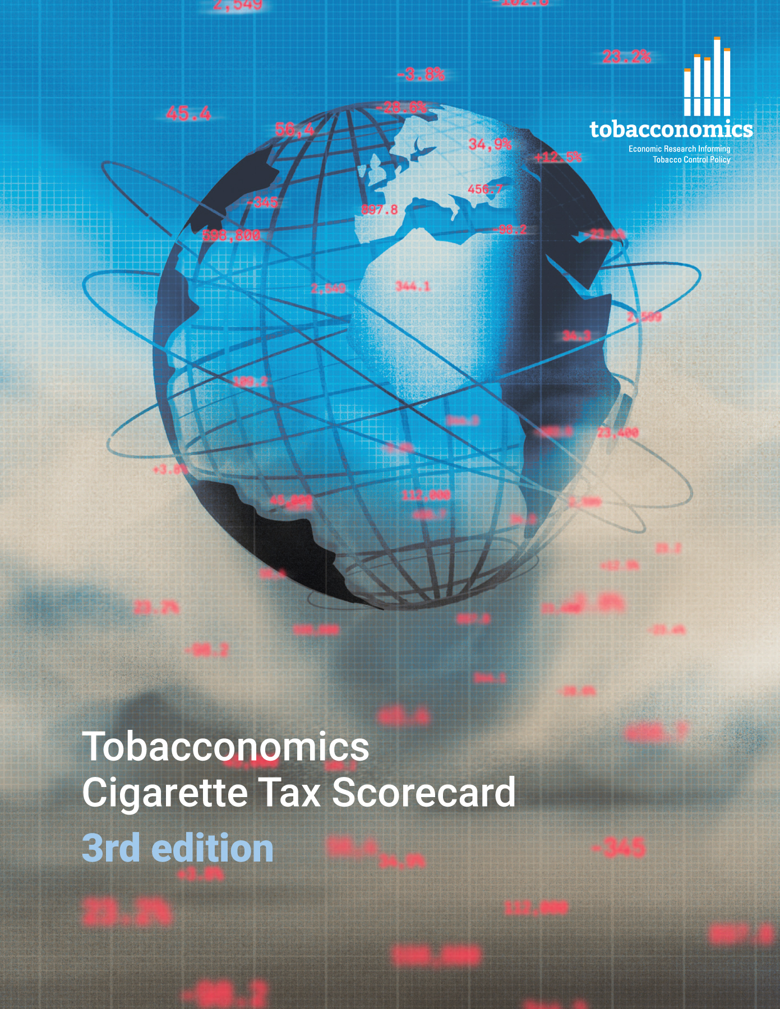
Cigarette tax policies in Slovakia, 2022
4 key tax components were assessed using a 5-point scale, with the overall score reflecting an average of Slovakia’s component scores.
The scores reflect the current strengths and opportunities in Slovakia to further increase tax revenue and improve health.
OPPORTUNITY
for improvement
www.tobacconomics.org | @tobacconomics | Tobacconomics Cigarette Tax Scorecard (3rd edition)

Slide 2
How does Slovakia compare to other countries?
Slovakia’s overall score in 2022 is compared to the average overall scores in its income group, region, the world, and top performers.
www.tobacconomics.org | @tobacconomics | Tobacconomics Cigarette Tax Scorecard (3rd edition)

Slide 3
How does Slovakia compare to other countries?
The components of Slovakia’s score in 2022 are compared to component scores in the region, income group, world, and top performers.
AFFORDABILITY CHANGE
requires the most improvement.
www.tobacconomics.org | @tobacconomics | Tobacconomics Cigarette Tax Scorecard (3rd edition)

Slide 4
Slovakia’s cigarette tax policies over time
Slovakia’s overall score decreased decreased from 2016 to 2020, before increasing slightly in 2022 as the affordability change score dropped while the tax share of price increased slightly.
www.tobacconomics.org | @tobacconomics | Tobacconomics Cigarette Tax Scorecard (3rd edition)

