Slide 1
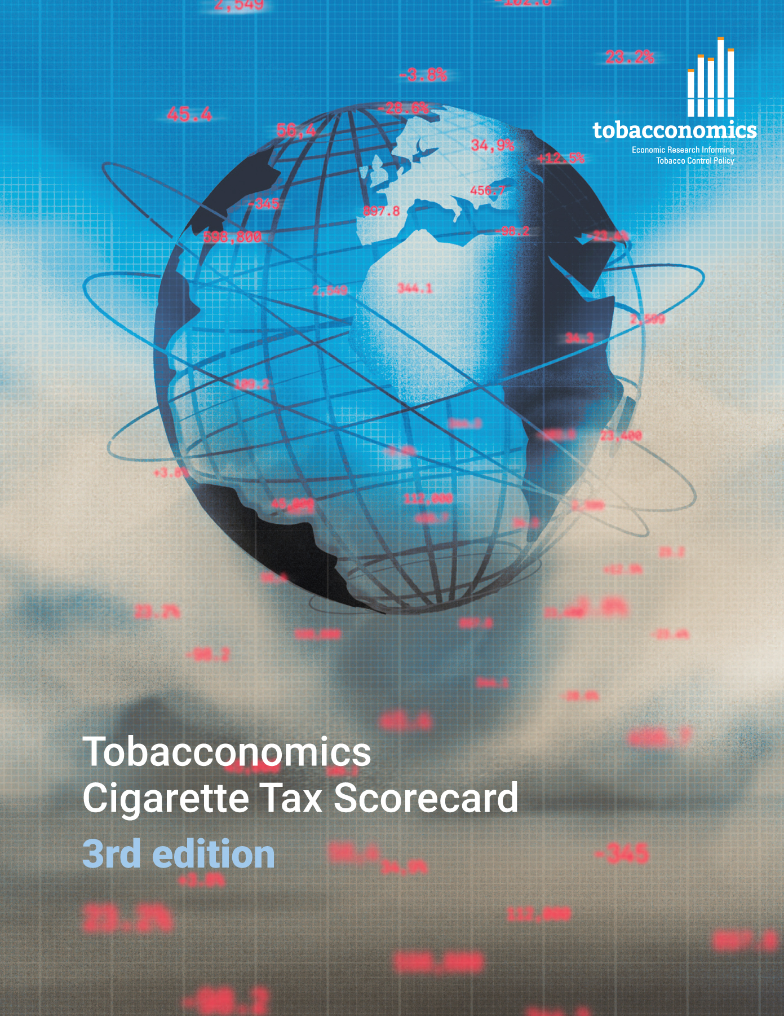

Cigarette tax policies in Solomon Islands, 2022
  4 key tax components were assessed using a 5-point scale, with the overall score reflecting an average of Solomon Islands’ component scores.
  The scores reflect the current strengths and opportunities in Solomon Islands to further increase tax revenue and improve health.
OPPORTUNITY
for improvement
www.tobacconomics.org | @tobacconomics | Tobacconomics Cigarette Tax Scorecard (3rd edition)

Slide 2
How does Solomon Islands compare to other countries?
  Solomon Islands’ overall score in 2022 is compared to the average overall scores in its income group, region, the world, and top performers.
www.tobacconomics.org | @tobacconomics | Tobacconomics Cigarette Tax Scorecard (3rd edition)

Slide 3
How does Solomon Islands compare to other countries?
  The components of Solomon Islands’ score in 2022 are compared to component scores in the region, income group, world, and top performers.
AFFORDABILITY CHANGE
requires the most improvement.
www.tobacconomics.org | @tobacconomics | Tobacconomics Cigarette Tax Scorecard (3rd edition)

Slide 4
Solomon Islands cigarette tax policies over time
Solomon Islands' overall score decreased slightly from 2016 to 2018 due to a decrease in cigarette prices before increasing slightly due to an increase in the tax share of price.
www.tobacconomics.org | @tobacconomics | Tobacconomics Cigarette Tax Scorecard (3rd edition)

