Slide 1
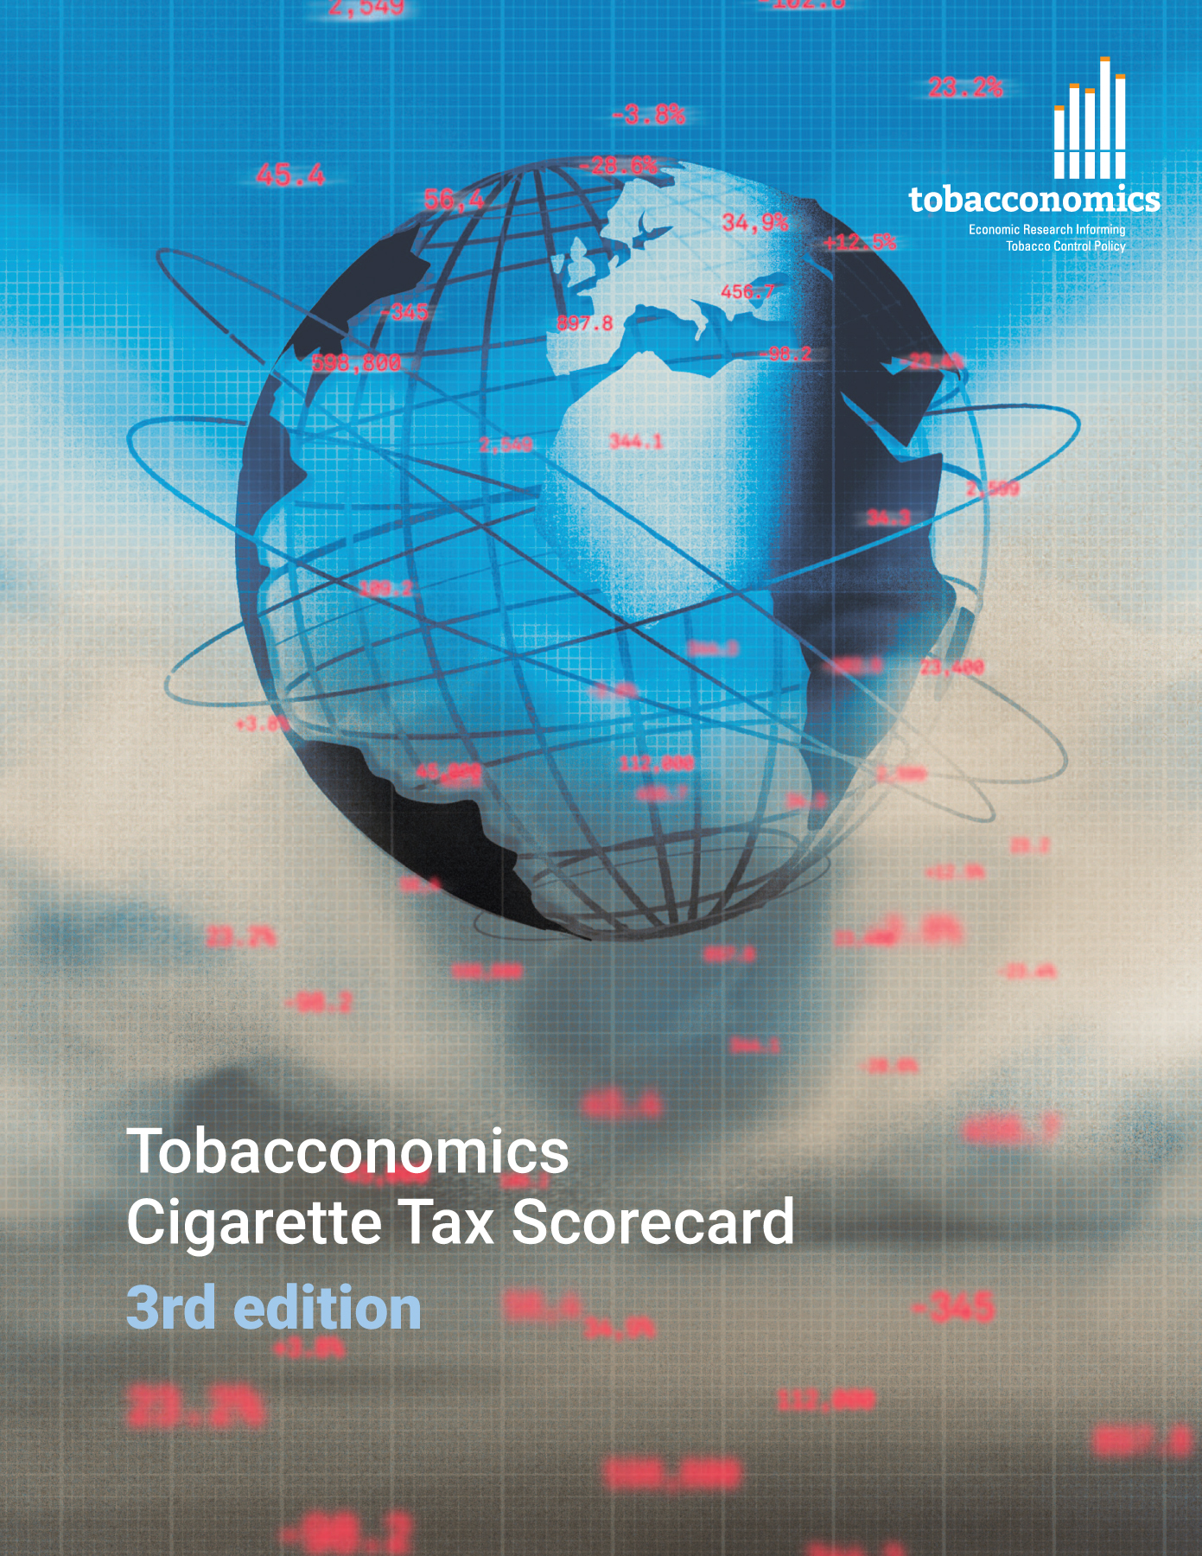
Cigarette tax policies in Saudi Arabia, 2022
4 key tax components were assessed using a 5-point scale, with the overall score reflecting an average of Saudi Arabia’s component scores.
The scores reflect the current strengths and opportunities in Saudi Arabia’s to further increase tax revenue and improve health.
OPPORTUNITY
for improvement
www.tobacconomics.org | @tobacconomics | Tobacconomics Cigarette Tax Scorecard (3rd edition)

Slide 2
How does Saudi Arabia compare to other countries?
Saudi Arabia’s overall score in 2022 is compared to the average overall scores in its income group, region, the world, and top performers.
www.tobacconomics.org | @tobacconomics | Tobacconomics Cigarette Tax Scorecard (3rd edition)

Slide 3
How does Saudi Arabia compare to other countries?
The components of Saudi Arabia’s score in 2022 are compared to component scores in the region, income group, world, and top performers.
AFFORDABILITY CHANGE
requires the most improvement.
www.tobacconomics.org | @tobacconomics | Tobacconomics Cigarette Tax Scorecard (3rd edition)

Slide 4
Saudi Arabia’s cigarette tax policies over time
Saudi Arabia's overall score increased before it reduced in 2022 largely due to a failure to reduce affordability.
www.tobacconomics.org | @tobacconomics | Tobacconomics Cigarette Tax Scorecard (3rd edition)

