Slide 1
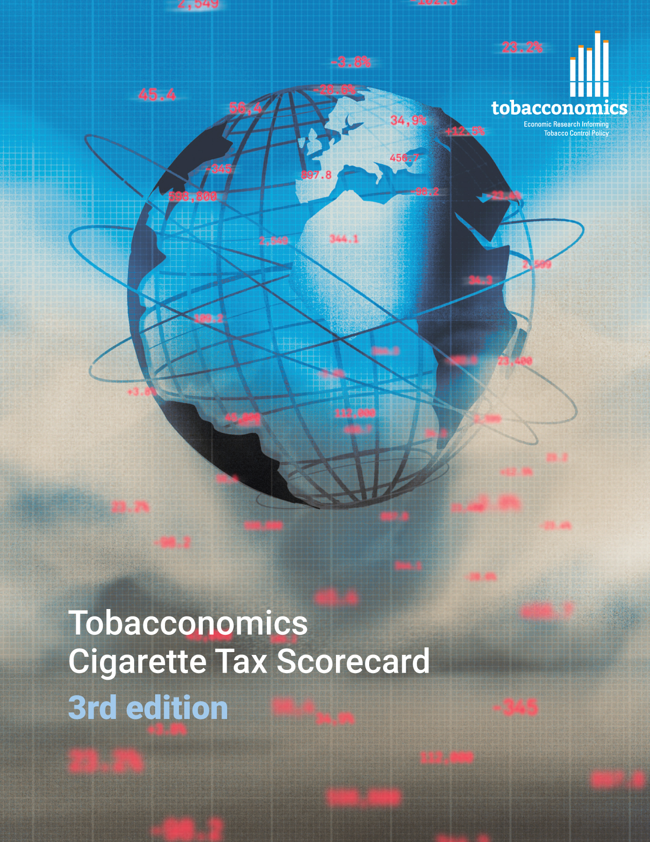
Cigarette tax policies in New Zealand, 2022
4 key tax components were assessed using a 5-point scale, with the overall score reflecting an average of New Zealand’s component scores.
The scores reflect the current strengths and opportunities in New Zealand to further increase tax revenue and improve health.
OPPORTUNITY
for improvement
www.tobacconomics.org | @tobacconomics | Tobacconomics Cigarette Tax Scorecard (3rd edition)

Slide 2
How does New Zealand compare to other countries?
New Zealand’s overall score in 2022 is compared to the average overall scores in its income group, region, the world, and top performers.
www.tobacconomics.org | @tobacconomics | Tobacconomics Cigarette Tax Scorecard (3rd edition)

Slide 3
How does New Zealand compare to other countries?
The components of New Zealand’s score in 2022 are compared to component scores in the region, income group, world, and top performers.
AFFORDABILITY CHANGE
requires the most improvement.
www.tobacconomics.org | @tobacconomics | Tobacconomics Cigarette Tax Scorecard (3rd edition)

Slide 4
New Zealand’s cigarette tax policies over time
New Zealand's overall score fluctuated between 2014 and 2020 before decreasing in 2022 due to a failure to reduce affordability.
www.tobacconomics.org | @tobacconomics | Tobacconomics Cigarette Tax Scorecard (3rd edition)

