Slide 1
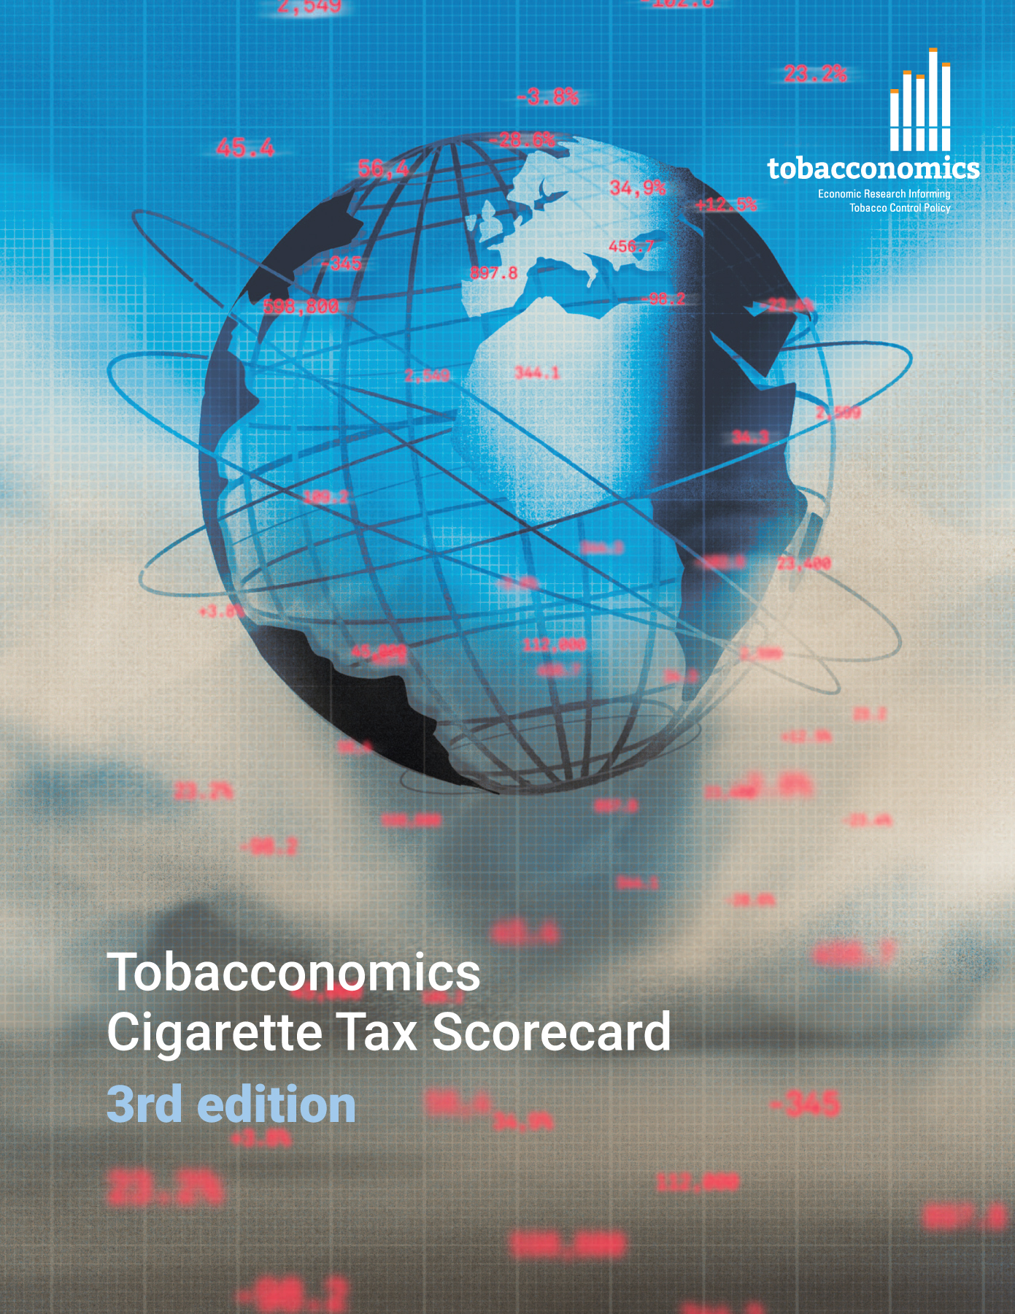
Cigarette tax policies in Netherlands, 2022
4 key tax components were assessed using a 5-point scale, with the overall score reflecting an average of Netherlands’ component scores.
The scores reflect the current strengths and opportunities in Netherlands to further increase tax revenue and improve health.
OPPORTUNITY
for improvement
www.tobacconomics.org | @tobacconomics | Tobacconomics Cigarette Tax Scorecard (3rd edition)

Slide 2
How does Netherlands compare to other countries?
Netherlands’ overall score in 2022 is compared to the average overall scores in its income group, region, the world, and top performers.
www.tobacconomics.org | @tobacconomics | Tobacconomics Cigarette Tax Scorecard (3rd edition)

Slide 3
How does Netherlands compare to other countries?
The components of Netherlands’ score in 2022 are compared to component scores in the region, income group, world, and top performers.
AFFORDABILITY CHANGE
requires the most improvement.
www.tobacconomics.org | @tobacconomics | Tobacconomics Cigarette Tax Scorecard (3rd edition)

Slide 4
Netherlands’ cigarette tax policies over time
Netherlands's overall score decreased in 2018 largely due to a failure to reduce cigarette affordability, and then it remained constant until 2022.
www.tobacconomics.org | @tobacconomics | Tobacconomics Cigarette Tax Scorecard (3rd edition)

