Slide 1
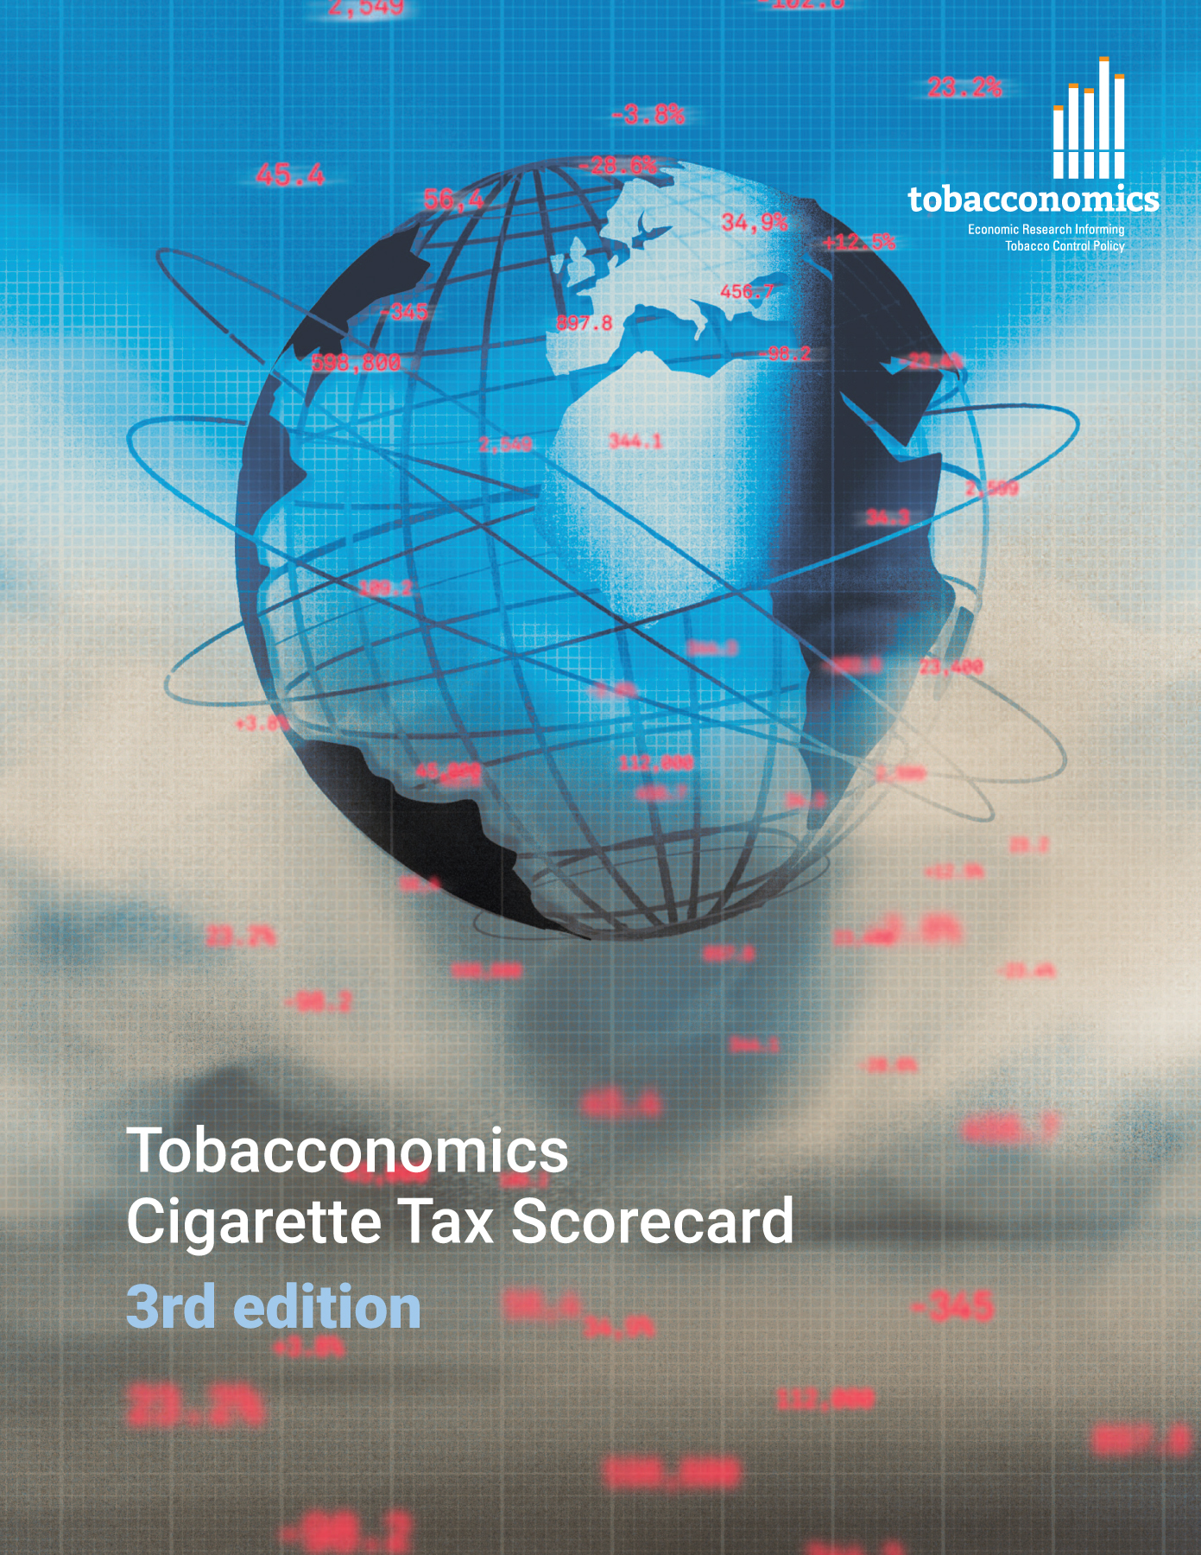
Cigarette tax policies in Nigeria, 2022
4 key tax components were assessed using a 5-point scale, with the overall score reflecting an average of Nigeria’s component scores.
The scores reflect the current strengths and opportunities in Nigeria to further increase tax revenue and improve health.
OPPORTUNITY
for improvement
www.tobacconomics.org | @tobacconomics | Tobacconomics Cigarette Tax Scorecard (3rd edition)

Slide 2
How does Nigeria compare to other countries?
Nigeria’s overall score in 2022 is compared to the average overall scores in its income group, region, the world, and top performers.
www.tobacconomics.org | @tobacconomics | Tobacconomics Cigarette Tax Scorecard (3rd edition)

Slide 3
How does Nigeria compare to other countries?
The components of Nigeria’s score in 2022 are compared to component scores in the region, income group, world, and top performers.
AFFORDABILITY CHANGE
requires the most improvement.
www.tobacconomics.org | @tobacconomics | Tobacconomics Cigarette Tax Scorecard (3rd edition)

Slide 4
Nigeria’s cigarette tax policies over time
Nigeria's overall score increased in 2020, and then remained unchanged in 2022 due to an improvement in the tax structure and an increase in the tax share of price.
www.tobacconomics.org | @tobacconomics | Tobacconomics Cigarette Tax Scorecard (3rd edition)

