Slide 1
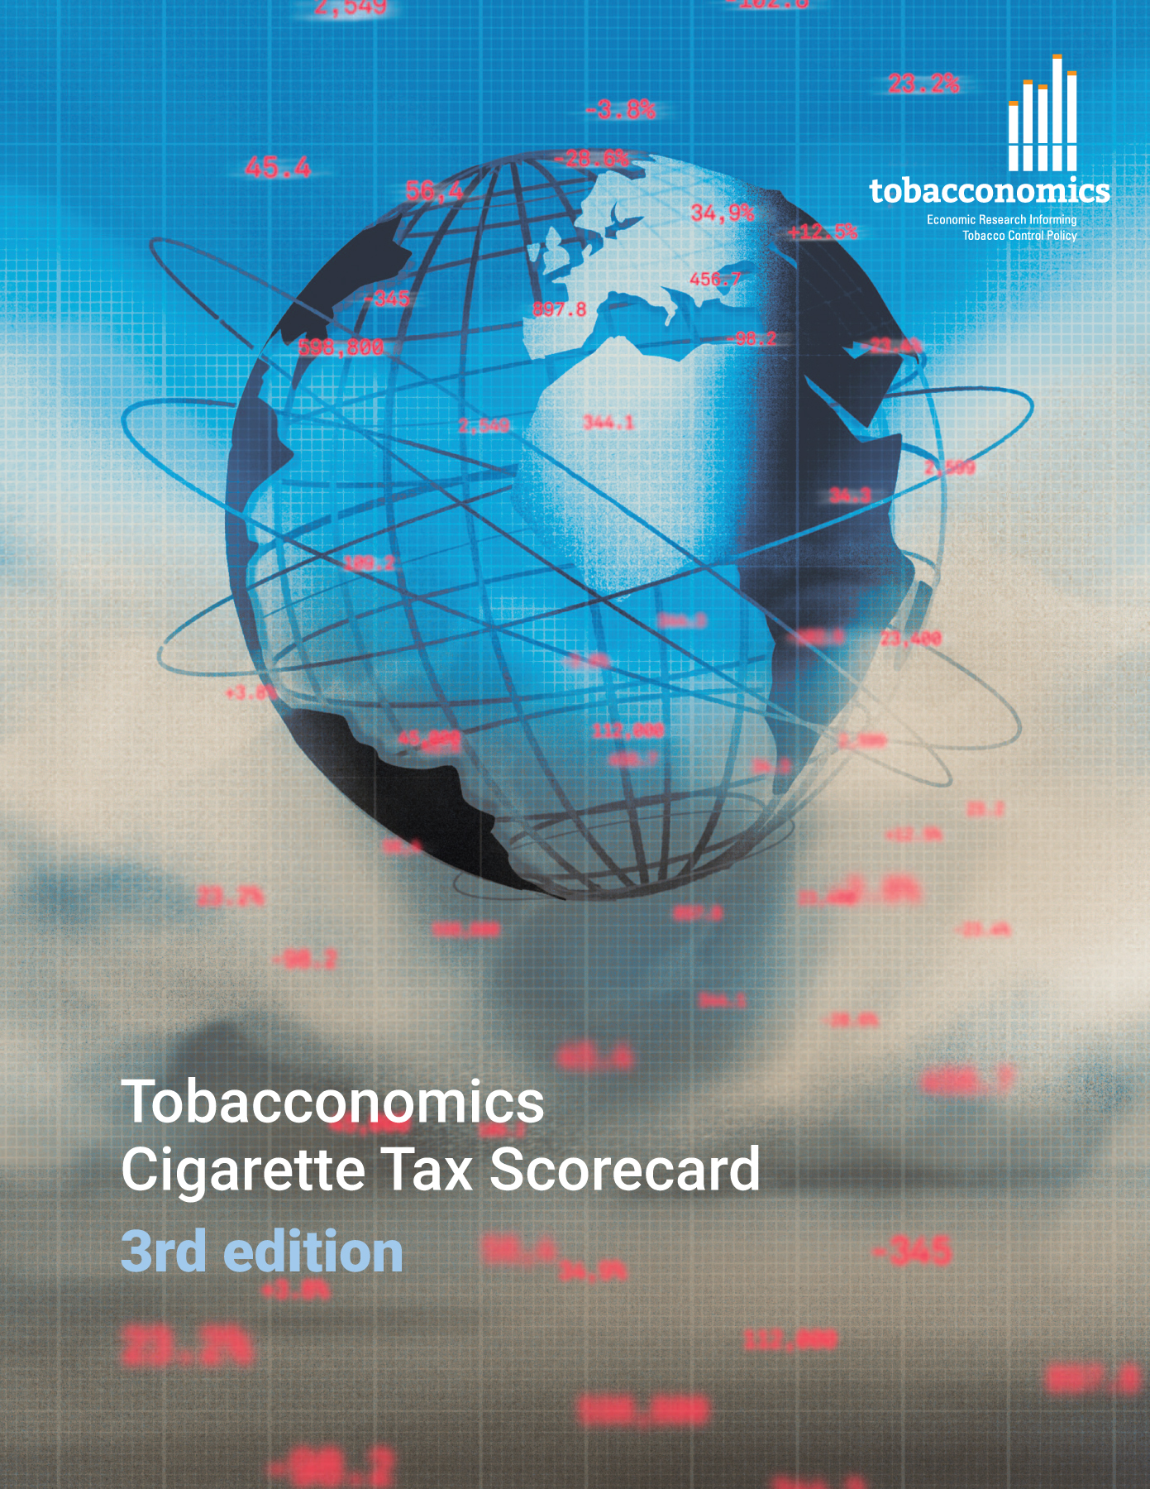

Cigarette tax policies in Mozambique, 2022
  4 key tax components were assessed using a 5-point scale, with the overall score reflecting an average of Mozambique’s component scores.
  The scores reflect the current strengths and opportunities in Mozambique to further increase tax revenue and improve health.
OPPORTUNITY
for improvement
www.tobacconomics.org | @tobacconomics | Tobacconomics Cigarette Tax Scorecard (3rd edition)

Slide 2
How does Mozambique compare to other countries?
  Mozambique’s overall score in 2022 is compared to the average overall scores in its income group, region, the world, and top performers.
www.tobacconomics.org | @tobacconomics | Tobacconomics Cigarette Tax Scorecard (3rd edition)

Slide 3
How does Mozambique compare to other countries?
  The components of Mozambique’s score in 2022 are compared to component scores in the region, income group, world, and top performers.
TAX SHARE
require the most improvement.
www.tobacconomics.org | @tobacconomics | Tobacconomics Cigarette Tax Scorecard (3rd edition)

Slide 4
Mozambique’s cigarette tax policies over time
  Mozambique's overall score increased from 2016 to 2022 largely due to a reduction in affordability and improvement in the tax structure.
www.tobacconomics.org | @tobacconomics | Tobacconomics Cigarette Tax Scorecard (3rd edition)

