Slide 1
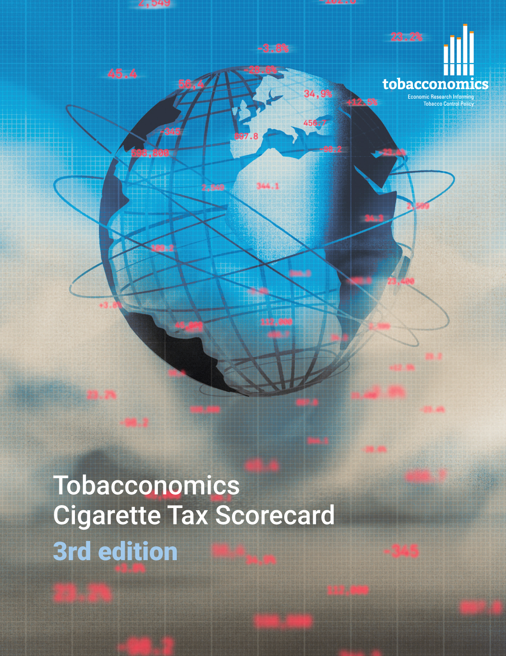
Cigarette tax policies in Mauritius, 2022
4 key tax components were assessed using a 5-point scale, with the overall score reflecting an average of Mauritius’s component scores.
The scores reflect the current strengths and opportunities in Mauritius to further increase tax revenue and improve health.
OPPORTUNITY
for improvement
www.tobacconomics.org | @tobacconomics | Tobacconomics Cigarette Tax Scorecard (3rd edition)

Slide 2
How does Mauritius compare to other countries?
Mauritius’s overall score in 2022 is compared to the average overall scores in its income group, region, the world, and top performers.
www.tobacconomics.org | @tobacconomics | Tobacconomics Cigarette Tax Scorecard (3rd edition)

Slide 3
How does Mauritius compare to other countries?
The components of Mauritius’ score in 2022 are compared to component scores in the region, income group, world, and top performers.
AFFORDABILITY CHANGE
requires the most improvement.
www.tobacconomics.org | @tobacconomics | Tobacconomics Cigarette Tax Scorecard (3rd edition)

Slide 4
Mauritius’ cigarette tax policies over time
Mauritius's overall score fluctuated between 2014 and 2020, then it rose in 2022 due to change in the cigarette affordability and an increase in the cigarette price.
www.tobacconomics.org | @tobacconomics | Tobacconomics Cigarette Tax Scorecard (3rd edition)

