Slide 1
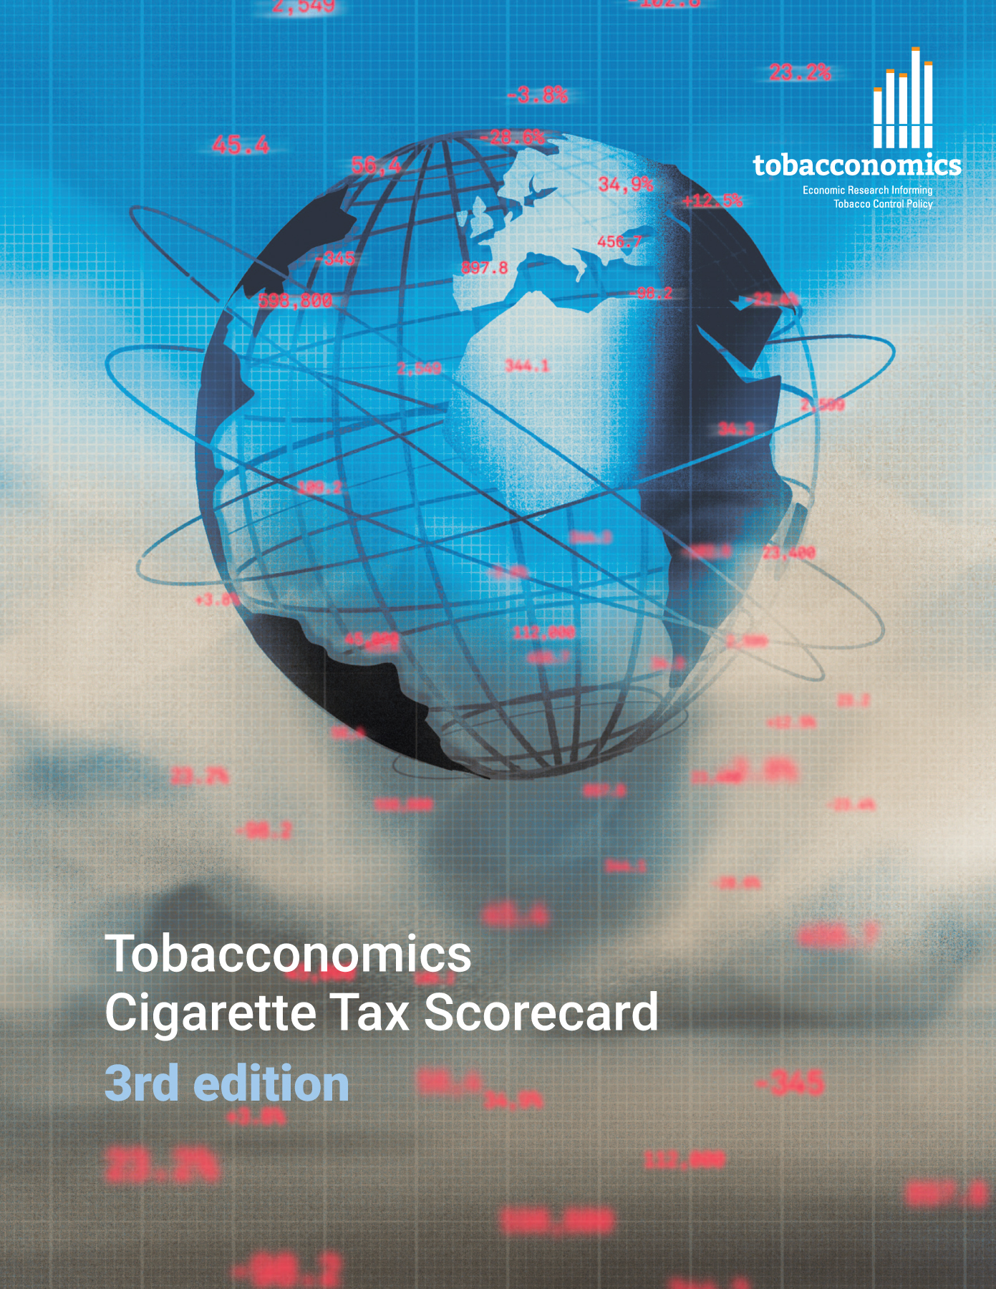
Cigarette tax policies in Malta, 2022
4 key tax components were assessed using a 5-point scale, with the overall score reflecting an average of Malta’s component scores.
The scores reflect the current strengths and opportunities in Malta to further increase tax revenue and improve health.
OPPORTUNITY
for improvement
www.tobacconomics.org | @tobacconomics | Tobacconomics Cigarette Tax Scorecard (3rd edition)

Slide 2
How does Malta compare to other countries?
Malta’s overall score in 2022 is compared to the average overall scores in its income group, region, the world, and top performers.
www.tobacconomics.org | @tobacconomics | Tobacconomics Cigarette Tax Scorecard (3rd edition)

Slide 3
How does Malta compare to other countries?
The components of Malta’s score in 2022 are compared to component scores in the region, income group, world, and top performers.
AFFORDABILITY CHANGE
requires the most improvement.
www.tobacconomics.org | @tobacconomics | Tobacconomics Cigarette Tax Scorecard (3rd edition)

Slide 4
Malta’s cigarette tax policies over time
Malta's overall score slightly increased in 2016 due to an increase in tax share of price, then it remained constant until 2022.
www.tobacconomics.org | @tobacconomics | Tobacconomics Cigarette Tax Scorecard (3rd edition)

