Slide 1
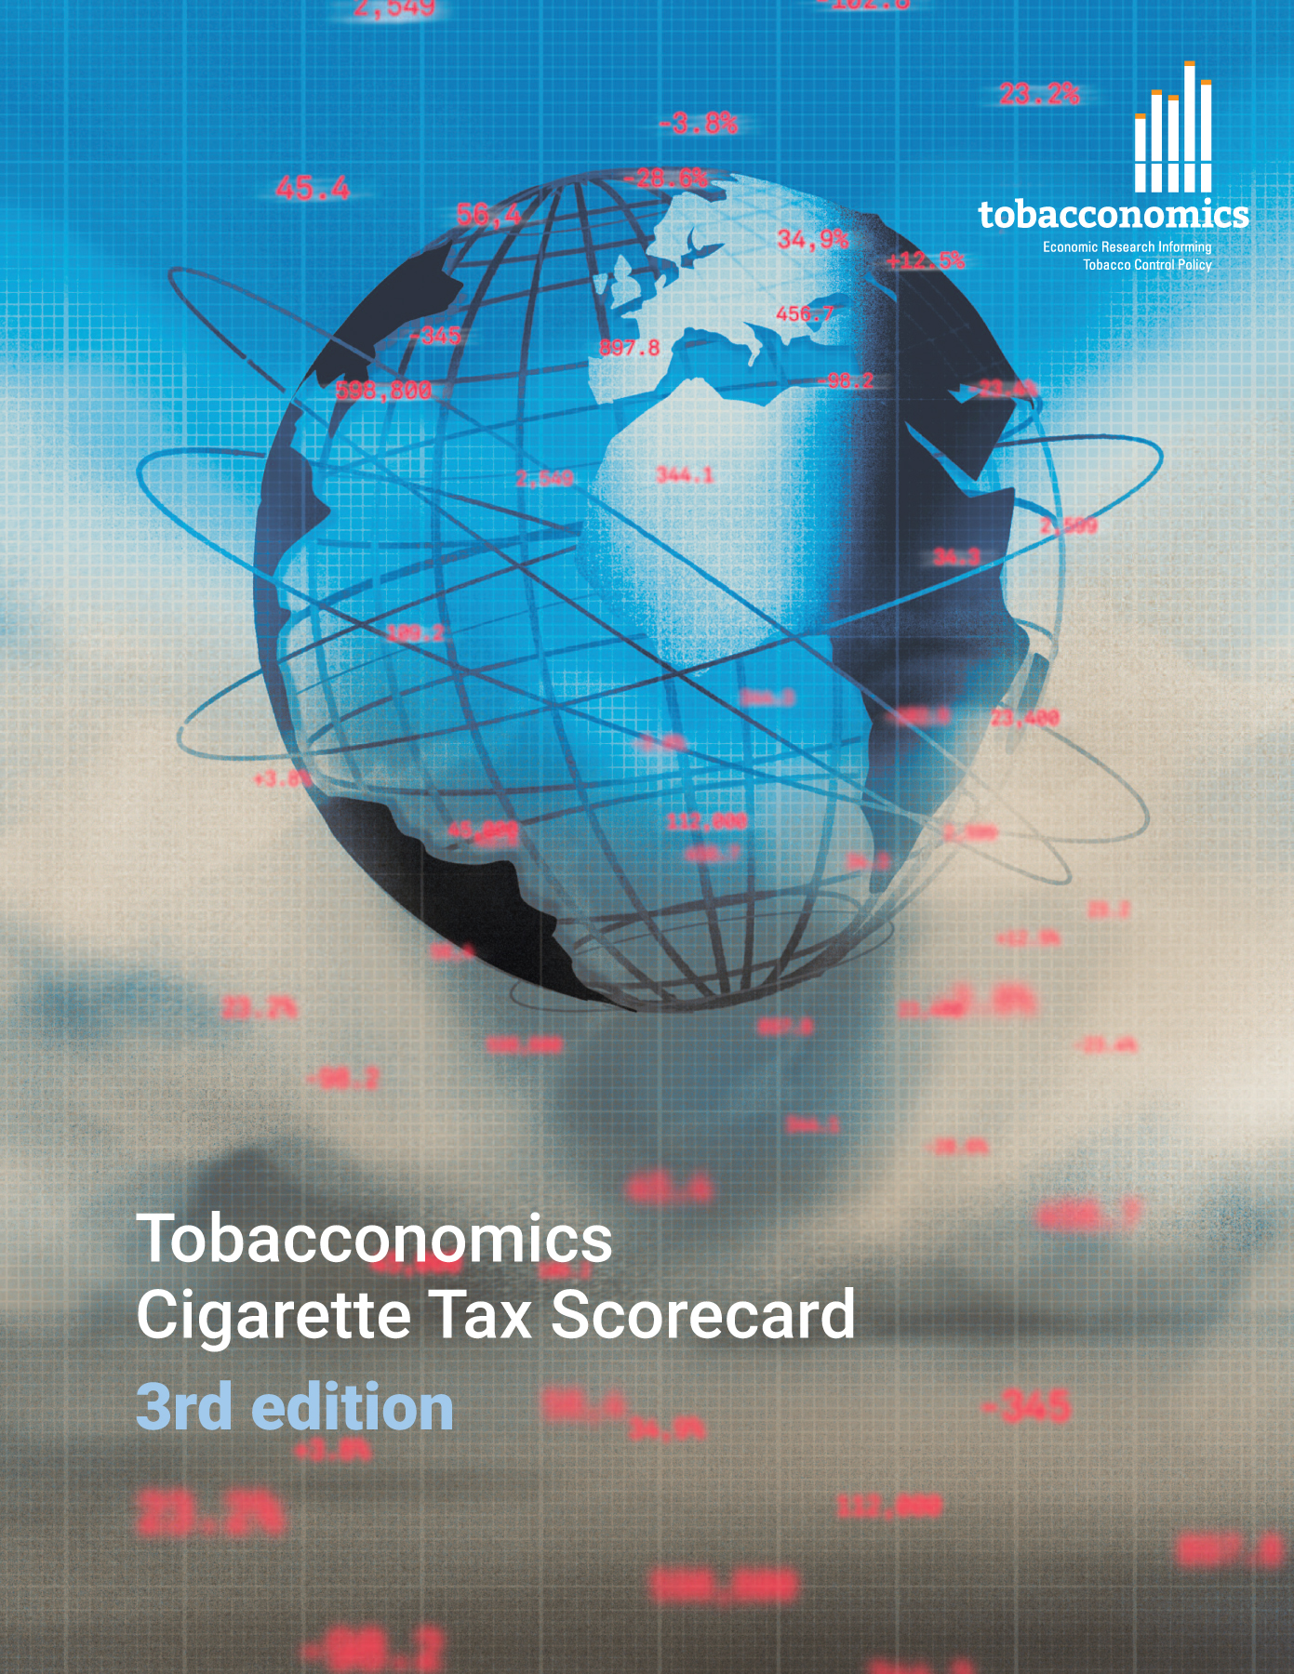
Cigarette tax policies in Mauritania, 2022
4 key tax components were assessed using a 5-point scale, with the overall score reflecting an average of Mauritania’s component scores.
The scores reflect the current strengths and opportunities in Mauritania to further increase tax revenue and improve health.
OPPORTUNITY
for improvement
www.tobacconomics.org | @tobacconomics | Tobacconomics Cigarette Tax Scorecard (3rd edition)

Slide 2
How does Mauritania compare to other countries?
Mauritania’s overall score in 2022 is compared to the average overall scores in its income group, region, the world, and top performers.
www.tobacconomics.org | @tobacconomics | Tobacconomics Cigarette Tax Scorecard (3rd edition)

Slide 3
How does Mauritania compare to other countries?
The components of Mauritania’s score in 2022 are compared to component scores in the region, income group, world, and top performers.
AFFORDABILITY CHANGE & TAX SHARE
require the most improvement.
www.tobacconomics.org | @tobacconomics | Tobacconomics Cigarette Tax Scorecard (3rd edition)

Slide 4
Mauritania’s cigarette tax policies over time
Mauritania's overall score slightly decreased in 2016 due to a failure to reduce the cigarette affordability over time, and then it remained constant until 2022.
www.tobacconomics.org | @tobacconomics | Tobacconomics Cigarette Tax Scorecard (3rd edition)

