Slide 1
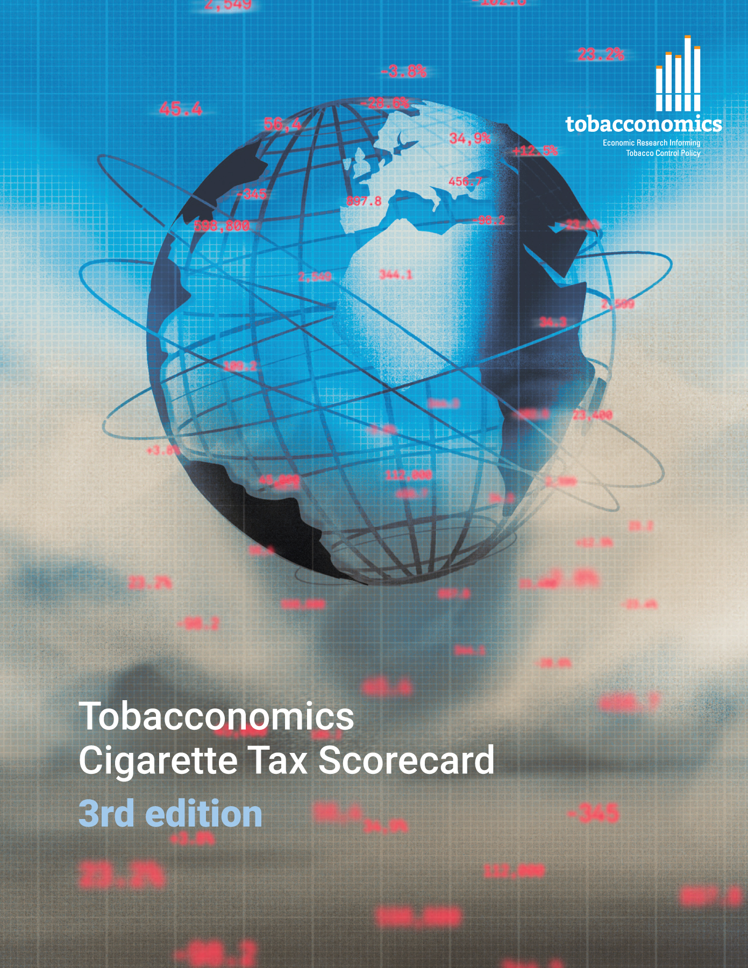
Cigarette tax policies in Madagascar, 2022
4 key tax components were assessed using a 5-point scale, with the overall score reflecting an average of Madagascar’s component scores.
The scores reflect the current strengths and opportunities in Madagascar to further increase tax revenue and improve health.
OPPORTUNITY
for improvement
www.tobacconomics.org | @tobacconomics | Tobacconomics Cigarette Tax Scorecard (3rd edition)

Slide 2
How does Madagascar compare to other countries?
Madagascar’s overall score in 2022 is compared to the average overall scores in its income group, region, the world, and top performers.
www.tobacconomics.org | @tobacconomics | Tobacconomics Cigarette Tax Scorecard (3rd edition)

Slide 3
How does Madagascar compare to other countries?
The components of Madagascar’s score in 2022 are compared to component scores in the region, income group, world, and top performers.
AFFORDABILITY CHANGE
requires the most improvement.
www.tobacconomics.org | @tobacconomics | Tobacconomics Cigarette Tax Scorecard (3rd edition)

Slide 4
Madagascar’s cigarette tax policies over time
Madagascar's overall score remained relatively constant between 2014 and 2020. Then it increased slightly in 2022 due to an increased in the tax share of price and an improvement in the tax structure.
www.tobacconomics.org | @tobacconomics | Tobacconomics Cigarette Tax Scorecard (3rd edition)

