Slide 1
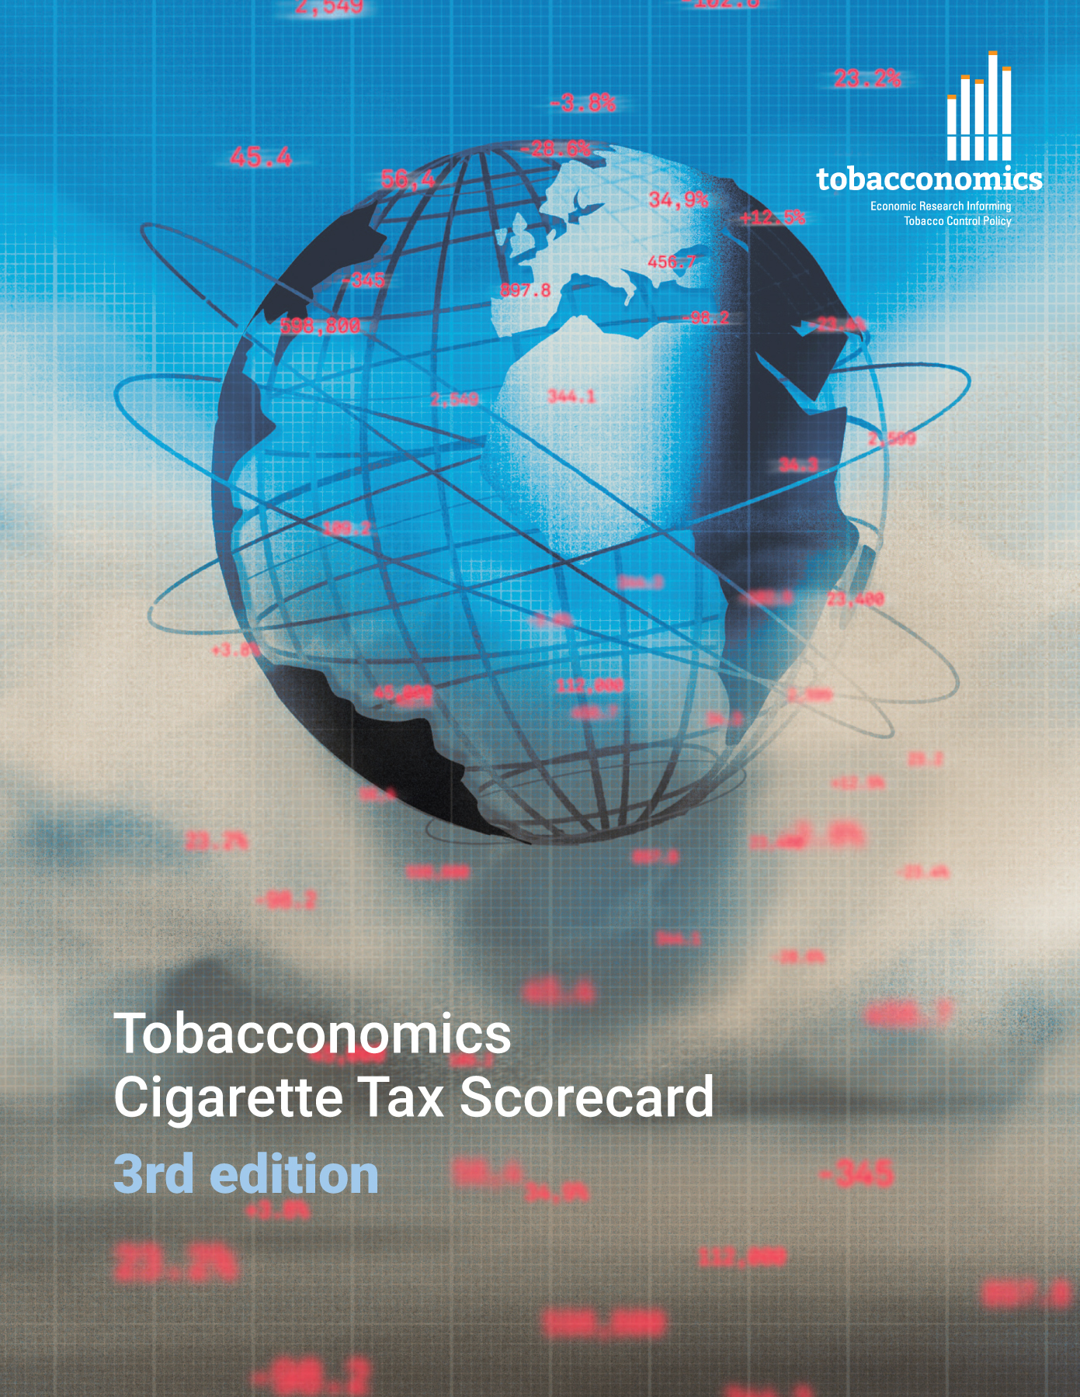
Cigarette tax policies in Sri Lanka, 2022
4 key tax components were assessed using a 5-point scale, with the overall score reflecting an average of Sri Lanka’s component scores.
The scores reflect the current strengths and opportunities in Sri Lanka to further increase tax revenue and improve health.
OPPORTUNITY
for improvement
www.tobacconomics.org | @tobacconomics | Tobacconomics Cigarette Tax Scorecard (3rd edition)

Slide 2
How does Sri Lanka compare to other countries?
Sri Lanka’s overall score in 2022 is compared to the average overall scores in its income group, region, the world, and top performers.
www.tobacconomics.org | @tobacconomics | Tobacconomics Cigarette Tax Scorecard (3rd edition)

Slide 3
How does Sri Lanka compare to other countries?
The components of Sri Lanka’s score in 2022 are compared to component scores in the region, income group, world, and top performers.
AFFORDABILITY CHANGE
requires the most improvement.
www.tobacconomics.org | @tobacconomics | Tobacconomics Cigarette Tax Scorecard (3rd edition)

Slide 4
Sri Lanka’s cigarette tax policies over time
Sri Lanka's overall score increased from 2014 to 2020, then it decreased in 2022 due to a failure to reduce affordability and a decrease in the tax share of price.
www.tobacconomics.org | @tobacconomics | Tobacconomics Cigarette Tax Scorecard (3rd edition)

