Slide 1
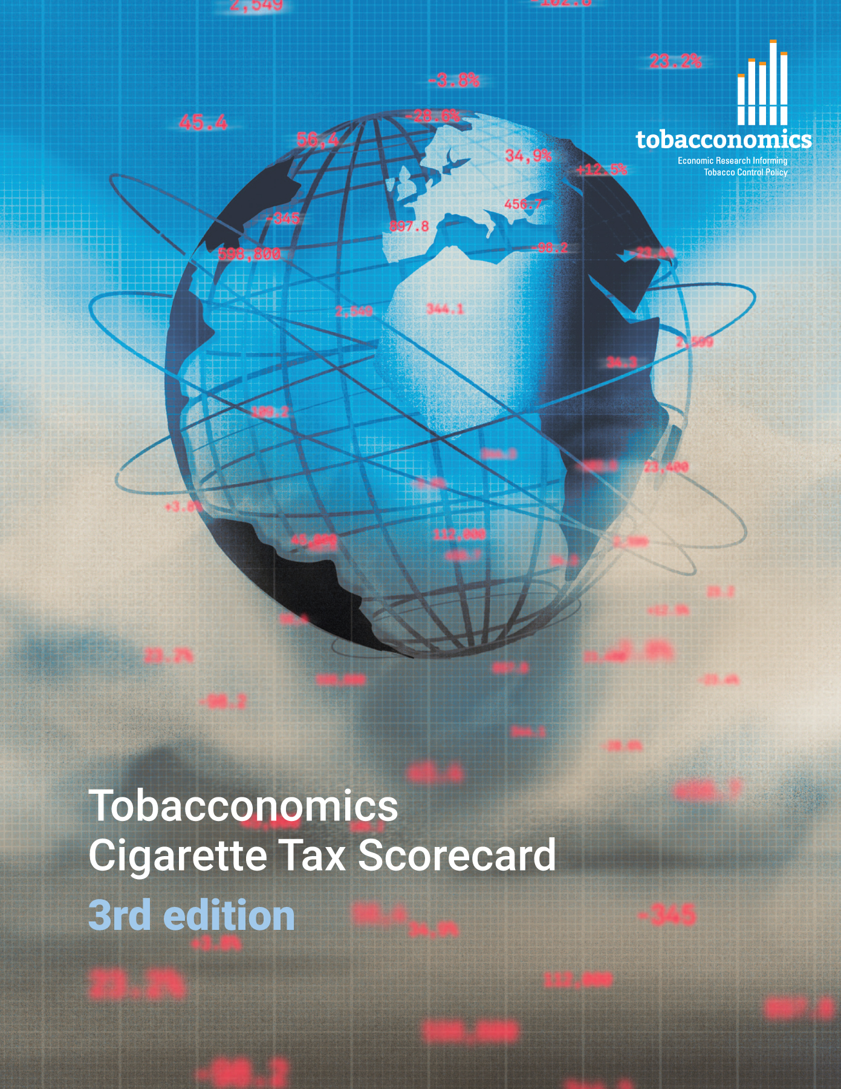
Cigarette tax policies in Saint Lucia, 2022
4 key tax components were assessed using a 5-point scale, with the overall score reflecting an average of Saint Lucia’s component scores.
The scores reflect the current strengths and opportunities in Saint Lucia’s to further increase tax revenue and improve health.
OPPORTUNITY
for improvement
www.tobacconomics.org | @tobacconomics | Tobacconomics Cigarette Tax Scorecard (3rd edition)

Slide 2
How does Saint Lucia compare to other countries?
Saint Lucia’s overall score in 2022 is compared to the average overall scores in its income group, region, the world, and top performers.
www.tobacconomics.org | @tobacconomics | Tobacconomics Cigarette Tax Scorecard (3rd edition)

Slide 3
How does Saint Lucia compare to other countries?
The components of Saint Lucia’s score in 2022 are compared to component scores in the region, income group, world, and top performers.
AFFORDABILITY CHANGE & TAX SHARE
require the most improvement.
www.tobacconomics.org | @tobacconomics | Tobacconomics Cigarette Tax Scorecard (3rd edition)

Slide 4
Saint Lucia’s cigarette tax policies over time
Saint Lucia's overall score fluctuated and remained relatively constant due to a decrease in the tax share of price while there was an increase in the cigarette price and the affordability.
www.tobacconomics.org | @tobacconomics | Tobacconomics Cigarette Tax Scorecard (3rd edition)

