Slide 1
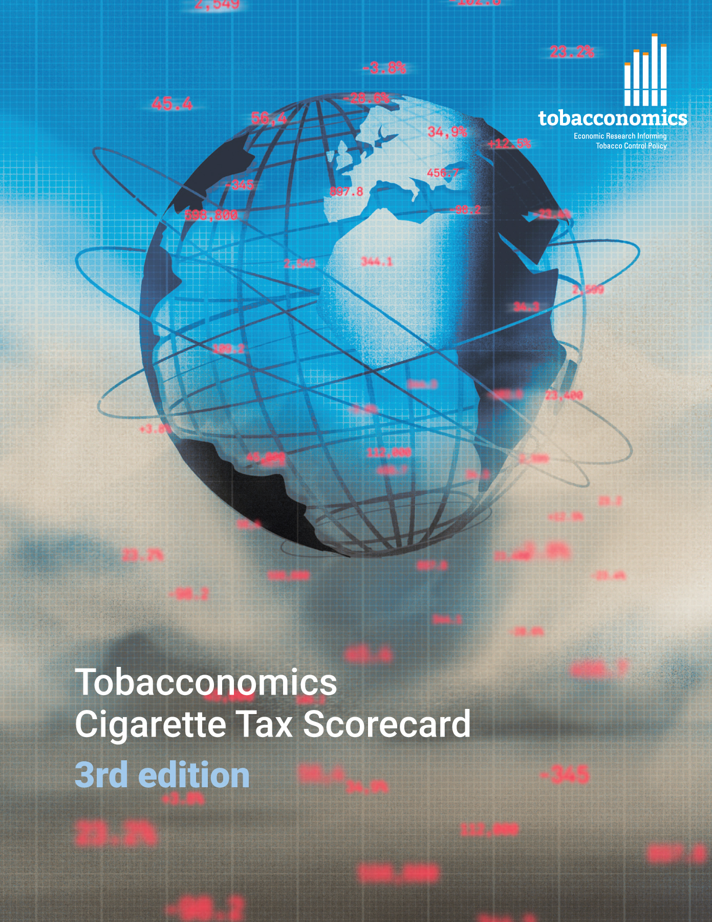
Cigarette tax policies in Saint Kitts and Nevis, 2022
4 key tax components were assessed using a 5-point scale, with the overall score reflecting an average of Saint Kitts and Nevis’ component scores.
The scores reflect the current strengths and opportunities in Saint Kitts and Nevis to further increase tax revenue and improve health.
OPPORTUNITY
for improvement
www.tobacconomics.org | @tobacconomics | Tobacconomics Cigarette Tax Scorecard (3rd edition)

Slide 2
How does Saint Kitts and Nevis compare to other countries?
Saint Kitts and Nevis’ overall score in 2022 is compared to the average overall scores in its income group, region, the world, and top performers.
www.tobacconomics.org | @tobacconomics | Tobacconomics Cigarette Tax Scorecard (3rd edition)

Slide 3
How does Saint Kitts and Nevis compare to other countries?
The components of Saint Kitts and Nevis’ score in 2022 are compared to component scores in the region, income group, world, and top performers.
AFFORDABILITY CHANGE & TAX SHARE
require the most improvement.
www.tobacconomics.org | @tobacconomics | Tobacconomics Cigarette Tax Scorecard (3rd edition)

Slide 4
Saint Kitts and Nevis’ cigarette tax policies over time
Saint Kitts and Nevis's overall score remained unchanged over time due to no change in the component scores. Tax share and Affordability change scores were not available.
www.tobacconomics.org | @tobacconomics | Tobacconomics Cigarette Tax Scorecard (3rd edition)

