Slide 1
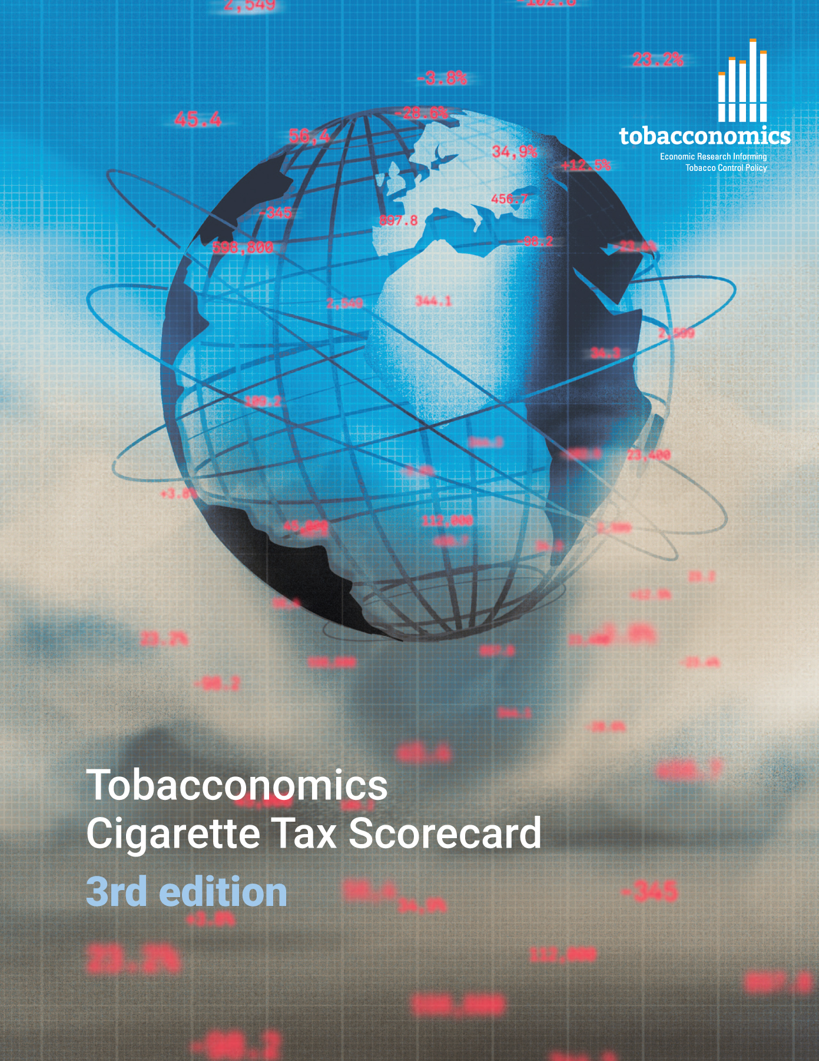
Cigarette tax policies in Iran, 2022
4 key tax components were assessed using a 5-point scale, with the overall score reflecting an average of Iran’s component scores.
The scores reflect the current strengths and opportunities in Iran to further increase tax revenue and improve health.
OPPORTUNITY
for improvement
www.tobacconomics.org | @tobacconomics | Tobacconomics Cigarette Tax Scorecard (3rd edition)

Slide 2
How does Iran compare to other countries?
Iran’s overall score in 2022 is compared to the average overall scores in its income group, region, the world, and top performers.
www.tobacconomics.org | @tobacconomics | Tobacconomics Cigarette Tax Scorecard (3rd edition)

Slide 3
How does Iran compare to other countries?
The components of Iran’s score in 2022 are compared to component scores in the region, income group, world, and top performers.
AFFORDABILITY CHANGE,
TAX SHARE &
TAX STRUCTURE
require the most improvement.
www.tobacconomics.org | @tobacconomics | Tobacconomics Cigarette Tax Scorecard (3rd edition)

Slide 4
Iran’s cigarette tax policies over time
Iran's overall score decreased from 2016 to 2018 as the tax structure became less effective, then increased in 2020 before decreasing again, largely due to a failure to reduce affordability over time.
www.tobacconomics.org | @tobacconomics | Tobacconomics Cigarette Tax Scorecard (3rd edition)

