Slide 1
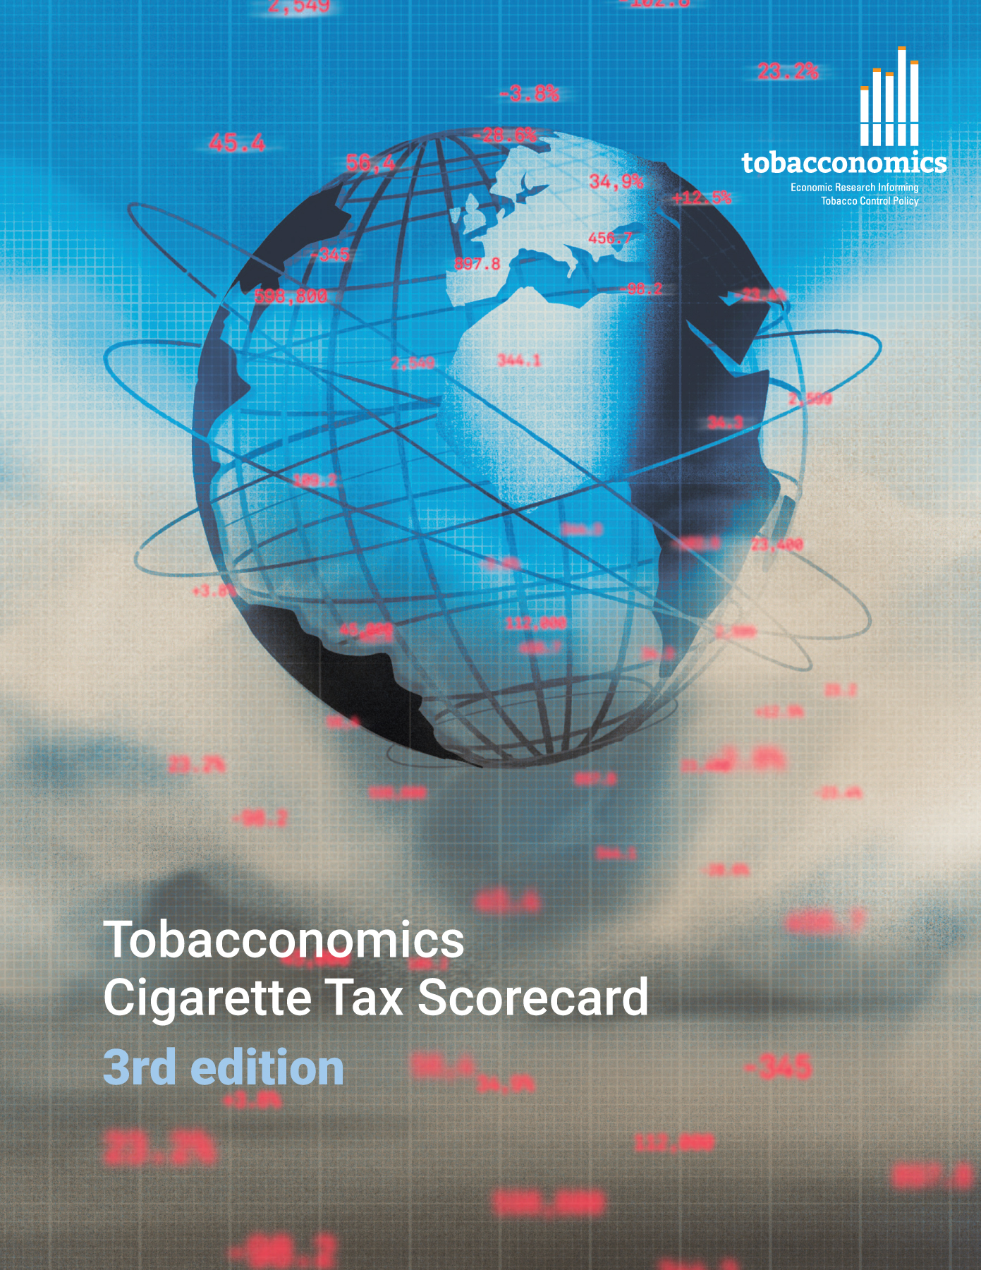

Cigarette tax policies in Equatorial Guinea, 2022
  4 key tax components were assessed using a 5-point scale, with the overall score reflecting an average of Equatorial Guinea’s component scores.
  The scores reflect the current strengths and opportunities in Equatorial Guinea to further increase tax revenue and improve health.
OPPORTUNITY
for improvement
www.tobacconomics.org | @tobacconomics | Tobacconomics Cigarette Tax Scorecard (3rd edition)

Slide 2
How does Equatorial Guinea compare to other countries?
  Equatorial Guinea’s overall score in 2022 is compared to the average overall scores in its income group, region, the world, and top performers.
www.tobacconomics.org | @tobacconomics | Tobacconomics Cigarette Tax Scorecard (3rd edition)

Slide 3
How does Equatorial Guinea compare to other countries?
  The components of Equatorial Guinea’s score in 2022 are compared to component scores in the region, income group, world, and top performers.
AFFORDABILITY CHANGE, CIGARETTE PRICE, TAX SHARE
require the most improvement.
www.tobacconomics.org | @tobacconomics | Tobacconomics Cigarette Tax Scorecard (3rd edition)

Slide 4
Equatorial Guinea’s cigarette tax policies over time
  Equatorial Guinea's overall score relatively remained constant, with a small decrease in 2022 due to a reduction in cigarette prices and a failure to reduce affordability despite an improvement in tax structure.
www.tobacconomics.org | @tobacconomics | Tobacconomics Cigarette Tax Scorecard (3rd edition)

