Slide 1
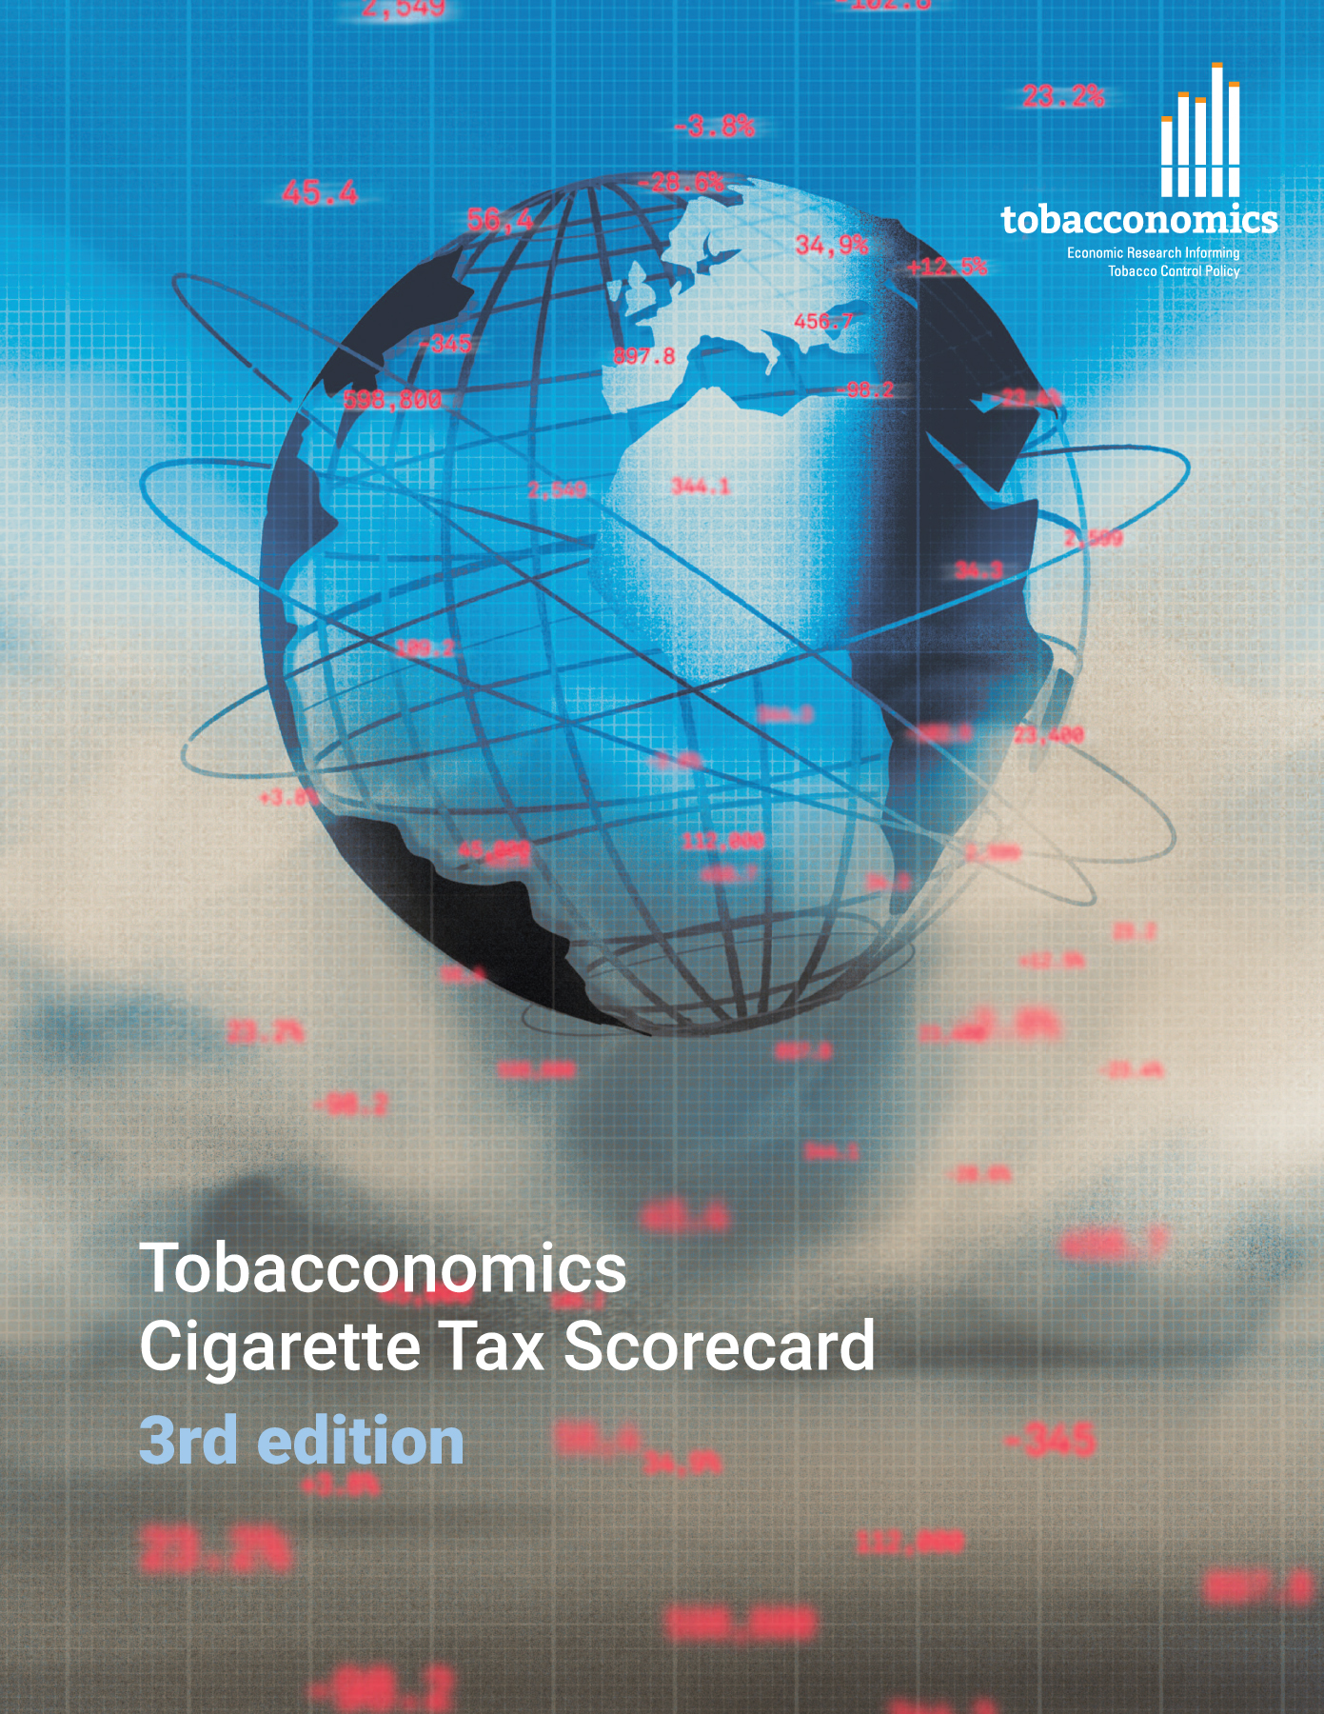
Cigarette tax policies in United Kingdom of Great Britain and Northern Ireland, 2022
4 key tax components were assessed using a 5-point scale, with the overall score reflecting an average of United Kingdom of Great Britain and Northern Ireland’s component scores.
The scores reflect the current strengths and opportunities in United Kingdom of Great Britain and Northern Ireland’s to further increase tax revenue and improve health.
www.tobacconomics.org | @tobacconomics | Tobacconomics Cigarette Tax Scorecard (3rd edition)

Slide 2
How does United Kingdom of Great Britain and Northern Ireland compare to other countries?
United Kingdom of Great Britain and Northern Ireland’s overall score in 2022 is compared to the average overall scores in its income group, region, the world, and top performers.
www.tobacconomics.org | @tobacconomics | Tobacconomics Cigarette Tax Scorecard (3rd edition)

Slide 3
How does United Kingdom of Great Britain and Northern Ireland compare to other countries?
The components of United Kingdom of Great Britain and Northern Ireland’s score in 2022 are compared to component scores in the region, income group, world, and top performers.
AFFORDABILITY CHANGE
requires the most improvement.
www.tobacconomics.org | @tobacconomics | Tobacconomics Cigarette Tax Scorecard (3rd edition)

Slide 4
United Kingdom of Great Britain and Northern Ireland’s cigarette tax policies over time
United Kingdom of Great Britain and Northern Ireland's overall score decreased slightly from 2014 to 2022 due to a failure to reduce the cigarette affordability over time.
www.tobacconomics.org | @tobacconomics | Tobacconomics Cigarette Tax Scorecard (3rd edition)

