Slide 1
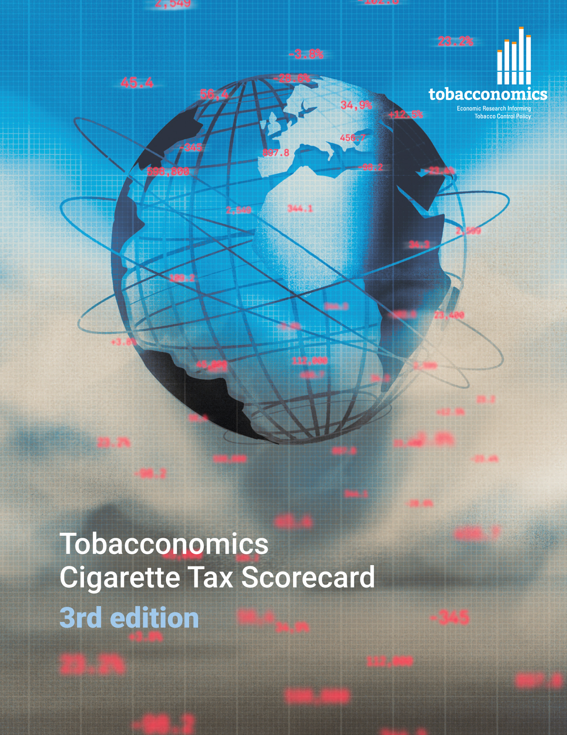
Cigarette tax policies in France, 2022
4 key tax components were assessed using a 5-point scale, with the overall score reflecting an average of France’s component scores.
The scores reflect the current strengths and opportunities in France to further increase tax revenue and improve health.
OPPORTUNITY
for improvement
www.tobacconomics.org | @tobacconomics | Tobacconomics Cigarette Tax Scorecard (3rd edition)

Slide 2
How does France compare to other countries?
France overall score in 2022 is compared to the average overall scores in its income group, region, the world, and top performers.
www.tobacconomics.org | @tobacconomics | Tobacconomics Cigarette Tax Scorecard (3rd edition)

Slide 3
How does France compare to other countries?
The components of France’s score in 2022 are compared to component scores in the region, income group, world, and top performers.
TAX STRUCTURE
requires the most improvement.
www.tobacconomics.org | @tobacconomics | Tobacconomics Cigarette Tax Scorecard (3rd edition)

Slide 4
France’s cigarette tax policies over time
France's overall score increased over time due to a reduction in cigarette affordability over time and an increase in cigarette prices.
www.tobacconomics.org | @tobacconomics | Tobacconomics Cigarette Tax Scorecard (3rd edition)

