Slide 1
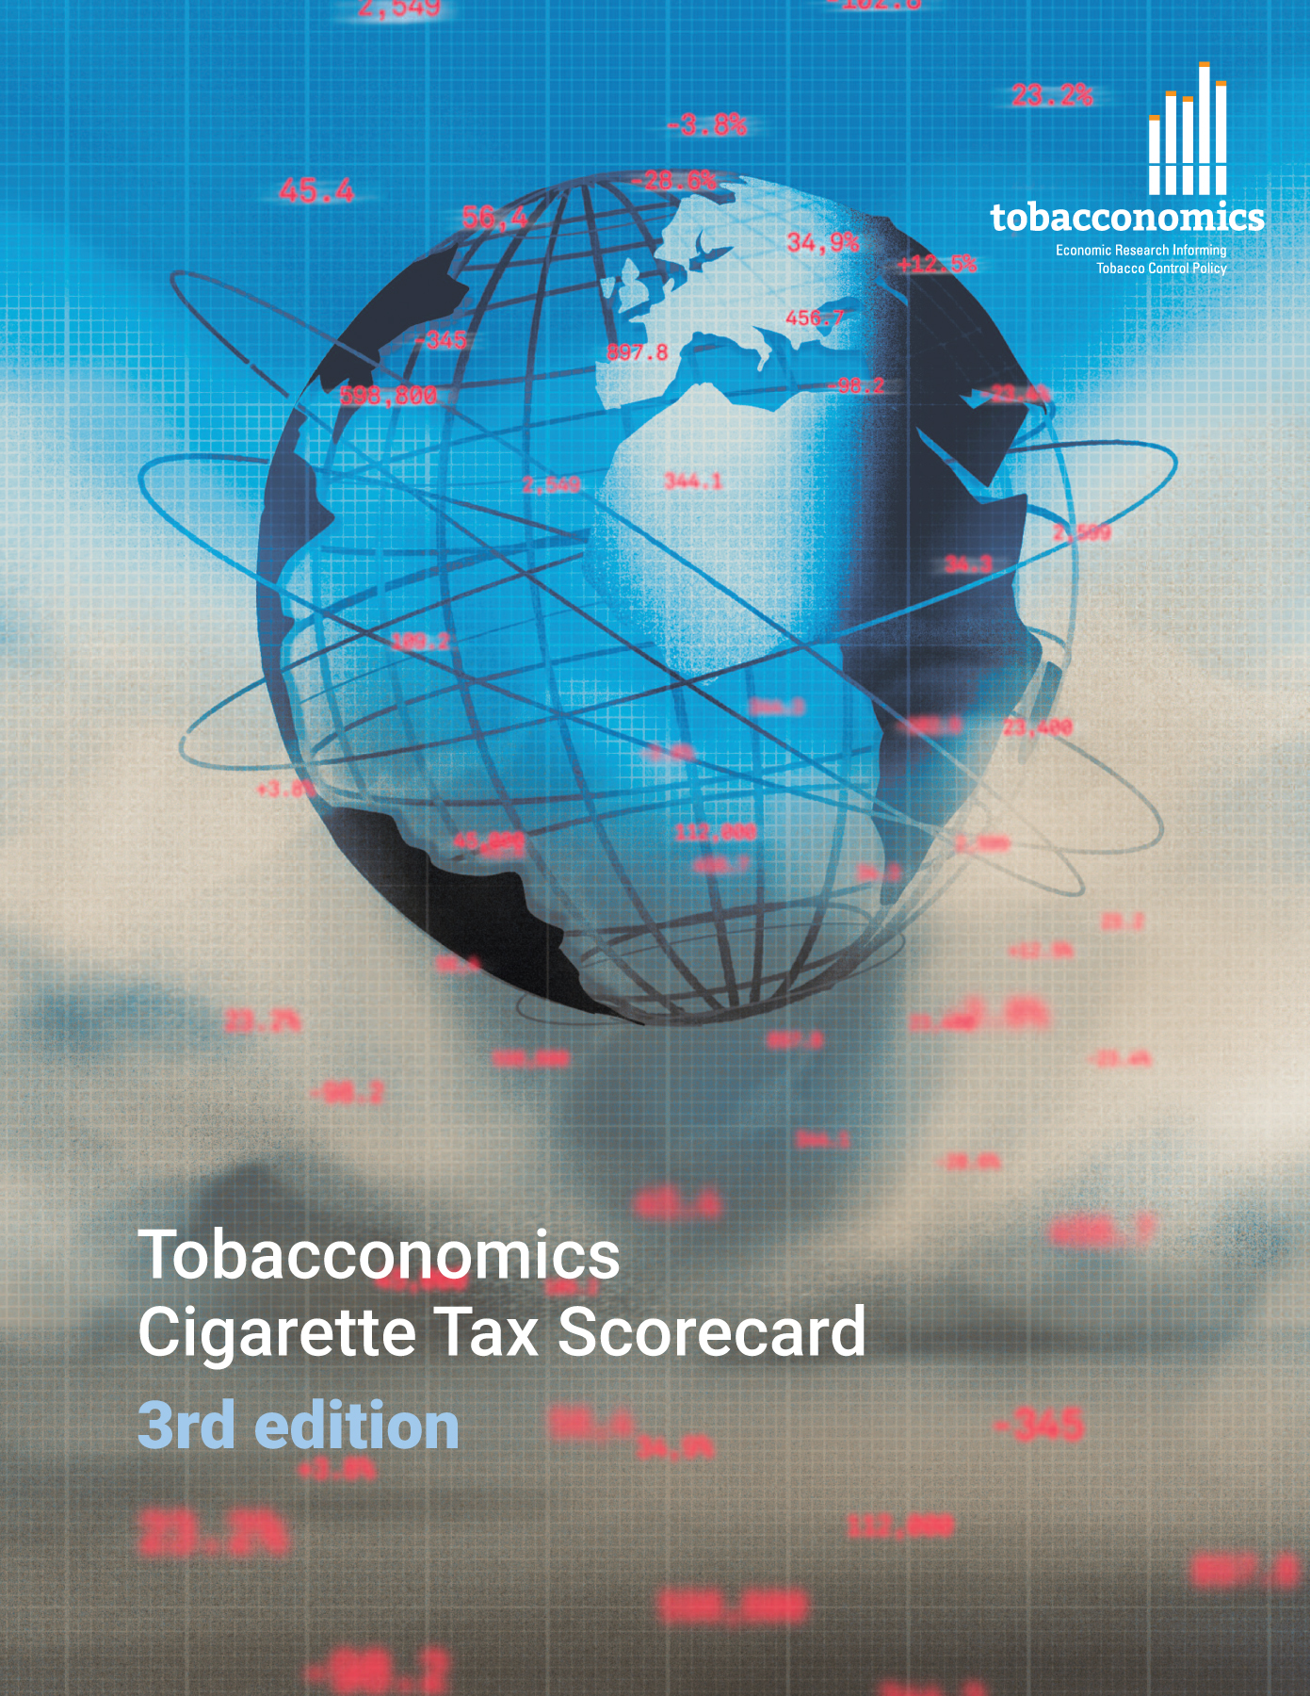
Cigarette tax policies in Dominican Republic, 2022
4 key tax components were assessed using a 5-point scale, with the overall score reflecting an average of Dominican Republic’s component scores.
The scores reflect the current strengths and opportunities in Dominican Republic to further increase tax revenue and improve health.
OPPORTUNITY
for improvement
www.tobacconomics.org | @tobacconomics | Tobacconomics Cigarette Tax Scorecard (3rd edition)

Slide 2
How does Dominican Republic compare to other countries?
Dominican Republic’s overall score in 2022 is compared to the average overall scores in its income group, region, the world, and top performers.
www.tobacconomics.org | @tobacconomics | Tobacconomics Cigarette Tax Scorecard (3rd edition)

Slide 3
How does Dominican Republic compare to other countries?
The components of Dominican Republic’s score in 2022 are compared to component scores in the region, income group, world, and top performers.
AFFORDABILITY CHANGE
requires the most improvement.
www.tobacconomics.org | @tobacconomics | Tobacconomics Cigarette Tax Scorecard (3rd edition)

Slide 4
Dominican Republic’s cigarette tax policies over time
Dominican Republic's overall score stayed constant over the years due to a simultaneous increase in cigarette prices and decrease in the tax share of price.
www.tobacconomics.org | @tobacconomics | Tobacconomics Cigarette Tax Scorecard (3rd edition)

