Slide 1
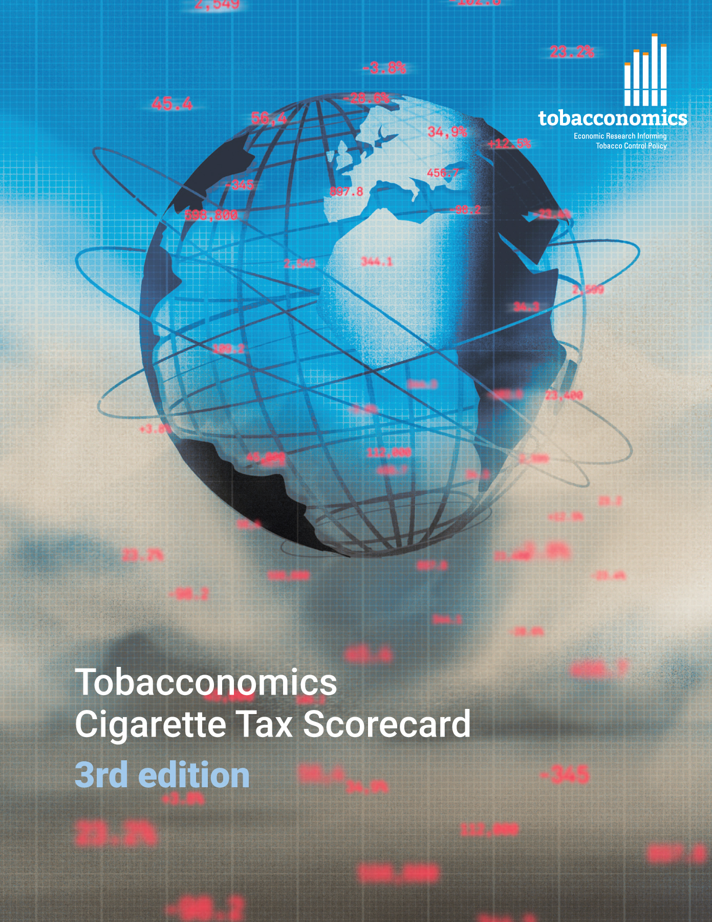
Cigarette tax policies in Dominica, 2022
4 key tax components were assessed using a 5-point scale, with the overall score reflecting an average of Dominica’s component scores.
The scores reflect the current strengths and opportunities in Dominica to further increase tax revenue and improve health.
OPPORTUNITY
for improvement
www.tobacconomics.org | @tobacconomics | Tobacconomics Cigarette Tax Scorecard (3rd edition)

Slide 2
How does Dominica compare to other countries?
Dominica’s overall score in 2022 is compared to the average overall scores in its income group, region, the world, and top performers.
www.tobacconomics.org | @tobacconomics | Tobacconomics Cigarette Tax Scorecard (3rd edition)

Slide 3
How does Dominica compare to other countries?
The components of Dominica’s score in 2022 are compared to component scores in the region, income group, world, and top performers.
TAX SHARE
requires the most improvement.
www.tobacconomics.org | @tobacconomics | Tobacconomics Cigarette Tax Scorecard (3rd edition)

Slide 4
Dominica’s cigarette tax policies over time
Dominica's overall score rose slightly in 2022 due to a small reduction in affordability over time.
www.tobacconomics.org | @tobacconomics | Tobacconomics Cigarette Tax Scorecard (3rd edition)

