Slide 1
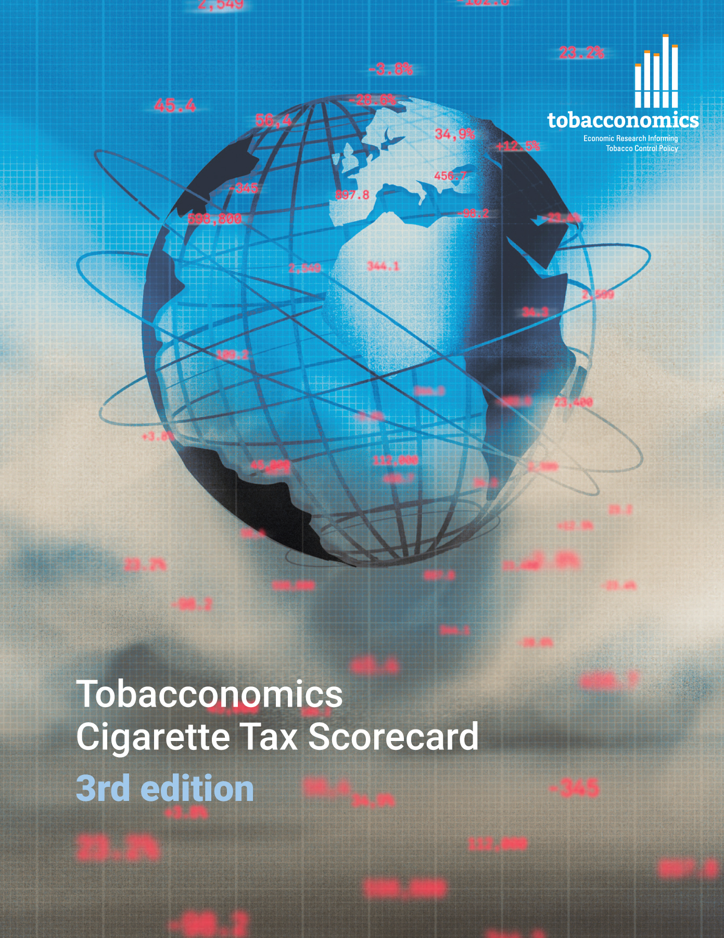
Cigarette tax policies in Denmark, 2022
4 key tax components were assessed using a 5-point scale, with the overall score reflecting an average of Denmark’s component scores.
The scores reflect the current strengths and opportunities in Denmark to further increase tax revenue and improve health.
OPPORTUNITY
for improvement
www.tobacconomics.org | @tobacconomics | Tobacconomics Cigarette Tax Scorecard (3rd edition)

Slide 2
How does Denmark compare to other countries?
Denmark’s overall score in 2022 is compared to the average overall scores in its income group, region, the world, and top performers.
www.tobacconomics.org | @tobacconomics | Tobacconomics Cigarette Tax Scorecard (3rd edition)

Slide 3
How does Denmark compare to other countries?
The components of Denmark’s score in 2022 are compared to component scores in the region, income group, world, and top performers.
AFFORDABILITY CHANGE
requires the most improvement.
www.tobacconomics.org | @tobacconomics | Tobacconomics Cigarette Tax Scorecard (3rd edition)

Slide 4
Denmark’s cigarette tax policies over time
Denmark's overall score fluctuated between 2014 and 2022 with a slight reduction in 2022 due to the decrease in the cigarette prices and a failure to reduce affordability over time.
www.tobacconomics.org | @tobacconomics | Tobacconomics Cigarette Tax Scorecard (3rd edition)

