Slide 1
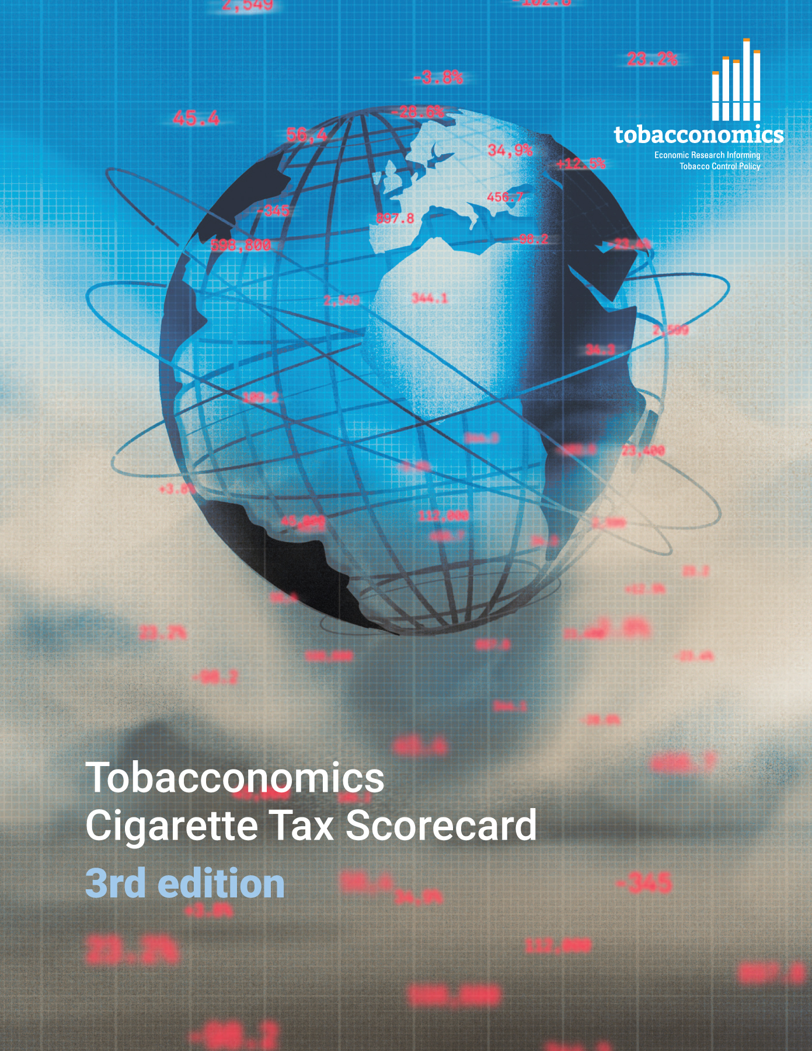
Cigarette tax policies in Germany, 2022
4 key tax components were assessed using a 5-point scale, with the overall score reflecting an average of Germany’s component scores.
The scores reflect the current strengths and opportunities in Germany to further increase tax revenue and improve health.
OPPORTUNITY
for improvement
www.tobacconomics.org | @tobacconomics | Tobacconomics Cigarette Tax Scorecard (3rd edition)

Slide 2
How does Germany compare to other countries?
Germany’s overall score in 2022 is compared to the average overall scores in its income group, region, the world, and top performers.
www.tobacconomics.org | @tobacconomics | Tobacconomics Cigarette Tax Scorecard (3rd edition)

Slide 3
How does Germany compare to other countries?
The components of Germany’s score in 2022 are compared to component scores in the region, income group, world, and top performers.
AFFORDABILITY CHANGE
requires the most improvement.
www.tobacconomics.org | @tobacconomics | Tobacconomics Cigarette Tax Scorecard (3rd edition)

Slide 4
Germany’s cigarette tax policies over time
Germany’s overall score increased from 2014 to 2020 then decreased In 2022 due to a failure to reduce affordability and decrease in tax share of price.
www.tobacconomics.org | @tobacconomics | Tobacconomics Cigarette Tax Scorecard (3rd edition)

