Slide 1
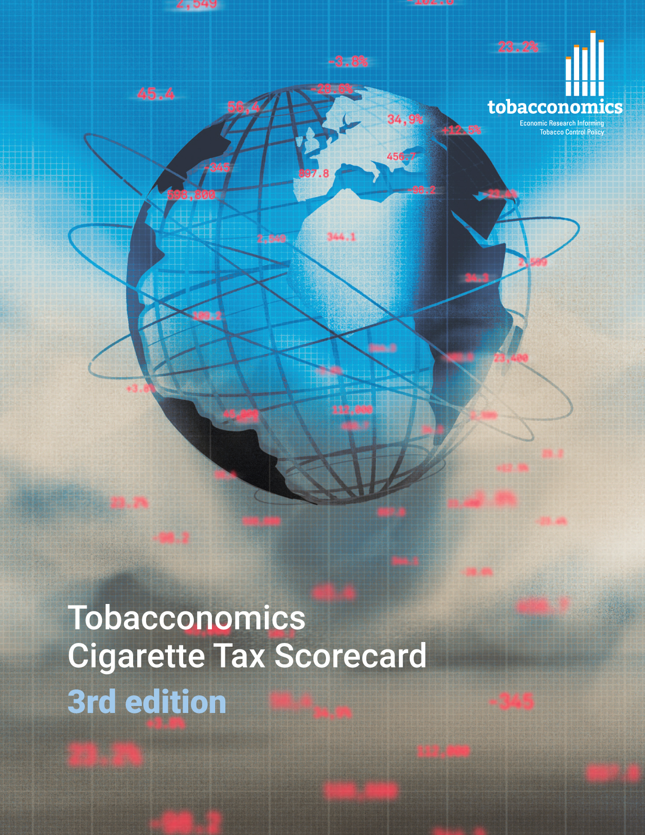
Cigarette tax policies in Cyprus, 2022
4 key tax components were assessed using a 5-point scale, with the overall score reflecting an average of Cyprus’s component scores.
The scores reflect the current strengths and opportunities in Cyprus to further increase tax revenue and improve health.
OPPORTUNITY
for improvement
www.tobacconomics.org | @tobacconomics | Tobacconomics Cigarette Tax Scorecard (3rd edition)

Slide 2
How does Cyprus compare to other countries?
Cyprus’s overall score in 2022 is compared to the average overall scores in its income group, region, the world, and top performers.
www.tobacconomics.org | @tobacconomics | Tobacconomics Cigarette Tax Scorecard (3rd edition)

Slide 3
How does Cyprus compare to other countries?
The components of Cyprus’s score in 2022 are compared to component scores in the region, income group, world, and top performers.
AFFORDABILITY CHANGE requires the most improvement.
www.tobacconomics.org | @tobacconomics | Tobacconomics Cigarette Tax Scorecard (3rd edition)

Slide 4
Cyprus’s cigarette tax policies over time
Cyprus's overall score decreased in 2018, and remained at same level until 2022 due to a failure to reduce cigarette affordability over time.
www.tobacconomics.org | @tobacconomics | Tobacconomics Cigarette Tax Scorecard (3rd edition)

