Slide 1
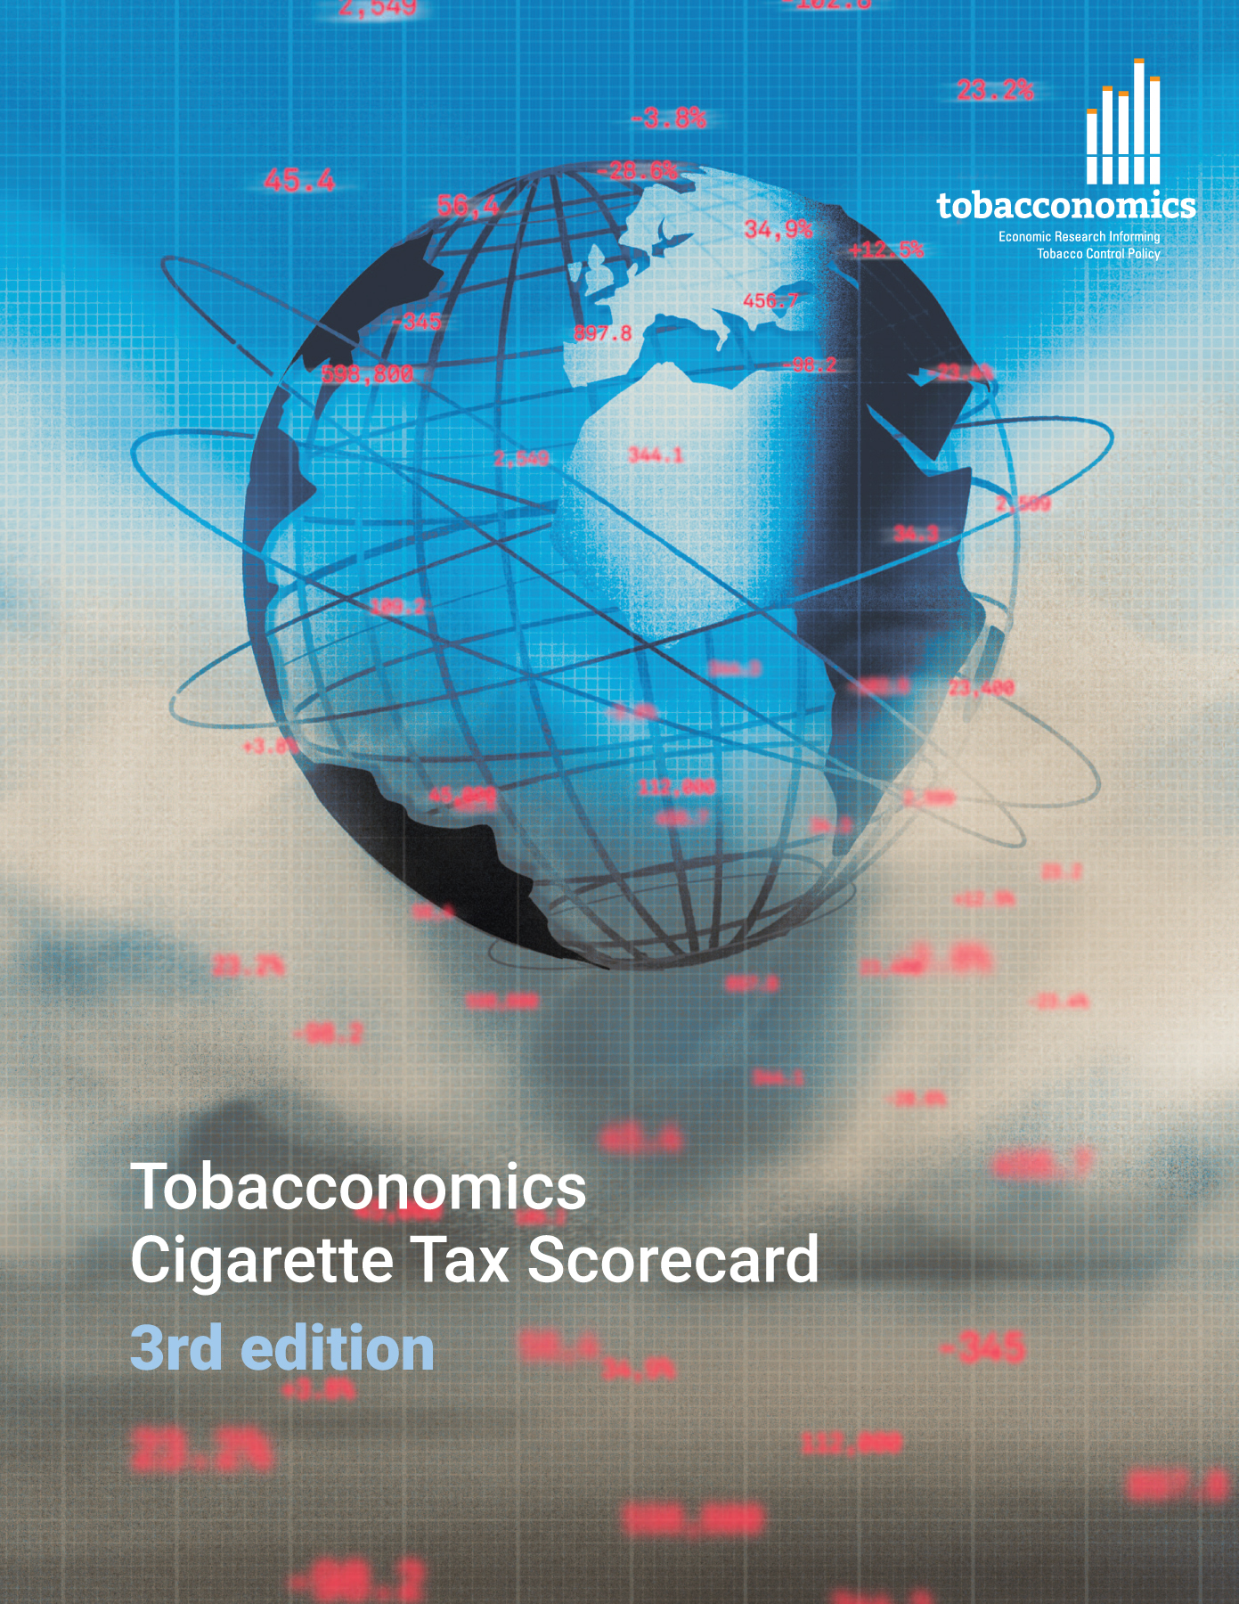

Cigarette tax policies in Costa Rica, 2022
4 key tax components were assessed using a 5-point scale, with the overall score reflecting an average of Costa Rica’s component scores.
The scores reflect the current strengths and opportunities in Costa Rica to further increase tax revenue and improve health.
OPPORTUNITY
for improvement
www.tobacconomics.org | @tobacconomics | Tobacconomics Cigarette Tax Scorecard (3rd edition)

Slide 2
How does Costa Rica compare to other countries?
Costa Rica’s overall score in 2022 is compared to the average overall scores in its income group, region, the world, and top performers.
www.tobacconomics.org | @tobacconomics | Tobacconomics Cigarette Tax Scorecard (3rd edition)

Slide 3
How does Costa Rica compare to other countries?
The components of Costa Rica’s score in 2022 are compared to component scores in the region, income group, world, and top performers.
AFFORDABILITY CHANGE
requires the most improvement.
www.tobacconomics.org | @tobacconomics | Tobacconomics Cigarette Tax Scorecard (3rd edition)

Slide 4
Costa Rica’s cigarette tax policies over time
Costa Rica's overall score decreased over the years due to a failure to reduce affordability over time.
www.tobacconomics.org | @tobacconomics | Tobacconomics Cigarette Tax Scorecard (3rd edition)

