Slide 1
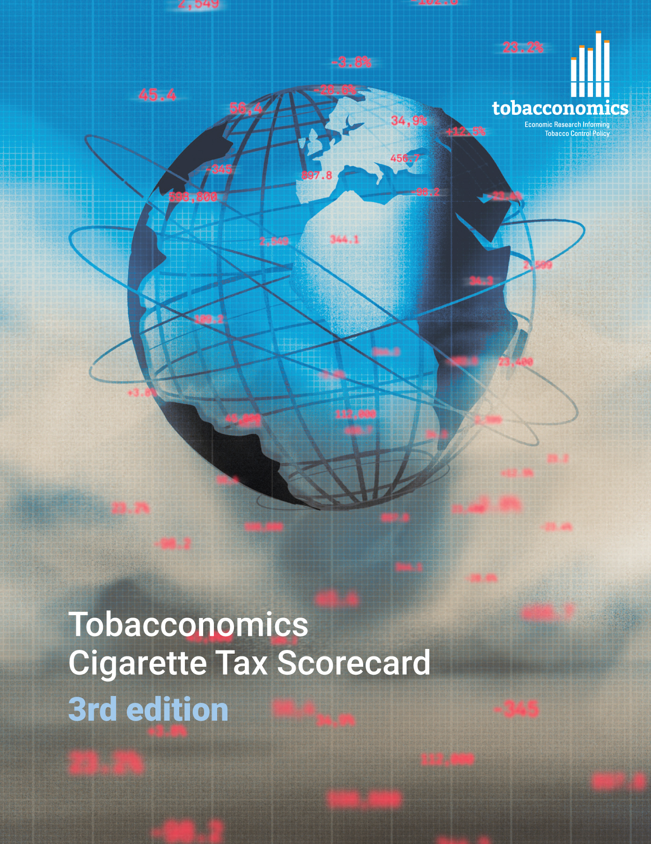
Cigarette tax policies in China, 2022
4 key tax components were assessed using a 5-point scale, with the overall score reflecting an average of China’s component scores.
The scores reflect the current strengths and opportunities in China to further increase tax revenue and improve health.
OPPORTUNITY
for improvement
www.tobacconomics.org | @tobacconomics | Tobacconomics Cigarette Tax Scorecard (3rd edition)

Slide 2
How does China compare to other countries?
China’s overall score in 2022 is compared to the average overall scores in its income group, region, the world, and top performers.
www.tobacconomics.org | @tobacconomics | Tobacconomics Cigarette Tax Scorecard (3rd edition)

Slide 3
How does China compare to other countries?
The components of China’s score in 2022 are compared to component scores in the region, income group, world, and top performers.
AFFORDABILITY CHANGE
requires the most improvement.
www.tobacconomics.org | @tobacconomics | Tobacconomics Cigarette Tax Scorecard (3rd edition)

Slide 4
China’s cigarette tax policies over time
China's overall score remained largely constant between 2014 and 2022. The tax share of price increased slightly in 2016 and 2018, before declining.
www.tobacconomics.org | @tobacconomics | Tobacconomics Cigarette Tax Scorecard (3rd edition)

