Slide 1
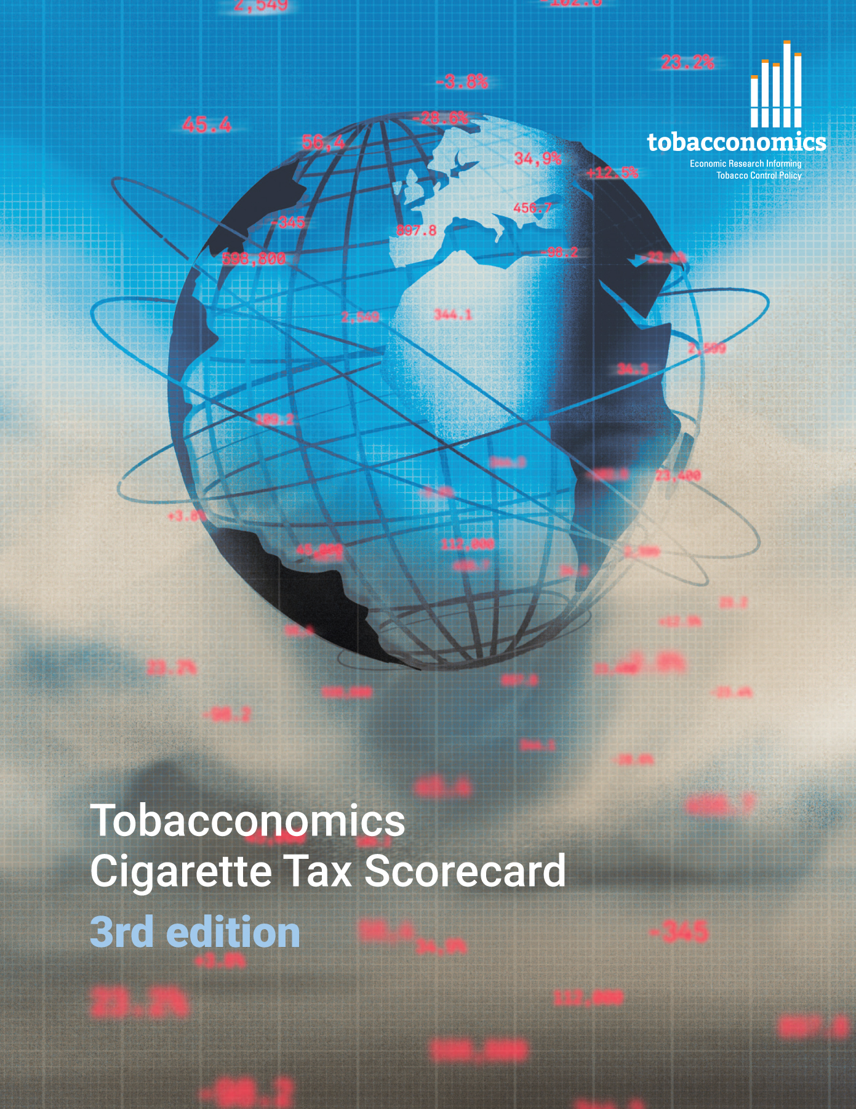
Cigarette tax policies in Switzerland, 2022
4 key tax components were assessed using a 5-point scale, with the overall score reflecting an average of Switzerland’s component scores.
The scores reflect the current strengths and opportunities in Switzerland’s to further increase tax revenue and improve health.
OPPORTUNITY
for improvement
www.tobacconomics.org | @tobacconomics | Tobacconomics Cigarette Tax Scorecard (3rd edition)

Slide 2
How does Switzerland compare to other countries?
Switzerland’s overall score in 2022 is compared to the average overall scores in its income group, region, the world, and top performers.
www.tobacconomics.org | @tobacconomics | Tobacconomics Cigarette Tax Scorecard (3rd edition)

Slide 3
How does Switzerland compare to other countries?
The components of Switzerland’s score in 2022 are compared to component scores in the region, income group, world, and top performers.
AFFORDABILITY CHANGE
requires the most improvement.
www.tobacconomics.org | @tobacconomics | Tobacconomics Cigarette Tax Scorecard (3rd edition)

Slide 4
Switzerland’s cigarette tax policies over time
Switzerland's overall score decreased from 2014 to 2022 due to a failure to reduce the affordability of cigarettes over time.
www.tobacconomics.org | @tobacconomics | Tobacconomics Cigarette Tax Scorecard (3rd edition)

