Slide 1
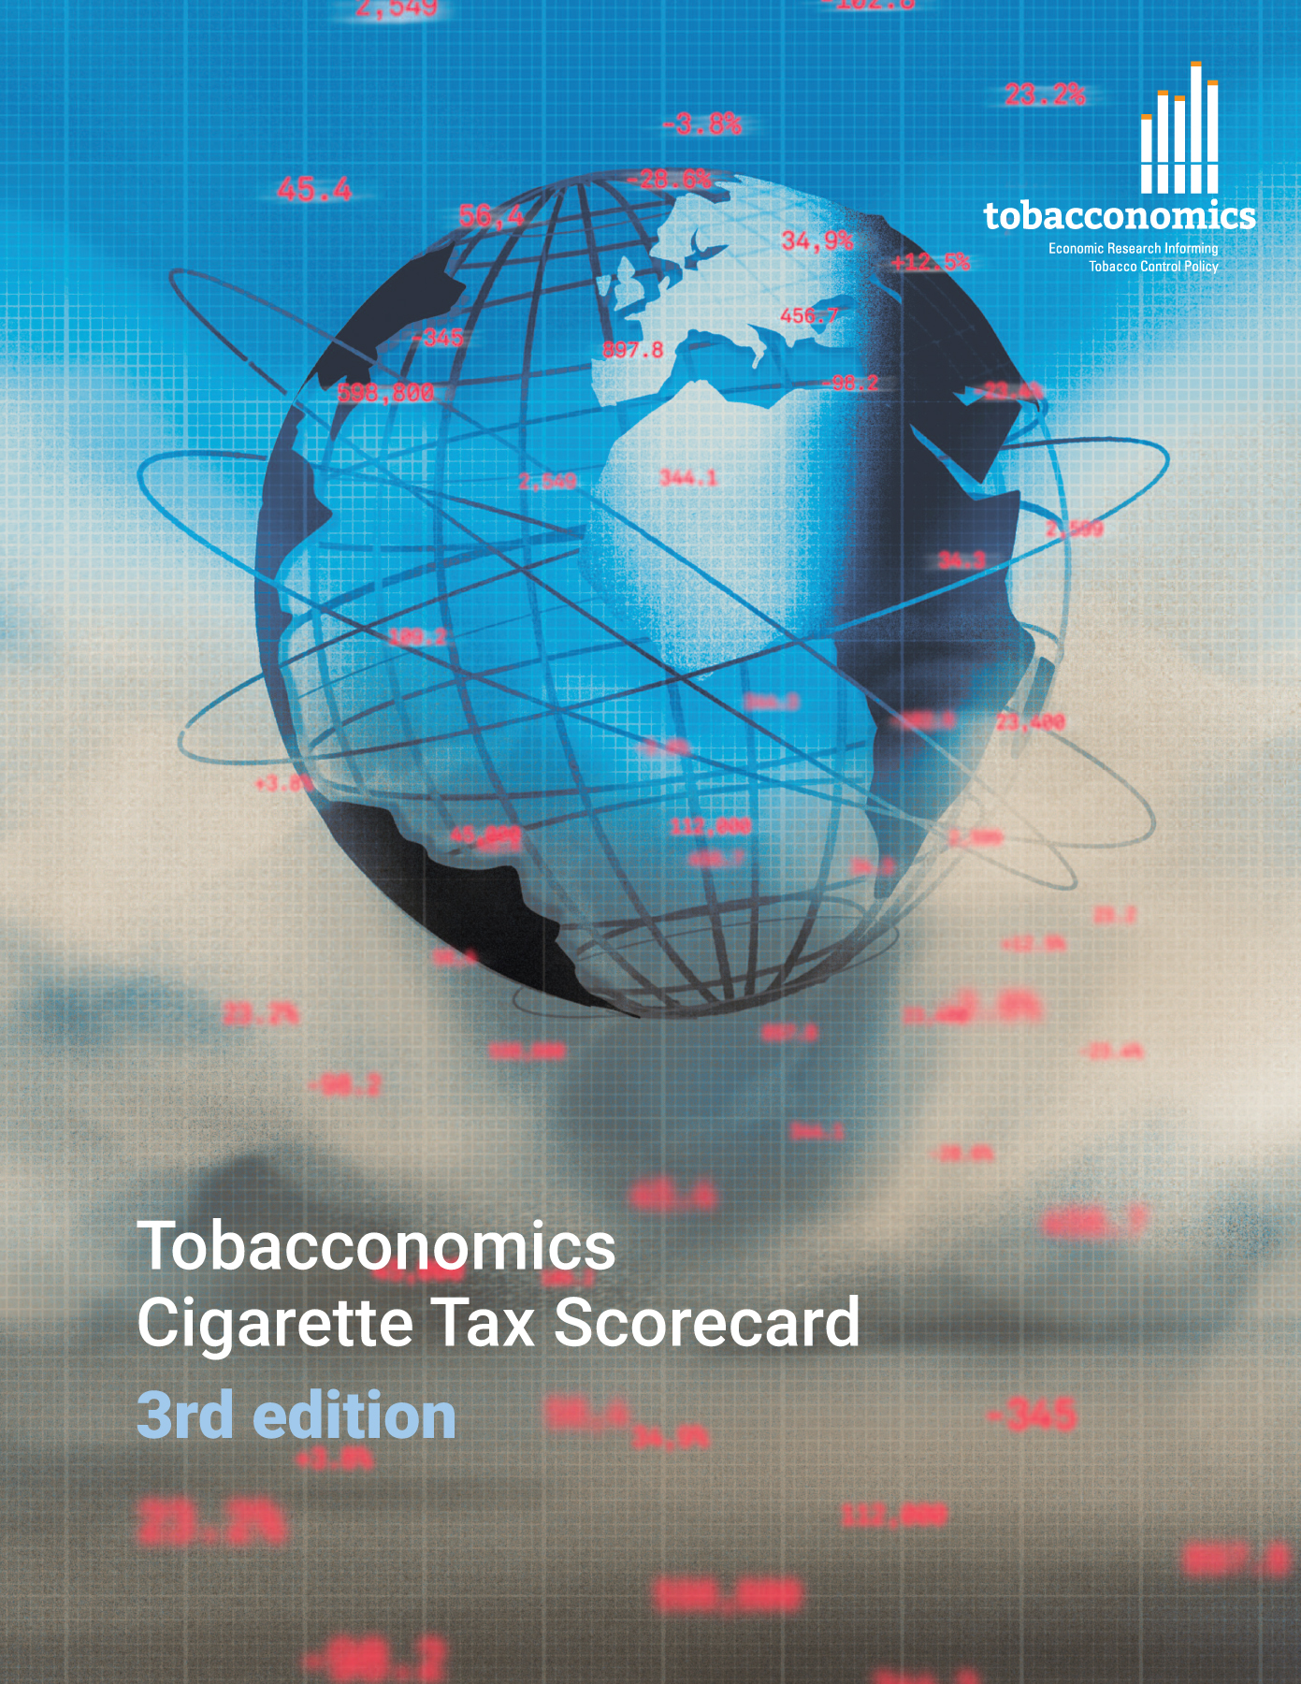
Cigarette tax policies in Belarus, 2022
4 key tax components were assessed using a 5-point scale, with the overall score reflecting an average of Belarus’s component scores.
The scores reflect the current strengths and opportunities in Bahamas to further increase tax revenue and improve health.
OPPORTUNITY
for improvement
www.tobacconomics.org | @tobacconomics | Tobacconomics Cigarette Tax Scorecard (3rd edition)

Slide 2
How does Belarus compare to other countries?
Belarus’s overall score in 2022 is compared to the average overall scores in its income group, region, the world, and top performers.
www.tobacconomics.org | @tobacconomics | Tobacconomics Cigarette Tax Scorecard (3rd edition)

Slide 3
How does Belarus compare to other countries?
The components of Belarus’s score in 2022 are compared to component scores in the region, income group, world, and top performers.
CIGARETTE PRICE &
AFFORDABILITY CHANGE
require the most improvement.
www.tobacconomics.org | @tobacconomics | Tobacconomics Cigarette Tax Scorecard (3rd edition)

Slide 4
Belarus’ cigarette tax policies over time
Belarus's overall score increased slightly between 2014 and 2020 and remained unchanged in 2022. The increase in 2020 was due to the increase in tax share score.
www.tobacconomics.org | @tobacconomics | Tobacconomics Cigarette Tax Scorecard (3rd edition)

