Slide 1
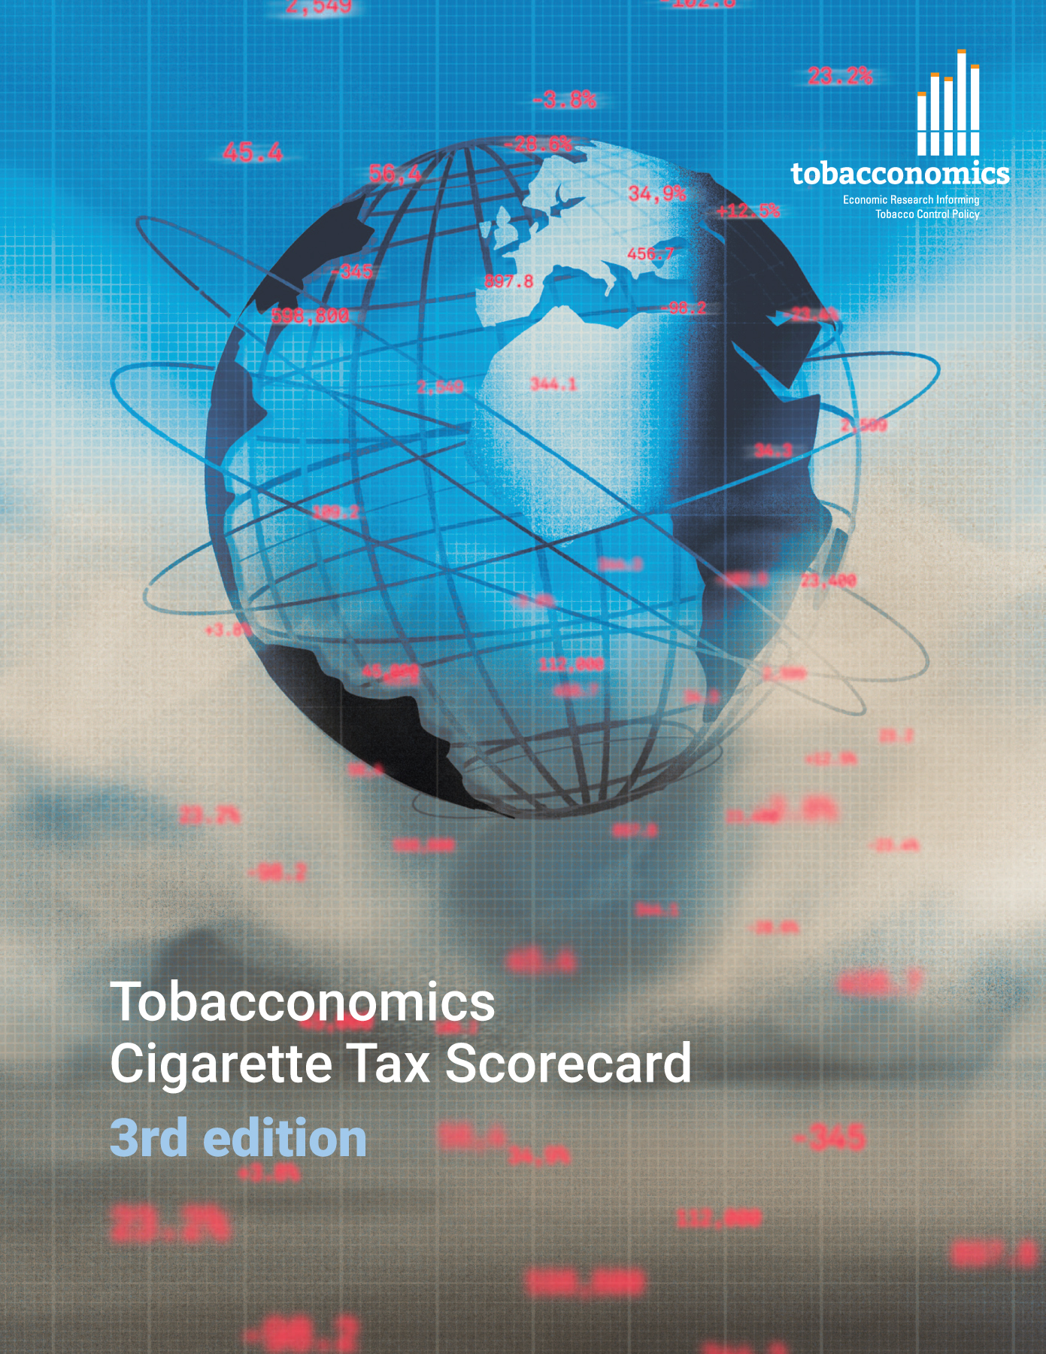
Cigarette tax policies in Bahamas, 2022
4 key tax components were assessed using a 5-point scale, with the overall score reflecting an average of Bahamas’s component scores.
The scores reflect the current strengths and opportunities in Bahamas to further increase tax revenue and improve health.
OPPORTUNITY
for improvement
www.tobacconomics.org | @tobacconomics | Tobacconomics Cigarette Tax Scorecard (3rd edition)

Slide 2
How does Bahamas compare to other countries?
Bahamas’s overall score in 2022 is compared to the average overall scores in its income group, region, the world, and top performers.
www.tobacconomics.org | @tobacconomics | Tobacconomics Cigarette Tax Scorecard (3rd edition)

Slide 3
How does Bahamas compare to other countries?
The components of Bahamas’s score in 2022 are compared to component scores in the region, income group, world, and top performers.
AFFORDABILITY CHANGE
requires the most improvement.
www.tobacconomics.org | @tobacconomics | Tobacconomics Cigarette Tax Scorecard (3rd edition)

Slide 4
Bahamas’s cigarette tax policies over time
Bahamas' overall score decreased between 2014 and 2020, then stabilized through 2022 due to declining cigarette affordability scores, despite improvements in tax share scores. Scores were unavailable for 2018.
www.tobacconomics.org | @tobacconomics | Tobacconomics Cigarette Tax Scorecard (3rd edition)

