Slide 1
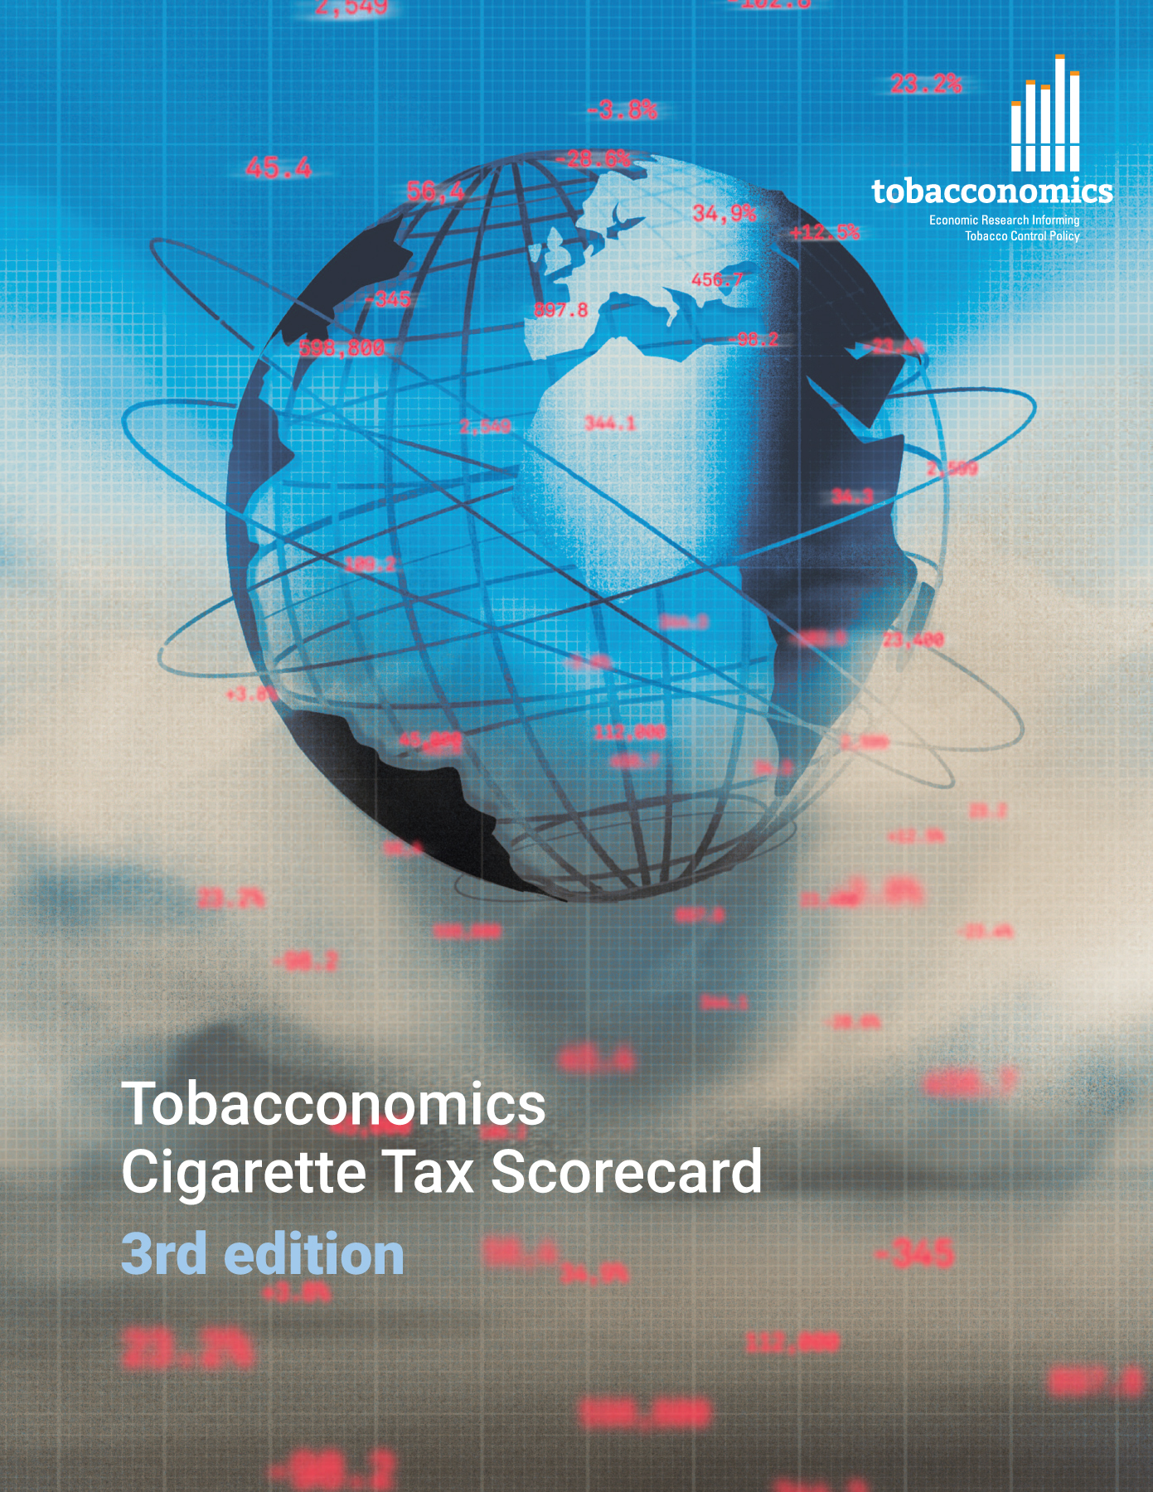
Cigarette tax policies in Bolivia, 2022
4 key tax components were assessed using a 5-point scale, with the overall score reflecting an average of Bolivia’s component scores.
The scores reflect the current strengths and opportunities in Bolivia to further increase tax revenue and improve health.
OPPORTUNITY
for improvement
www.tobacconomics.org | @tobacconomics | Tobacconomics Cigarette Tax Scorecard (3rd edition)

Slide 2
How does Bolivia compare to other countries?
Bolivia’s overall score in 2022 is compared to the average overall scores in its income group, region, the world, and top performers.
www.tobacconomics.org | @tobacconomics | Tobacconomics Cigarette Tax Scorecard (3rd edition)

Slide 3
How does Bolivia compare to other countries?
The components of Bolivia’s score in 2022 are compared to component scores in the region, income group, world, and top performers.
AFFORDABILITY CHANGE &
TAX SHARE
require the most improvement.
www.tobacconomics.org | @tobacconomics | Tobacconomics Cigarette Tax Scorecard (3rd edition)

Slide 4
Bolivia’s cigarette tax policies over time
Bolivia's overall scores decreased over the years due to a drop in the affordability change and reduction in the tax share of price.
www.tobacconomics.org | @tobacconomics | Tobacconomics Cigarette Tax Scorecard (3rd edition)

